Slide 1
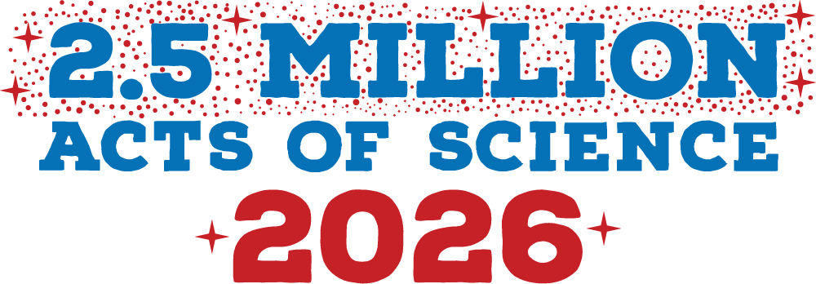


Be part of 2.50 Million Acts of Science during America250!
Citizen Science Month 2026
August 20, 2025
11AM PT / 2PM ET
Notes:
Tara

Slide 2
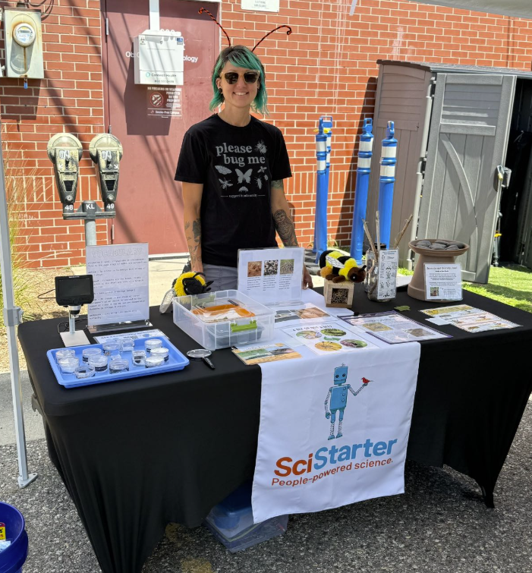

Welcome!
In the chat
Share your name, location and what you’re hoping to get out of today’s webinar?
Answer the poll
What best describes your role today?
Have you participated in CSM in the past?
SciStarter Ambassador Kelly K hosts a citizen science table at her local farmers market!
Notes:
Welcome, everyone! We're thrilled to have such a great mix of participants—from seasoned citizen science facilitators to those just starting out. Whether you're here from a library, museum, science center, or another community hub, we’re excited to explore how we can create more opportunities for people to take meaningful Acts of Science—together.
I bet we have a lot of people here who have participated in City Nature Challenge! We love participating in that, and we look forward to the CNC 2026. We won’t be talking much about it today, we will be sharing way and resources to share citizen science with the public beyond the city nature challenge, throughout all of April and in connection with America 250.

Slide 3
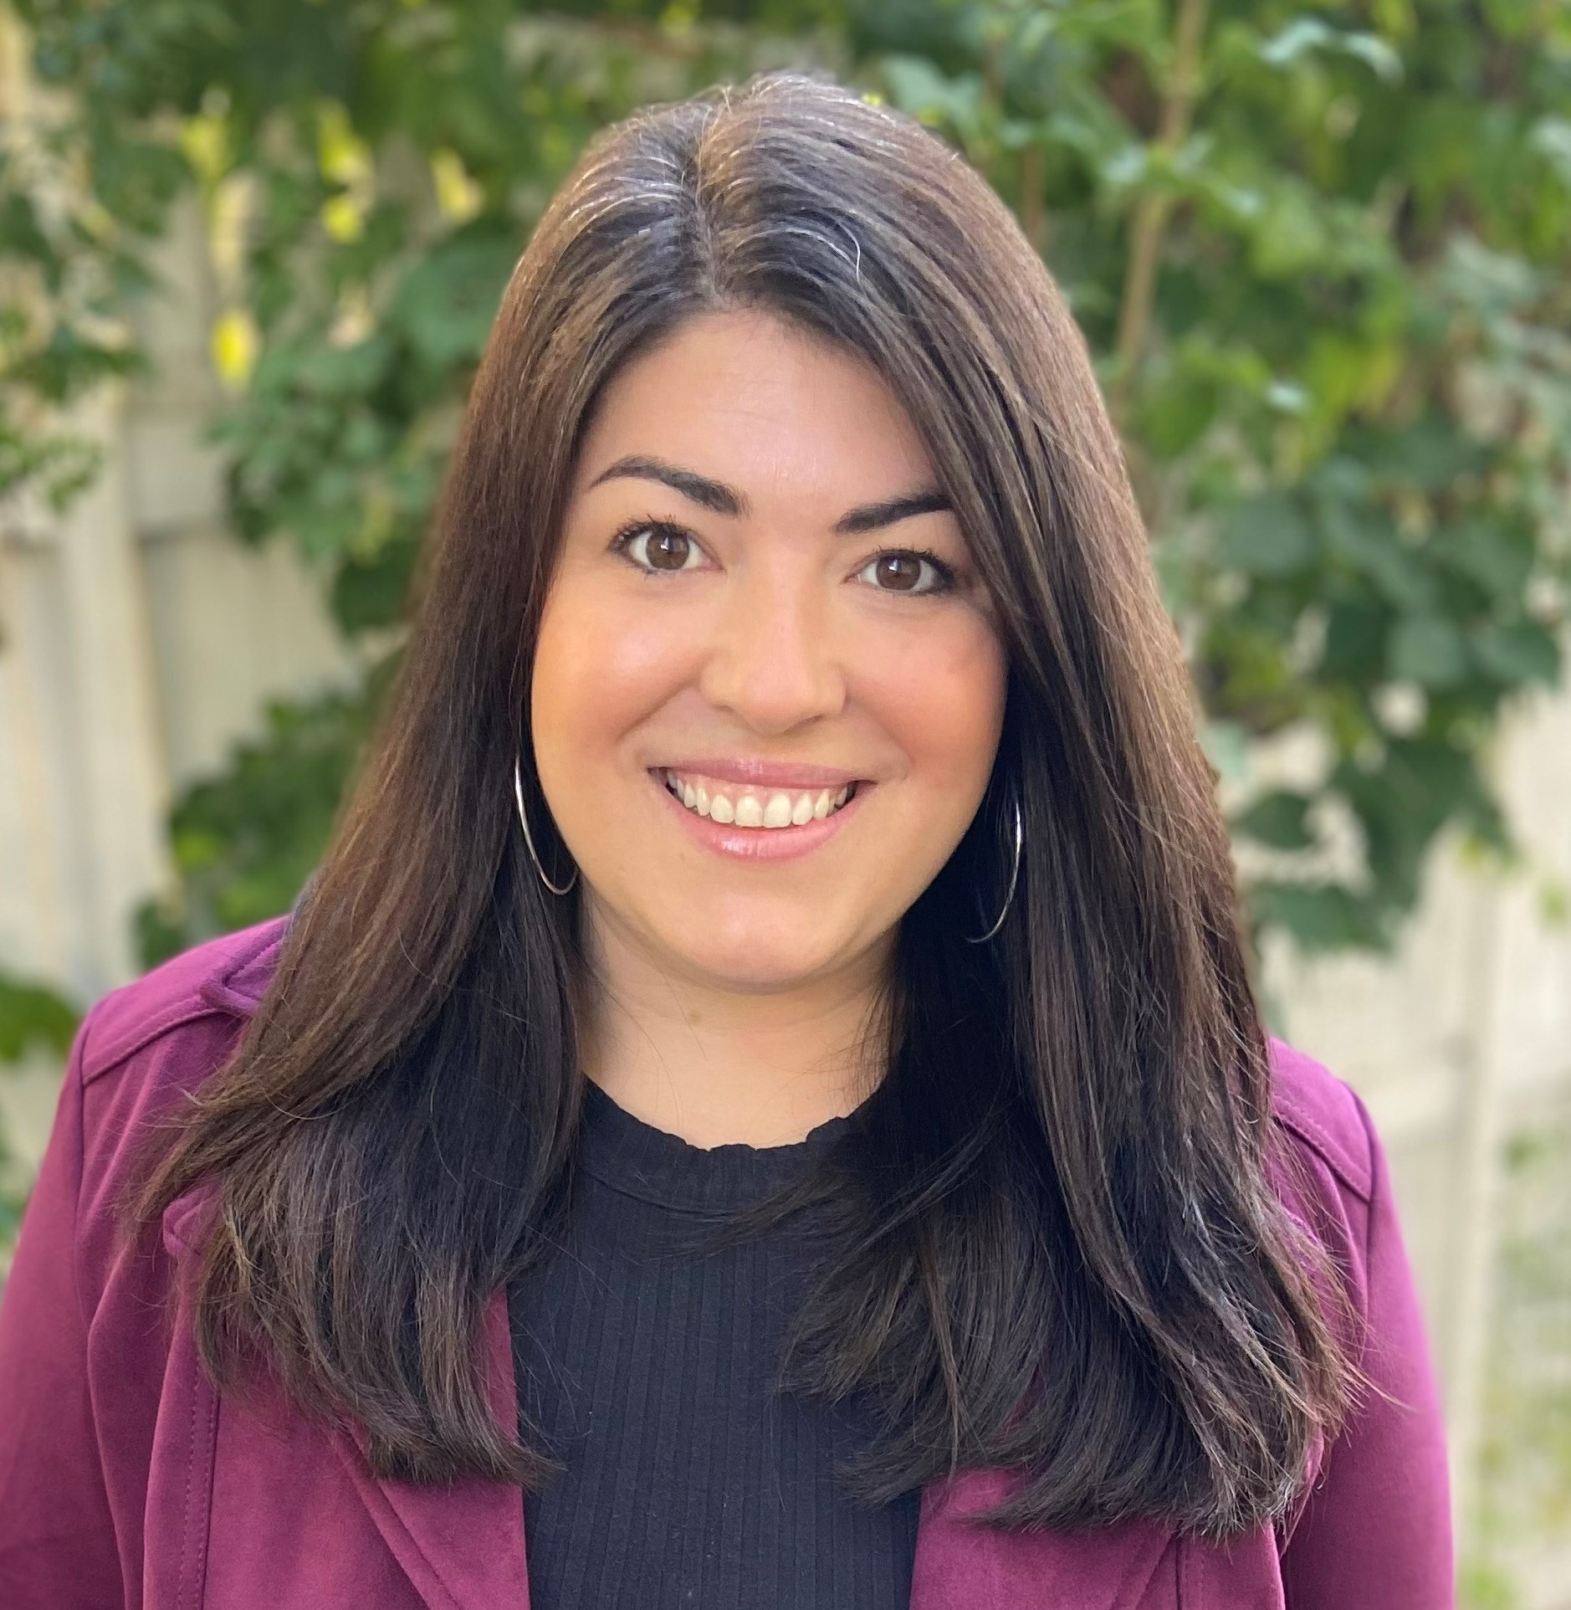
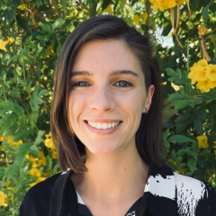

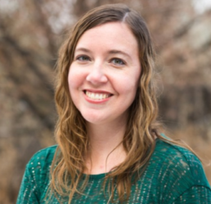

Who are we?
Notes:
Tara

Slide 4
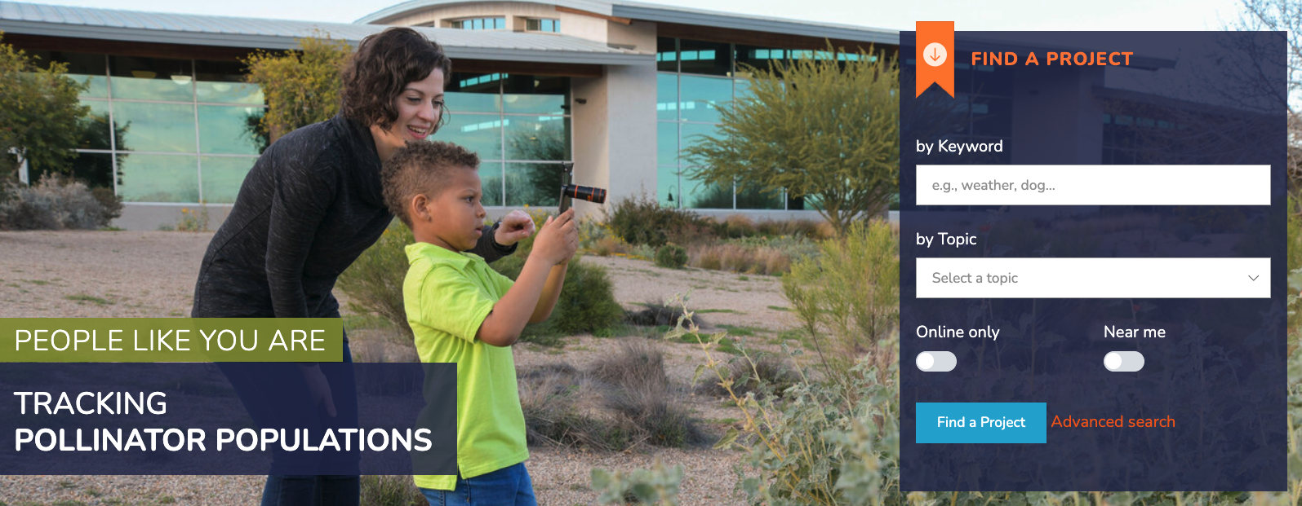
SciStarter.org/login
Notes:
EMMA
What is SciStarter
Millions of people are into science and nature
Thousands of scientists need their help
We Connect them.
Join SciStarter - promote it to your folks
Becauseof citizen scientists:
126 birds species “lost to science” identified (iNaturalist, eBird, Xeno-canto, 2024)
Hundreds of exoplanets have been discovered, including “Percival,” an exoplanet in a habitable zone (Planet Hunters TESS, 2024)
3.5 months of lab-equivalent Alzheimer’s research completed in one weekend through 2,566 hours of volunteer participation (Stall Catchers, 2019)
We’ve discovered that some invasive ants spread by hitchhiking (Taiwan, 2024)
We know the human belly buttons contain 50+ species of bacteria (Belly Button Biodiversity, 2012)
Trends in the data showed that the average night sky got brighter by 9.6% per year from 2011 to 2022, which is equivalent to doubling the sky brightness every 8 years. —KTS
Join SciStarter! http://SciStarter.org/login
To ensure you stay in the loop about all of these activities, we recommend you sign up for a free account on scistarter so you can explore the resources and save them to your dashboard: http://SciStarter.org/login

Slide 5
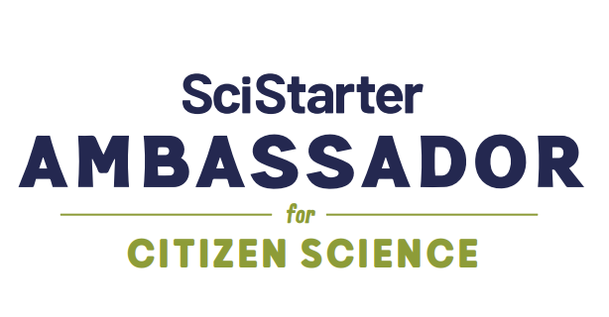
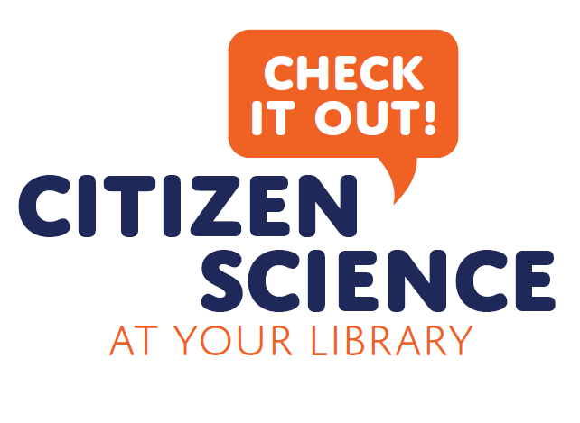
Building Capacity for Citizen Science
Get involved today by joining SciStarter and the Citizen and Community Science Library Network!
SciStarter.org/login
SciStarter.org/go/library-network
Notes:
Emma
160 trained Ambassadors available to you
1200 libraries across 49 states in the network
Yearly celebrations during citizen science month (April) to achieve millions of Acts of Science
Last year, …Results from CSM 2025, over 3 million acts of science. Learn more about it here: https://blog.scistarter.org/2025/06/what-we-achieved-together-during-citizen-science-month-2025
To ensure you stay in the loop about all of these activities, join the library network, there are no requirements to join: http://SciStarter.org/go/library-network

Slide 6
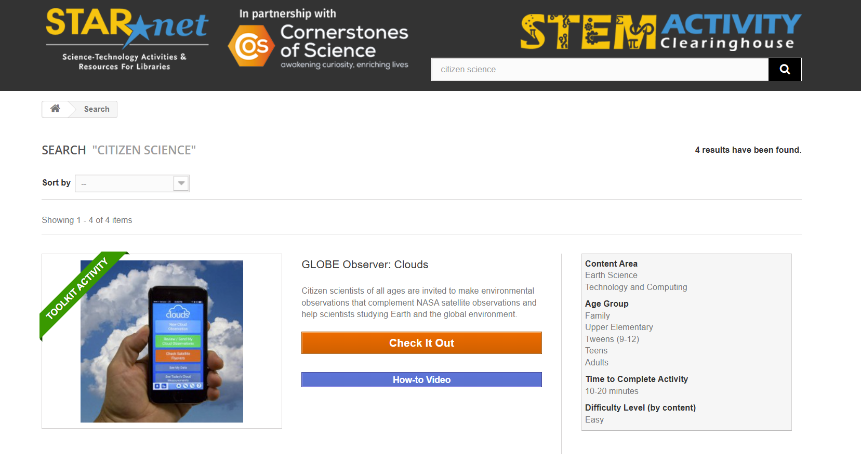
Building Capacity for Citizen Science
https://clearinghouse.starnetlibraries.org/

Slide 7
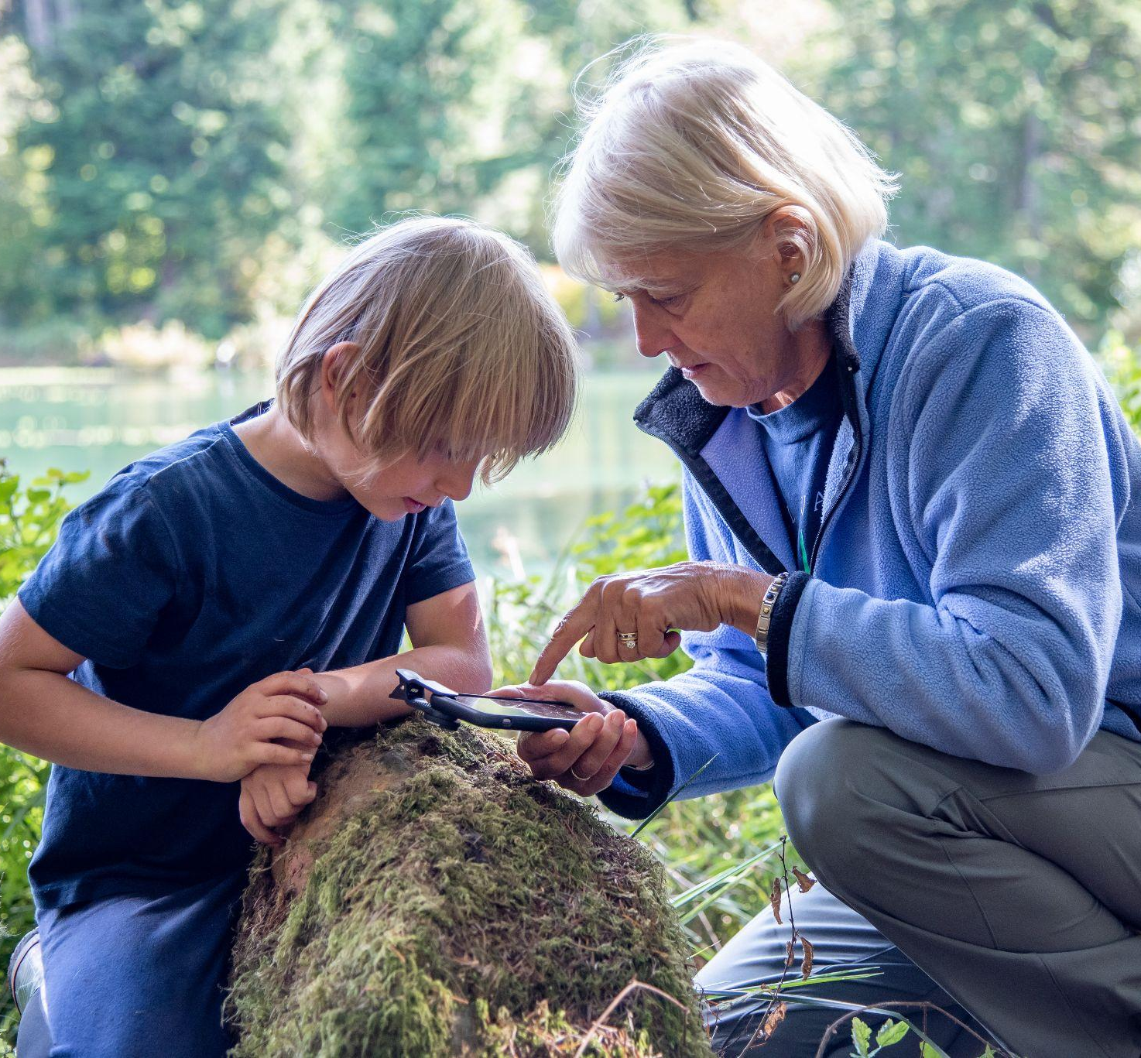
Our Common Goal
We’re here to help people connect with science through hands-on, community-powered experiences.
You’re helping your community act on science, not just learn about it—and that’s powerful!
Notes:
Tara

Slide 8
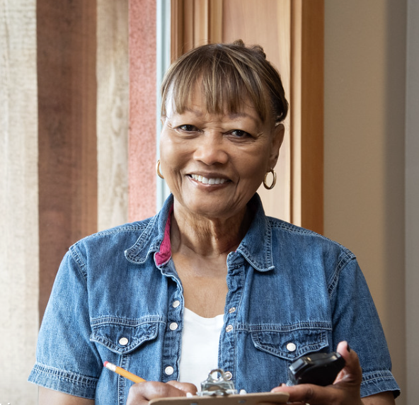
Goals for today
Discover easy ways to incorporate Acts of Science into your current programming
Prepare for Citizen Science Month (April) and America250/America Gives
Access ongoing support and resources to engage your communities in real-world science!
Notes:
Tara

Slide 9
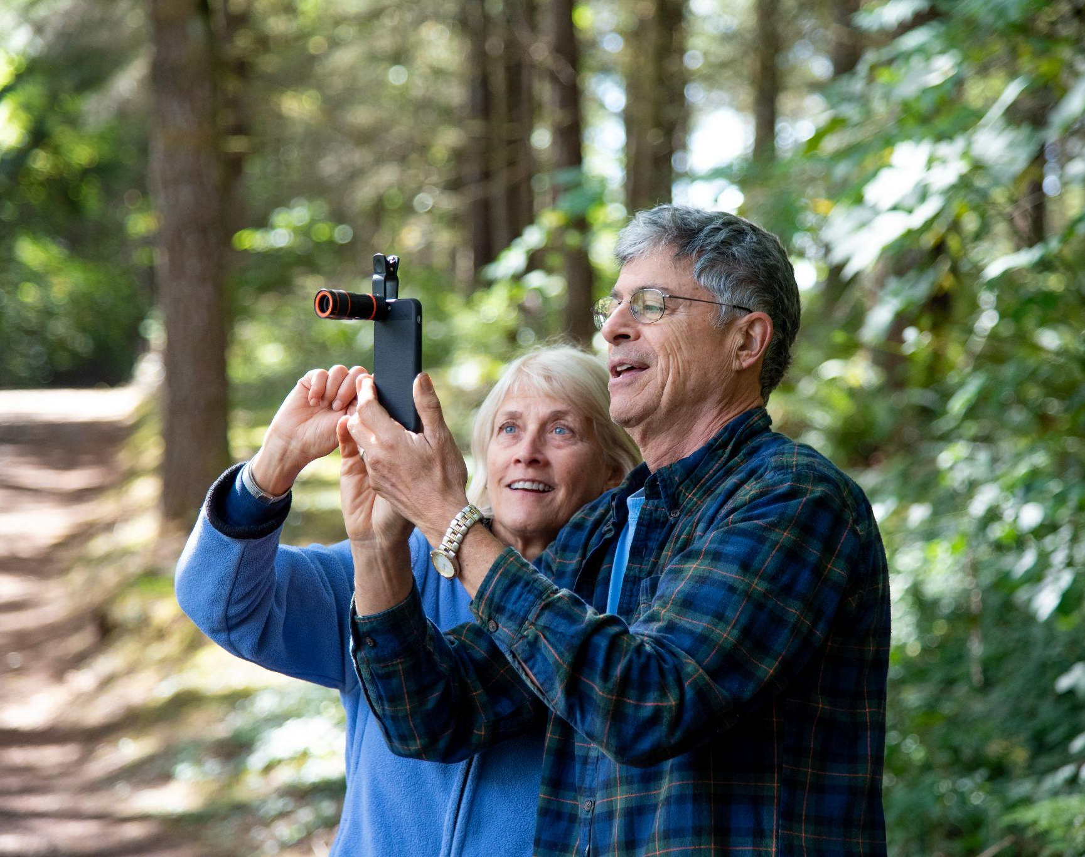
Acts of Science
What is an Act of Science?
It’s a real, measurable contribution to ongoing scientific research—often called “citizen science,” open to anyone, anywhere.
What does it look like in action?
Tracking bird migration. Counting pollinators. Reporting street flooding. Transcribing museum labels. Measuring light pollution. Every action helps scientists understand our world.
Why do people get involved?
Some join to give back. Others are driven by curiosity or the thrill of discovery. And for many, it’s a personal mission.
Notes:
Tara

Slide 10
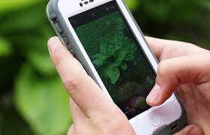
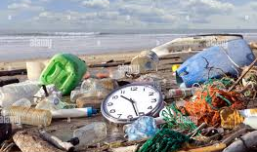
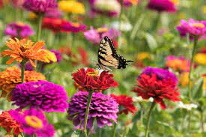
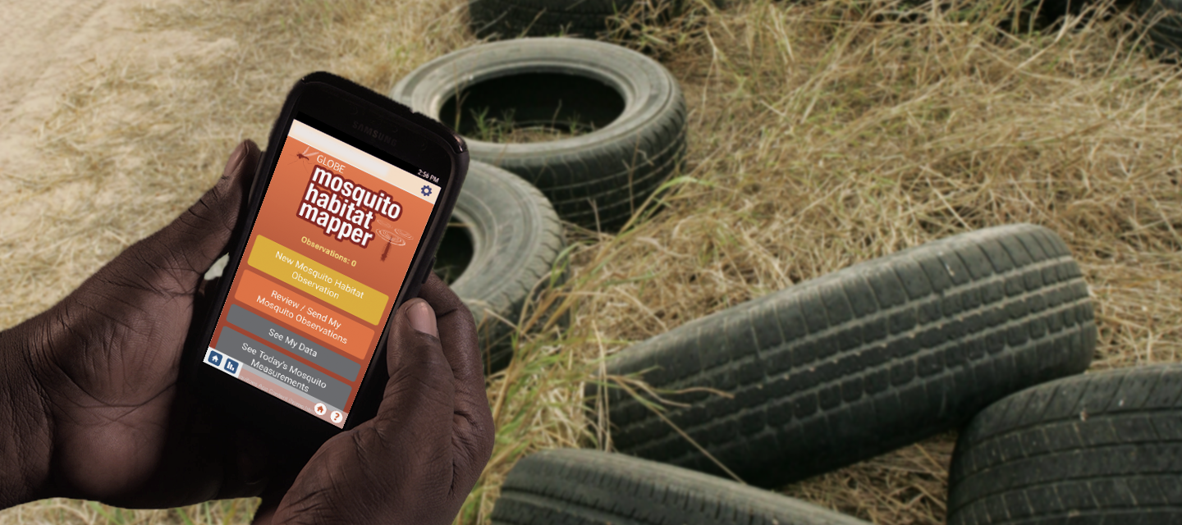
Which of these is an Act of Science?
There may be more than one answer.
A
B
Take a photo of a plant during a nature hike and upload to INaturalist
Organize a beach clean up
C
D
Plant a pollinator garden to increase pollinator activity
Find and report mosquito habitats to GLOBE Observer
Tree Planting Day
Notes:
Tara
Welcome, everyone! We're thrilled to have such a great mix of participants—from seasoned citizen science facilitators to those just starting out. Whether you're here from a library, museum, science center, or another community hub, we’re excited to explore how we can create more opportunities for people to take meaningful Acts of Science—together.

Slide 11
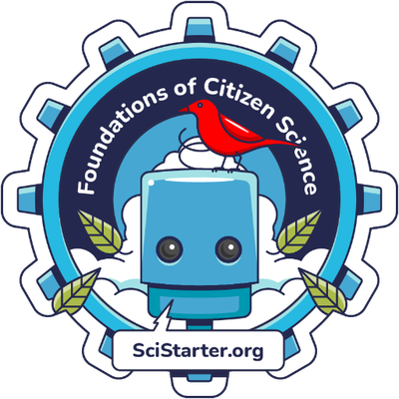
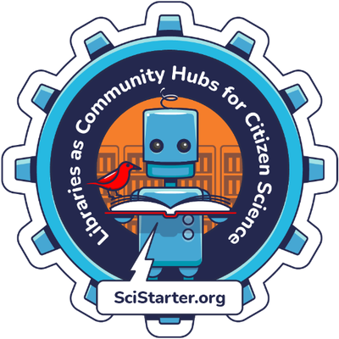
Want to go deeper?
Online, Self-Guided Trainings
Build your confidence and increase engagement and retention via online training, resources and support from SciStarter team members.
SciStarter.org/Training
Notes:
Tara

Slide 12
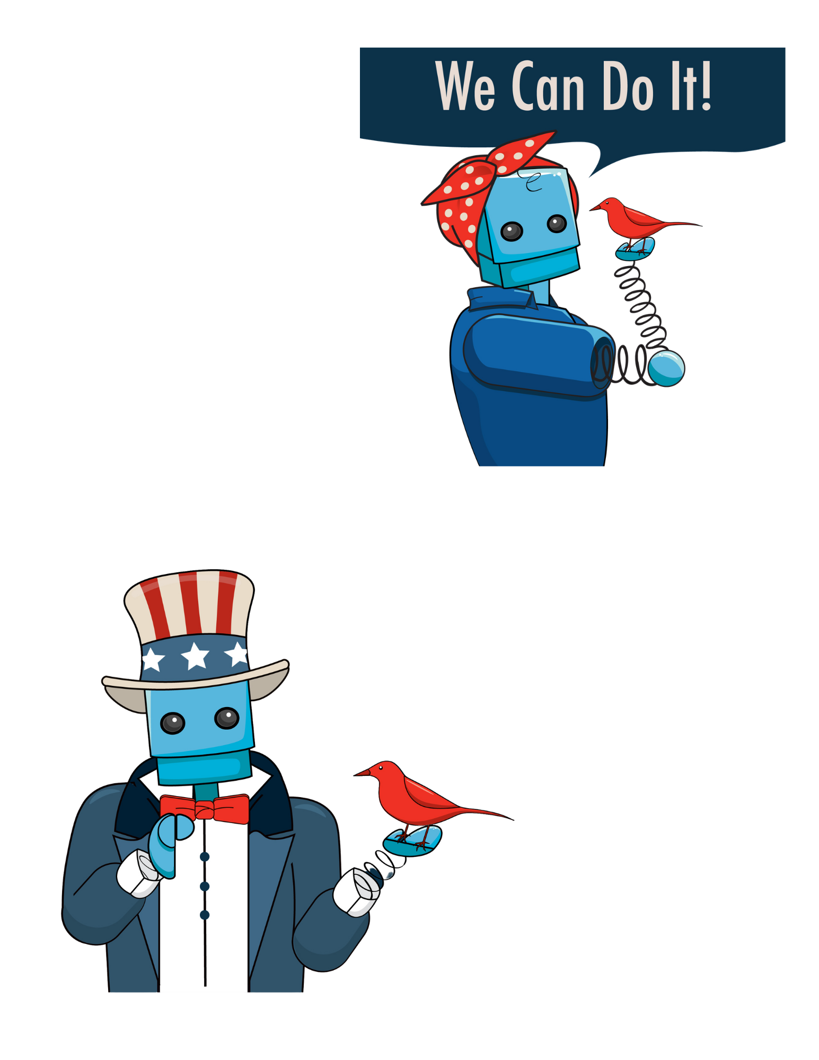
Upcoming National Campaigns
Citizen Science Month (April)
Everyone is invited to join the 2.50 Million Acts of Science Challenge this April 2026. Let’s make history together, one act of science at a time.
America250/America Gives
The US will commemorate the 250th anniversary of the signing of the Declaration of Independence all year in 2026.
SciStarter is an official partner of America Gives, the largest volunteer effort in US history!
https://pages.scistarter.org/library-america250/
Notes:
EMMA
A250: SciStarter is an official partner! Get involved in America Gives - the largest volunteer effort in US history - through SciStarter
Celebrate creativity, innovation, and civic participation.
Look ahead to the future we want to create, for ourselves and the next generation.
Share the full America’s story, before and beyond the signing of the Declaration of Independence.
America 250! Year long celebration - you’ll start seeing things happening around you already. Lots of materials are out -
Calling libraries, educators, organizations, people of all backgrounds worldwide: let’s make history together, one act of science at a time.
There is a unique opportunity this year to connect citizen science to America’s 250’s anniversary.
We can transcribe historical documents from the smithsonian.
The founding fathers were also citizen scientists! They documented nature for their own livelihoods…
Before science was specialized, we were all citizen scientists! We didn’t have labs, we went out and observed out own environments, learning about constellations,
By getting involved in Acts of Science with Scistarter, an official partner of America 250, you take part in volunteering for science as a part of the America Gives largest volunteer effort in the country’s history.
Of the thousands of projects of scistarter, hundreds of projects use api’s that report back to us. We also have self-reporting. Just know - that if you host an event or program during CitSciMonth, we will walk you through the process to ensure it counts. All of that will be counted toward America Gives.
We have the resources for you - for every step of the way : connecting with your community, planning an event practicing now.

Slide 13
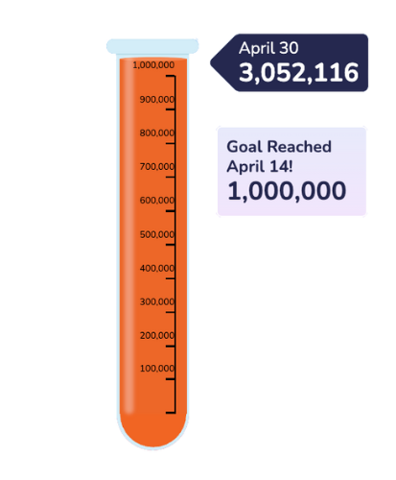
Citizen Science Month (April)
Events Facilitators
SciStarter does all the heavy lifting!
To ensure your Acts of Science are included for America Gives:
Add your April Events
Report back when the time comes: attendance #s and estimated Acts
2.50 Million Acts of Science
The
Public
Project Scientists
Notes:
Emma
Official Partner of America250 - they will be pointing people to citizen science month and Scistarter
America 250! Year long celebration - you’ll start seeing things happening around you already. Lots of materials are out -
Calling libraries, educators, organizations, people of all backgrounds worldwide: let’s make history together, one act of science at a time.
Emma: 100s of the projects are affiliates, so your data will be included as you participate. We take care of the reporting! Add your events, reply to our calls for reporting
Giles, E., Nickerson, C., Cox, T., Cavalier, D., Laxman, D., Ash, D., Arbuckle, D., Moundalak, R. (2025). Citizen Science Month Across the Years: Lessons Learned & Impacts Measured. CAPS 2025.

Slide 14
Quiz Time:
Acts of Science: Then & Now
Notes:
Welcome, everyone! We're thrilled to have such a great mix of participants—from seasoned citizen science facilitators to those just starting out. Whether you're here from a library, museum, science center, or another community hub, we’re excited to explore how we can create more opportunities for people to take meaningful Acts of Science—together.

Slide 15
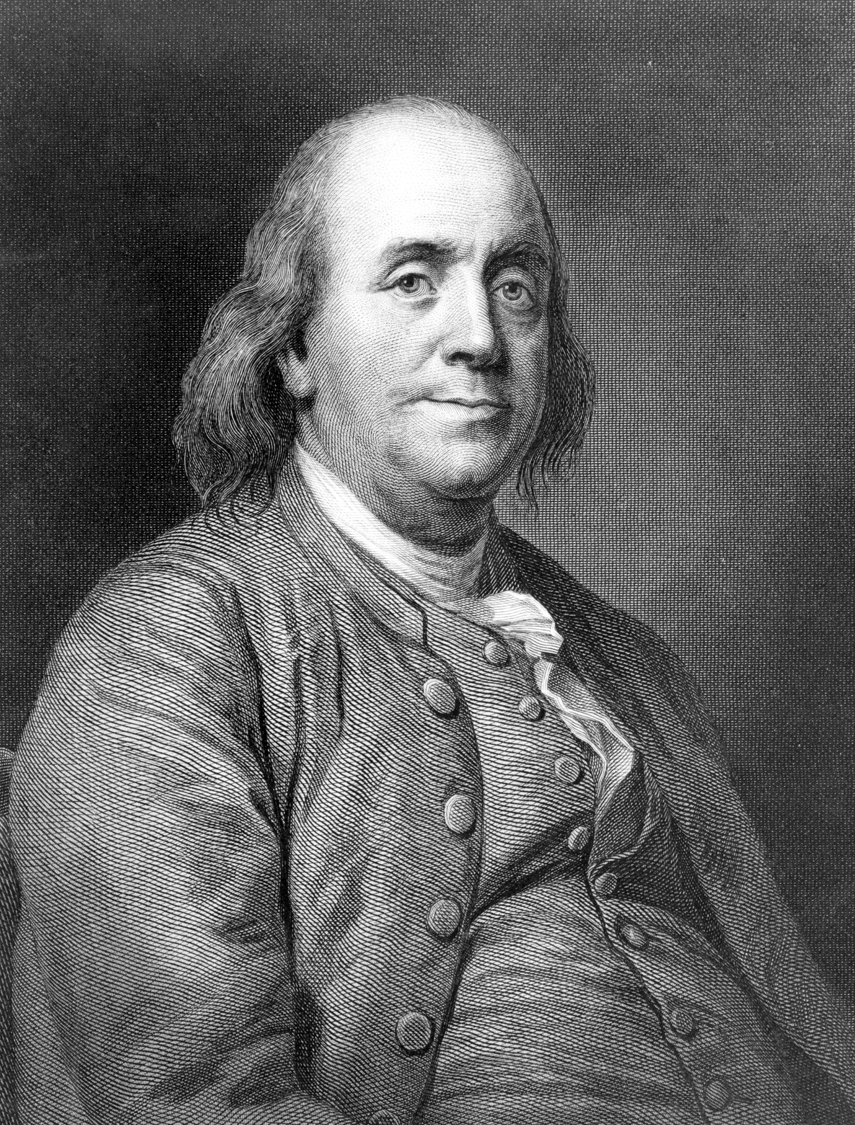
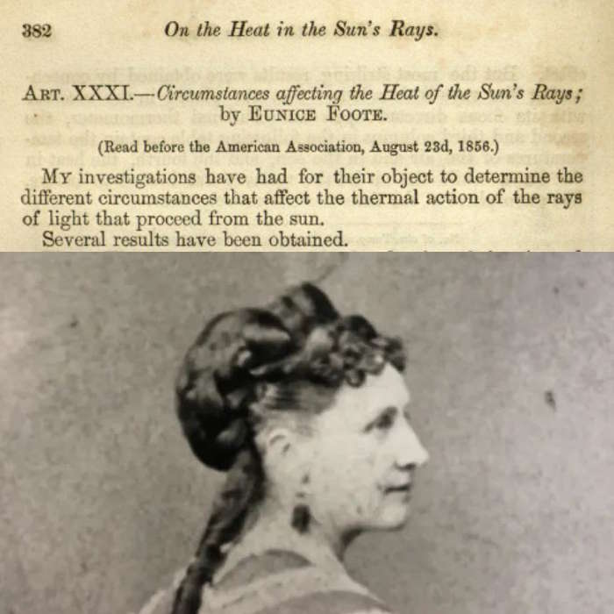
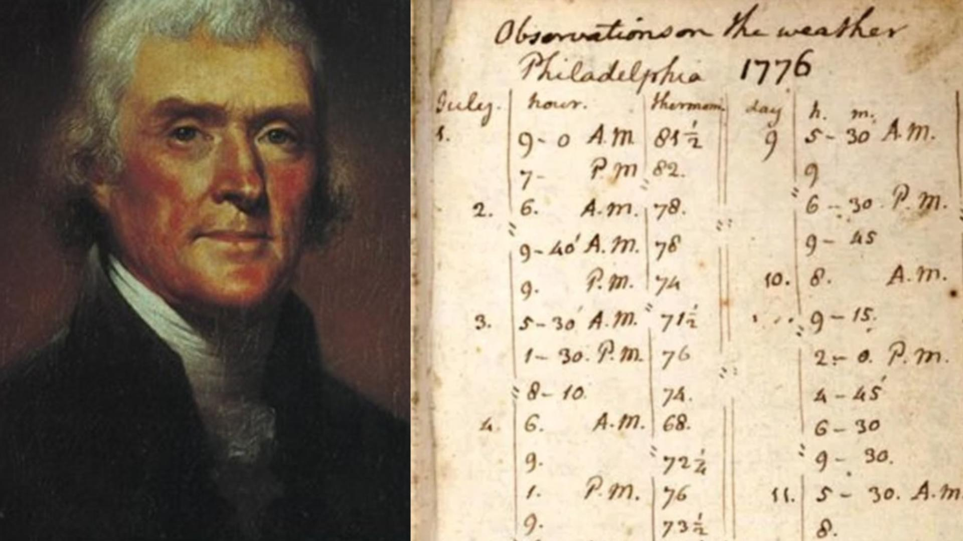
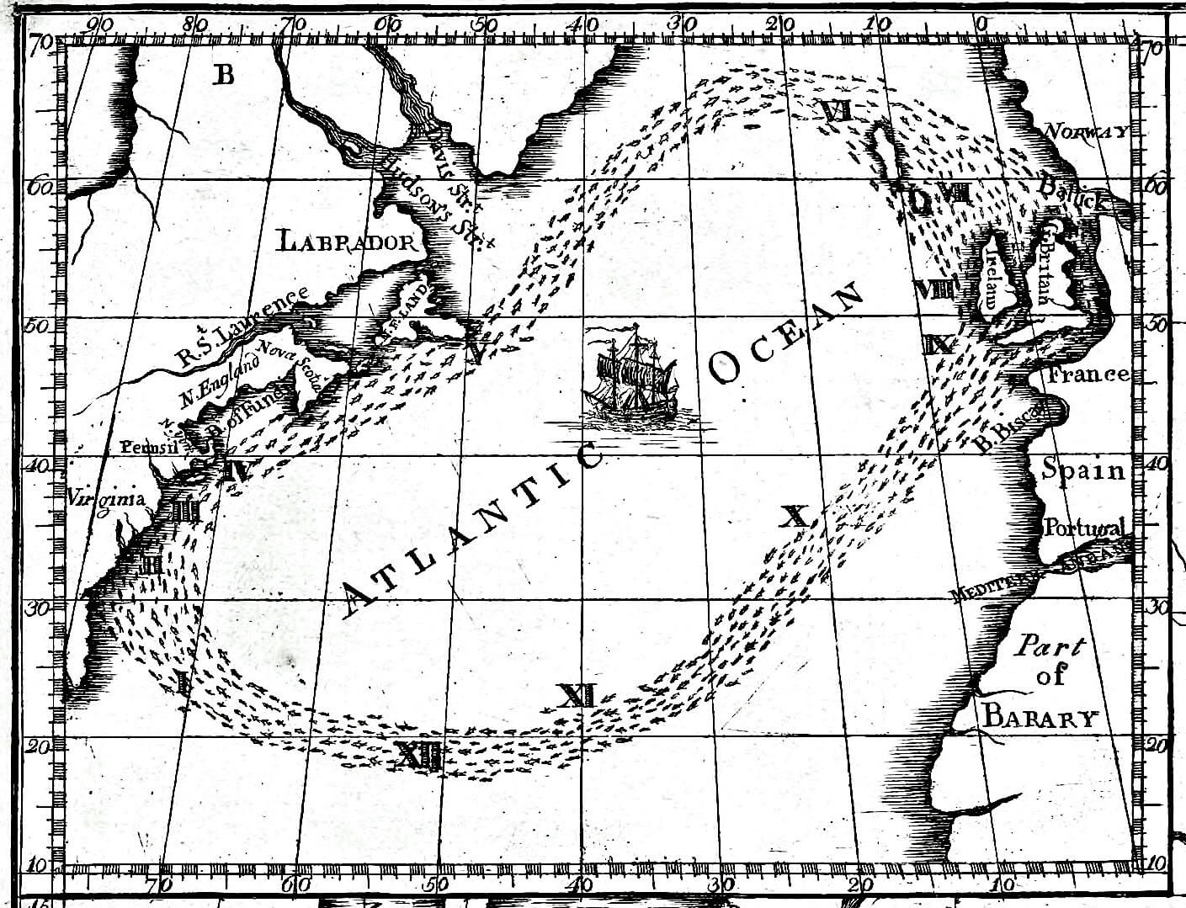
America250 Connections

Slide 16
Integrating Acts of Science
You don’t have to start from scratch.
Here are some ways others have done it:
Notes:
Welcome, everyone! We're thrilled to have such a great mix of participants—from seasoned citizen science facilitators to those just starting out. Whether you're here from a library, museum, science center, or another community hub, we’re excited to explore how we can create more opportunities for people to take meaningful Acts of Science—together.

Slide 17
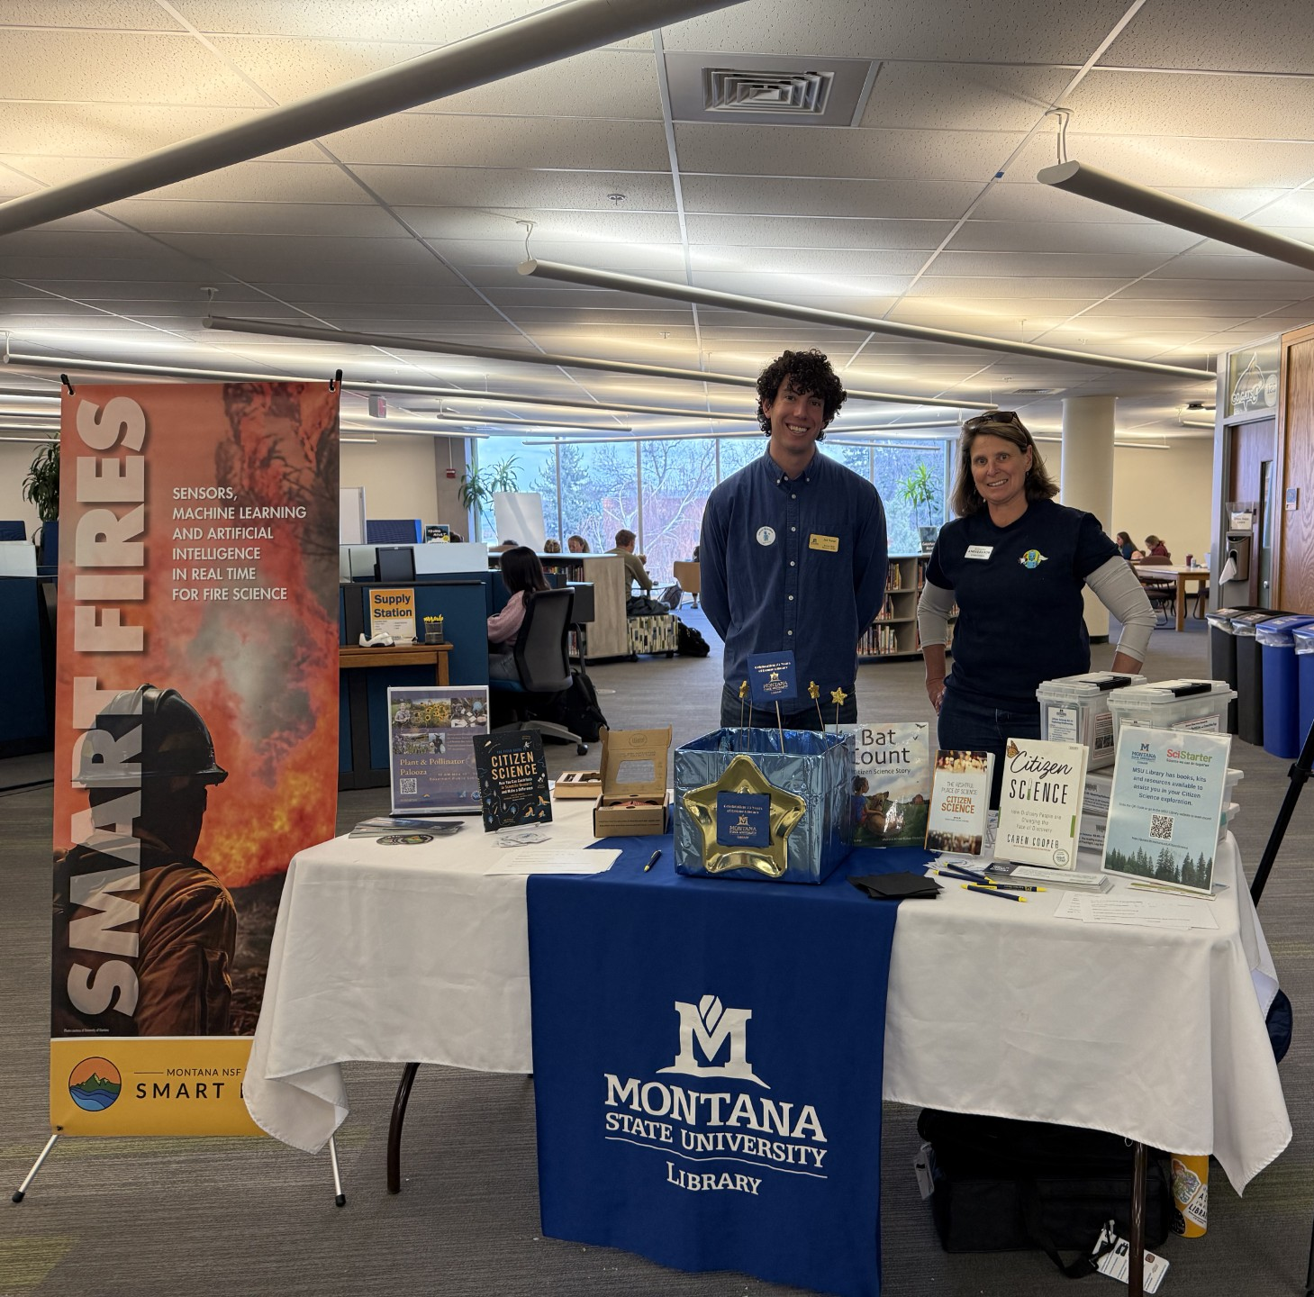
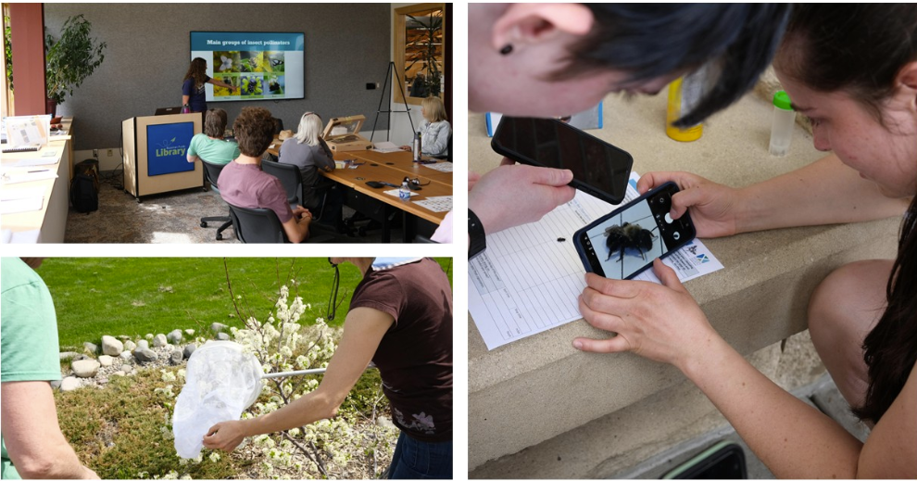
Integrating Acts of Science
Montana State University
Pollinator Event
Notes:
Learn about these events and more here: https://pages.scistarter.org/2025/05/scistarter-successfully-celebrates-75-years-of-nsf-powered-innovation-and-discovery-with-nationwide-citizen-science-events/
Examples to Share at Your Library:
Document Nature with iNaturalist
Take photos of plants, animals, or insects and share them with scientists using a free app.
Share Your Weather with iSeeChange
Record local weather and its community impacts using an easy journal app.
Explore Space Images with Zooniverse
Help researchers identify features in planetary images from space missions online.
Transcribe Historical Documents
Turn handwritten archives into searchable text by transcribing online.
Count Pollinators with the Great Sunflower Project
Observe bees and other pollinators and record your findings to help track population health.
Help Advance Medical Research with Stall Catchers
Analyze short video clips of blood flow in mouse brains to help scientists study Alzheimer’s disease. No experience needed—just watch, click, and contribute!
Example Activities,
Tell your book club about the benefits of citizen science and help people create SciStarter accounts.
Meet with your library director to introduce citizen science, SciStarter, and how libraries get involved in the library network.
Host an introduction to citizen science event at your library using the professionally designed slides and facilitator guide.
Arrange for a local subject matter expert to visit the library to discuss a relevant topic (e.g., birds or astronomy) connected to citizen science.
Organize a citizen science project competition at your library computer stations; such as a Stall Catchers “Catchathon.”
Host a pollinator party at a community garden by teaching people how to do projects like the Great Sunflower Project.
Support an existing citizen science program at your library as an additional facilitator.
Help your local Girls Scout troop complete their “Think Like a Citizen Scientist Journey.”
Present a citizen science project on a SciStarter LIVE! Webinar in collaboration with the SciStarter team.
Provide citizen science training to docents at a local nature center.
Collaborate with amateur astronomers to integrate citizen science activities during night sky events.

Slide 18
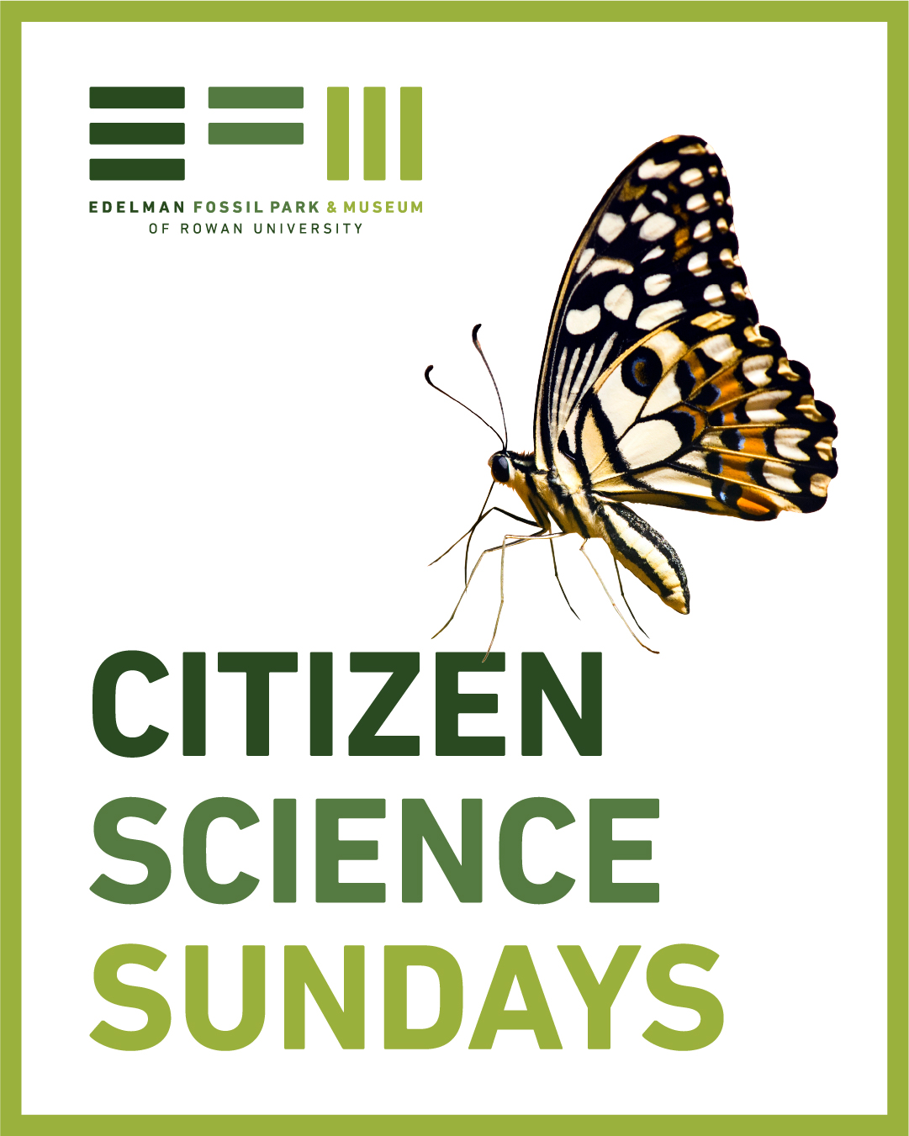
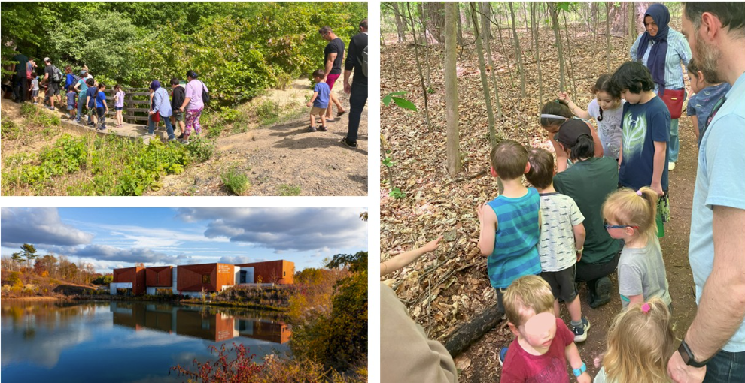
Integrating Acts of Science
Edelman Fossil Park Museum
Citizen Science Sundays
Notes:
Examples to Share at Your Library:
Document Nature with iNaturalist
Take photos of plants, animals, or insects and share them with scientists using a free app.
Share Your Weather with iSeeChange
Record local weather and its community impacts using an easy journal app.
Explore Space Images with Zooniverse
Help researchers identify features in planetary images from space missions online.
Transcribe Historical Documents
Turn handwritten archives into searchable text by transcribing online.
Count Pollinators with the Great Sunflower Project
Observe bees and other pollinators and record your findings to help track population health.
Help Advance Medical Research with Stall Catchers
Analyze short video clips of blood flow in mouse brains to help scientists study Alzheimer’s disease. No experience needed—just watch, click, and contribute!
Example Activities,
Tell your book club about the benefits of citizen science and help people create SciStarter accounts.
Meet with your library director to introduce citizen science, SciStarter, and how libraries get involved in the library network.
Host an introduction to citizen science event at your library using the professionally designed slides and facilitator guide.
Arrange for a local subject matter expert to visit the library to discuss a relevant topic (e.g., birds or astronomy) connected to citizen science.
Organize a citizen science project competition at your library computer stations; such as a Stall Catchers “Catchathon.”
Host a pollinator party at a community garden by teaching people how to do projects like the Great Sunflower Project.
Support an existing citizen science program at your library as an additional facilitator.
Help your local Girls Scout troop complete their “Think Like a Citizen Scientist Journey.”
Present a citizen science project on a SciStarter LIVE! Webinar in collaboration with the SciStarter team.
Provide citizen science training to docents at a local nature center.
Collaborate with amateur astronomers to integrate citizen science activities during night sky events.

Slide 19
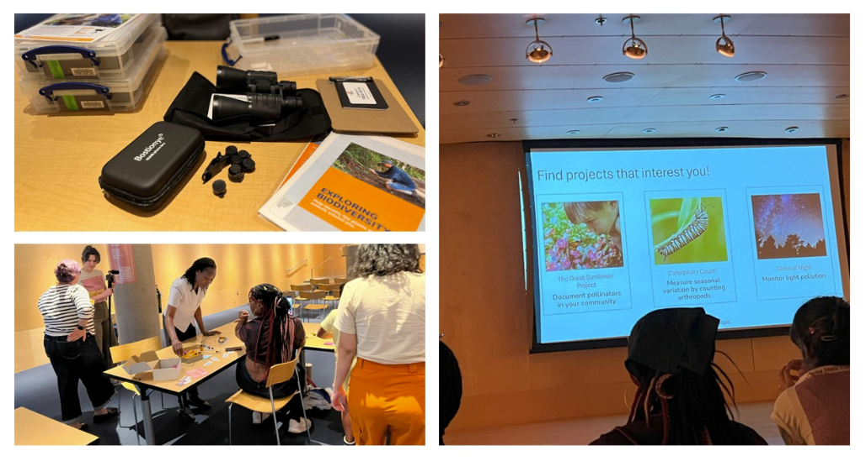
Integrating Acts of Science
Burton Barr Central Library
Introduction to Citizen Science Workshop
Notes:
Burton Barr hosted an event to introduce their visitors to Citizen science and engage with Citizen science kits.
Examples to Share at Your Library:
Document Nature with iNaturalist
Take photos of plants, animals, or insects and share them with scientists using a free app.
Share Your Weather with iSeeChange
Record local weather and its community impacts using an easy journal app.
Explore Space Images with Zooniverse
Help researchers identify features in planetary images from space missions online.
Transcribe Historical Documents
Turn handwritten archives into searchable text by transcribing online.
Count Pollinators with the Great Sunflower Project
Observe bees and other pollinators and record your findings to help track population health.
Help Advance Medical Research with Stall Catchers
Analyze short video clips of blood flow in mouse brains to help scientists study Alzheimer’s disease. No experience needed—just watch, click, and contribute!
Example Activities,
Tell your book club about the benefits of citizen science and help people create SciStarter accounts.
Meet with your library director to introduce citizen science, SciStarter, and how libraries get involved in the library network.
Host an introduction to citizen science event at your library using the professionally designed slides and facilitator guide.
Arrange for a local subject matter expert to visit the library to discuss a relevant topic (e.g., birds or astronomy) connected to citizen science.
Organize a citizen science project competition at your library computer stations; such as a Stall Catchers “Catchathon.”
Host a pollinator party at a community garden by teaching people how to do projects like the Great Sunflower Project.
Support an existing citizen science program at your library as an additional facilitator.
Help your local Girls Scout troop complete their “Think Like a Citizen Scientist Journey.”
Present a citizen science project on a SciStarter LIVE! Webinar in collaboration with the SciStarter team.
Provide citizen science training to docents at a local nature center.
Collaborate with amateur astronomers to integrate citizen science activities during night sky events.

Slide 20

Citizen Science Month 2026 Programming Alert!
Acts of Science: Connected
Many places. One purpose.
Acts that advance science.

Slide 21
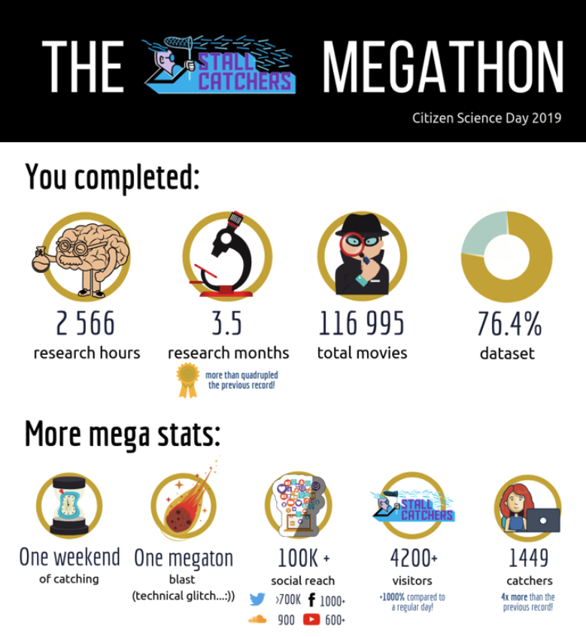
Acts of Science: Connected
Many Places. One purpose. Acts that advance science.
Four, weekly global events in April
Real-time participation in four different projects
We’ll do the heavy lifting (hosting project scientist, producing Zoom event, and more)...you just provide the space and participants and log into Zoom!
Turnkey Planning & Promotional Resources
Example: Libraries hosted events and Zoomed into a Stall Catchers/SciStarter meeting with the project scientist. Attendees performed the equivalent of 3.5 months of lab research time during that single event!
Notes:
Emma
We will organize a national event for hundreds of participating libraries, held once a week for four weeks in April, featuring one project at each of these events.
One major event will focus on a health project(!!). Libraries will provide the space, invite guests, add their creative flair (such as potluck meals and wearing themed hats), and offer technical capabilities to Zoom into the main event while maintaining a camera focused on their classroom/computer lab, or other designated area. We'll have clear instructions and links to best practices available for participating libraries.
People will meet in libraries and join our Zoom meeting where a scientist will explain a project and how to get involved. They'll join in a friendly competition between each library, see the results of their efforts at the end of the 2-hour event, have the opportunity to question the scientists throughout the entire event, and leave with information about the project and how to stay involved.
Because of the participation of citizens around the world, over the course of a single weekend, citizen scientists accomplished 2,566 research hours, or 3.5 months of lab-equivalent research time.
Beyond the bioblitz like the CNC, there are so many ways in which citizen science can be done in your community.
We’ve tried a lot of different approaches. Small projects need the most support
We know what works - get people together, get you trained, and do the project together
https://blog.scistarter.org/2019/05/citizen-science-day-global-community/ SciStarter and Stall cCatchers organized an incredibly successful event
We are in the process of interviewing for 3 more projects.
Friendly competition, immersive collective impact in a timebound
That day because of you, we can accomplish this 4 times over!
Third Tuesday Starting in September: https://scistarter.org/go/CSM2026-AoS-Connected We are interviewing projects for placement,
February ?
After you describe the Acts of Science: Connected collective impact event, pause to invite people to register for the first event to learn about one of the projects . Let them know that by the first event, we will confirm all four projects to be featured for this series.

Slide 22
Project Implementation Spotlight: CoCoRaHs
Notes:
TARA

Slide 23
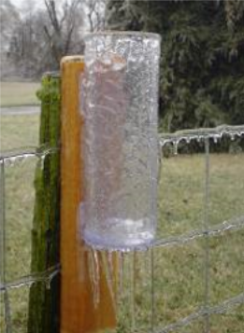
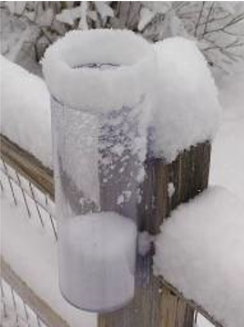
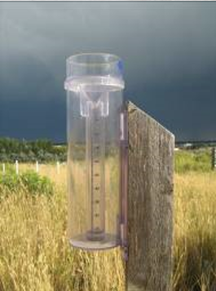
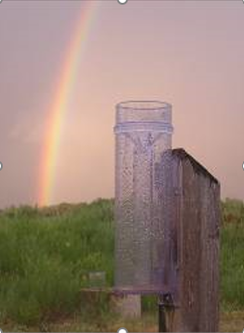
CoCoRaHS
“Crowdsourcing Precipitation Data”
Notes:
Community Collaborative Rain, Hail & Snow Network

Slide 24
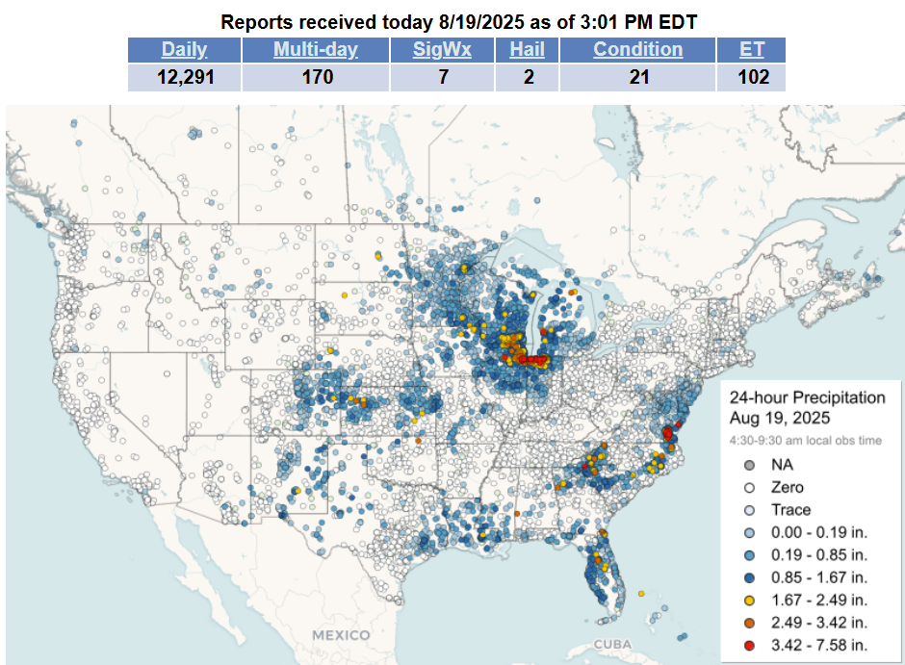
CoCoRaHS
Notes:
Community Collaborative Rain, Hail & Snow Network

Slide 25
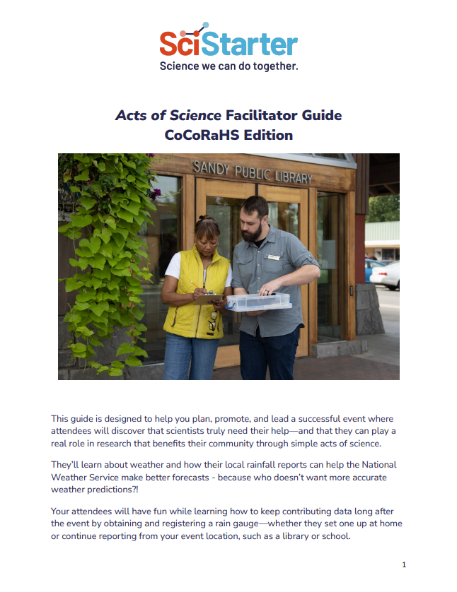
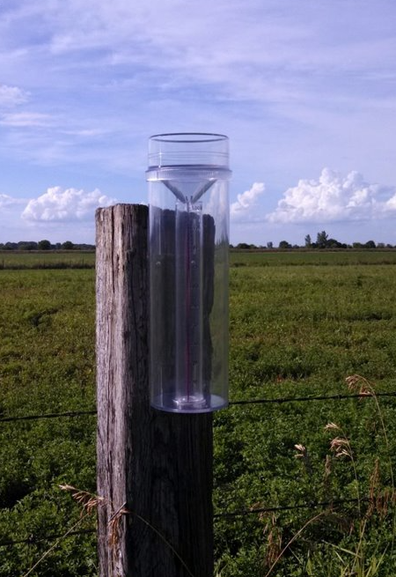
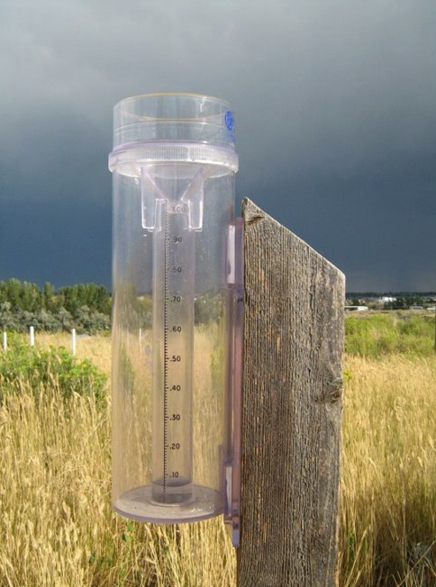
CoCoRaHS Guide
Simple, easy-to-handle, low-cost equipment

Slide 26
CoCoRaHS
Five easy steps:
Visit the project page to read through the basics: SciStarter.org/go/cocorahs
Click “visit” to sign up at www.cocorahs.org
Obtain a rain gauge (info on website)
View the “training slide show” or attend a training session
Set up the gauge in a good location
Start observing precipitation and report online (daily is optimal)
How can you become part of the network?

Slide 27


Notes:
Sharing stories and inspiring conversations about what water means to communities across the Four Corners Region of the Southwestern U.S. Water connects us despite differences.

Slide 28
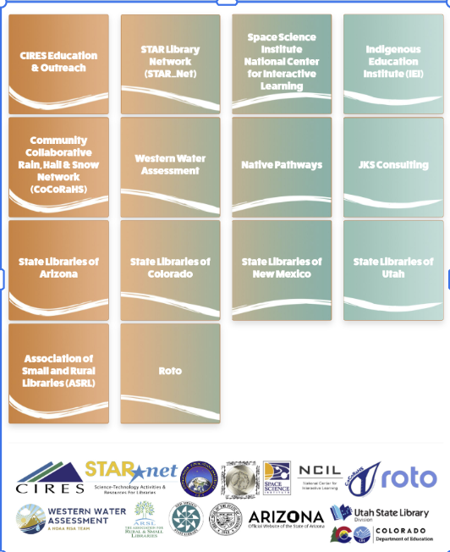
Collaboration between scientists, Indigenous science educators, learning researchers, informal educators, and library staff.
Notes:
Claire

Slide 29
We are Water Project Partnership
Library Partners
Lafayette Public Library in Lafayette (CO)
Aztec Public Library in Aztec (NM)
Navajo Nation Museum, Navajo Nation Library
Pine River Library in Bayfield (CO)
Montrose Regional Library in Montrose (CO)
Zuni Tribal Archives in Pueblo of Zuni
Ignacio Community Library in Ignacio (CO)
Page Public Library in Page (AZ)
Cortez Public Library in Cortez (CO)
Mesa County Public Library in Grand Junction (CO)
Hopi Public Library (AZ)
Alamosa Public Library (CO)
Southern Ute Indian Tribe Cultural Preservation Department
Lorelei Cloud
Shelly Thompson
Ute elders
Navajo Nation Educators and Elders
Vikki Tomas
Lorraine Redday
Laguna Pueblo
Kyle Swimmer
Notes:
We want to thank all our partners who work on We are Water

Slide 30
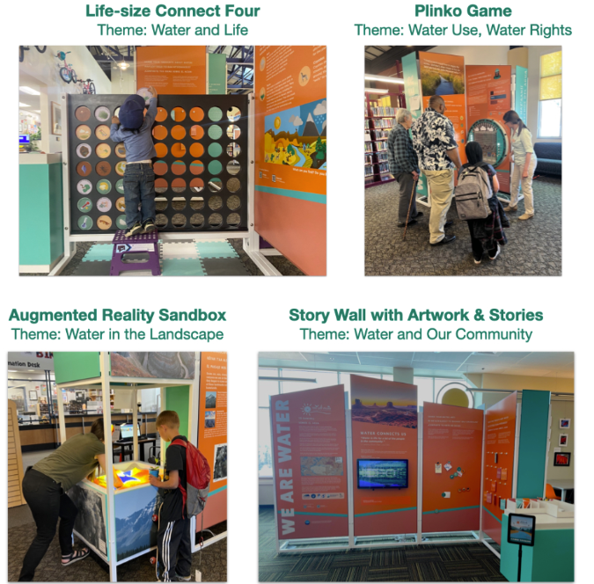
Four-Piece Library Exhibit
Interactive
Translation materials include English, Spanish, Navajo and Ute where applicable

Slide 31
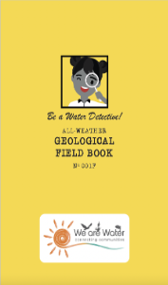
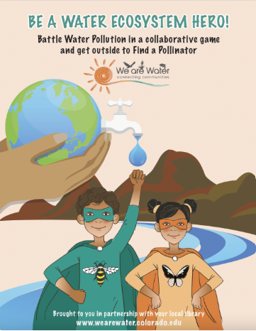
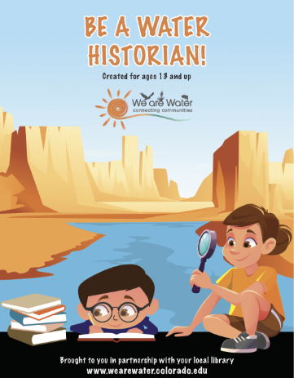
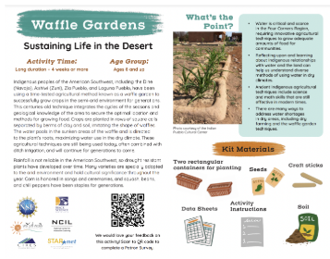
Learning Resources: Take and Make Kits
Be a Water Detective
Be a Water Ecosystem Hero
Be a Water Historian
Waffle Gardens
English | Spanish
English | Spanish
English | Spanish
English | Spanish
Navajo & English
https://wearewater.colorado.edu

Slide 32
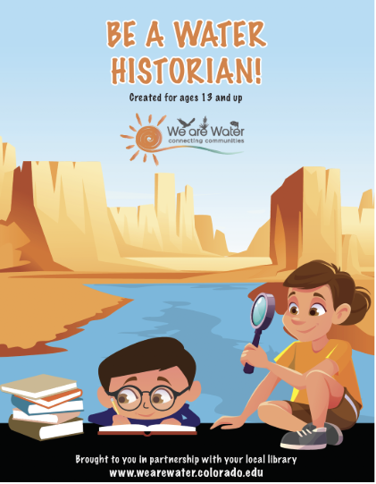
Learning Resources: Be a Water Historian
English | Spanish
Navajo & English
Interview and record stories from a family member, teacher, friend, or community member
Notes:
Learn how to be a good interviewer, from identifying the person you want to interview to writing effective interview questions; share recorded stories with people in your community

Slide 33
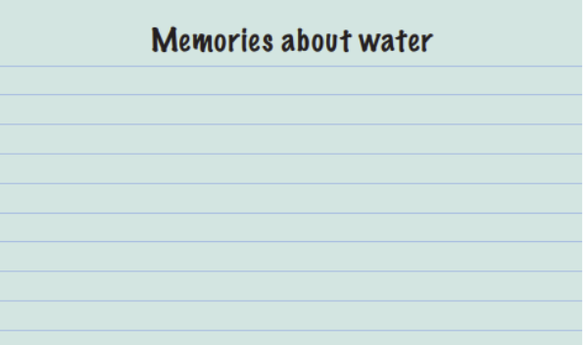
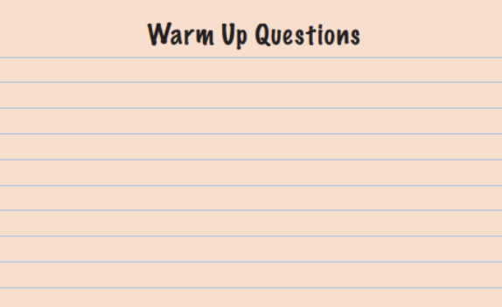
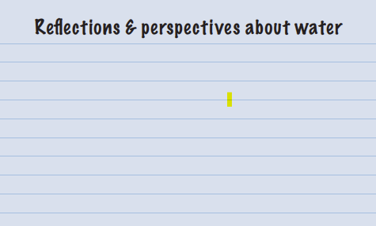
Be a Water Historian
What you will need:
Pen or pencil to write your questions
“Brainstorm Your Interview” Guide
A family, friend, or community member to interview
Smartphone, tablet, or computer to record
Notes:
The guide has tips for preparing for the interview, including giving the questions to the person you’re interviewing ahead of time, active listening, tips for how to record the interview, and opportunities for sharing the stories with the community or with the We are Water project.

Slide 34
Tools and Resources

Slide 35
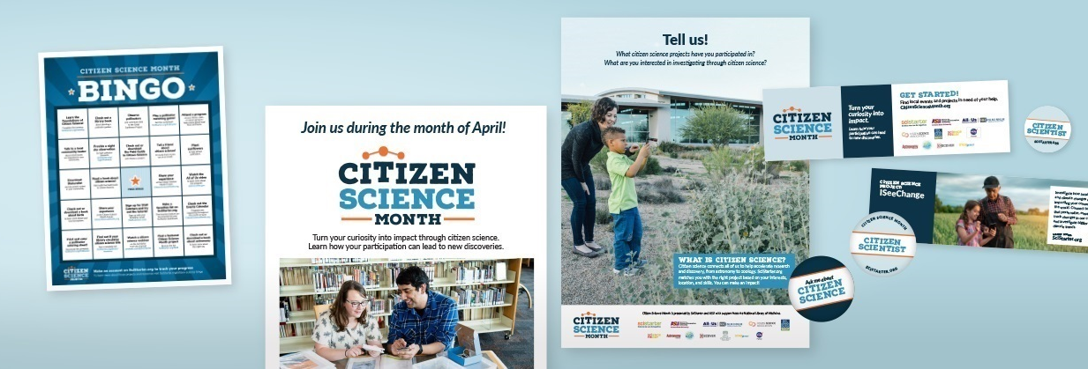
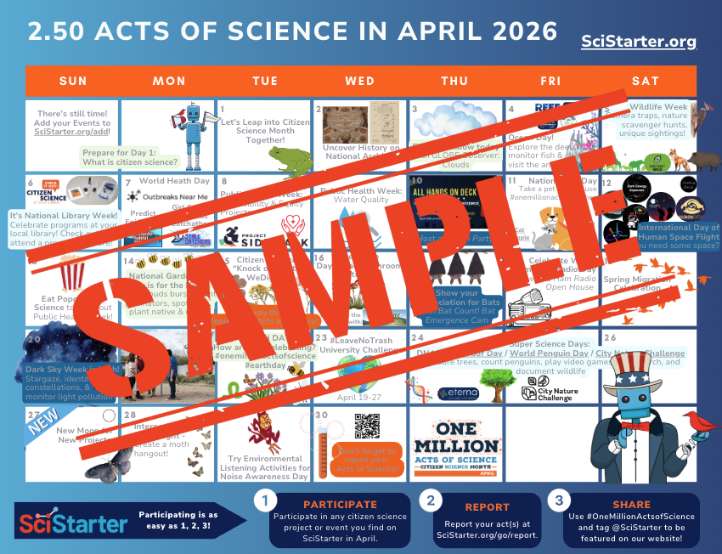

Resources for Facilitators
Promotional Toolkit
Flyers, Posters, Bookmarks, Sticker Designs
Free online trainings
Program planning guides,
April Event Calendar
Monthly meet ups on Zoom
Access to volunteers/Ambassadors
Plug and Play events & programs
Notes:
Emma

Slide 36

SciStarter Ambassadors
Search for Ambassadors in your area
Reach out for programming advice and support!
Notes:
Tara
Check out our poster for more:
Cox, T., Cavalier, D., Giles, E., Ash, D., Bennet, J., Britsch, B., & SciStarter Ambassadors (Cohorts 1–4). (2025). The SciStarter Ambassador Program: A volunteer training program designed to increase champions, connectors, and facilitators of participatory research and SciStarter resources across the US. CAPS 2025.

Slide 37
Next Steps

Slide 38

Calls to Action
Join SciStarter
Join the Citizen and Community Science Library Network
Take the Foundations Training
Participate in upcoming calls
Notes:
Monthly Meet ups on Zoom for

Slide 39
Here’s what is ahead
Fall 2026
Listen & Brainstorm
Spring 2026
Act
Summer 2026
Celebrate
Winter 2026
Train and Prepare
Notes:
Monthly Meet ups on Zoom for

Slide 40

Join us in October
Acts of Science:
Make Every Program Count this April
October 15, 2025
12PM PT/ 3PM ET
Register: SciStarter.org/acts-of-science-october2025
Notes:
More info on how to count all this toward 250 & Media kit will be ready.
https://scistarter.org/acts-of-science-october2025

