Slide 1
Supporting Neurodiverse Library Patrons (and Staff!)

Slide 2
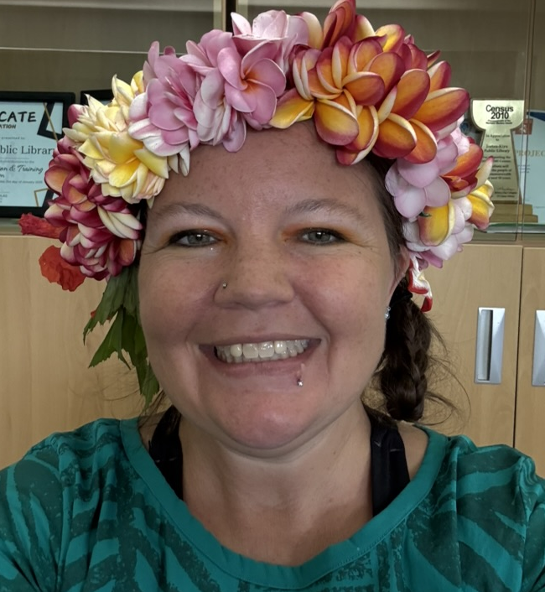
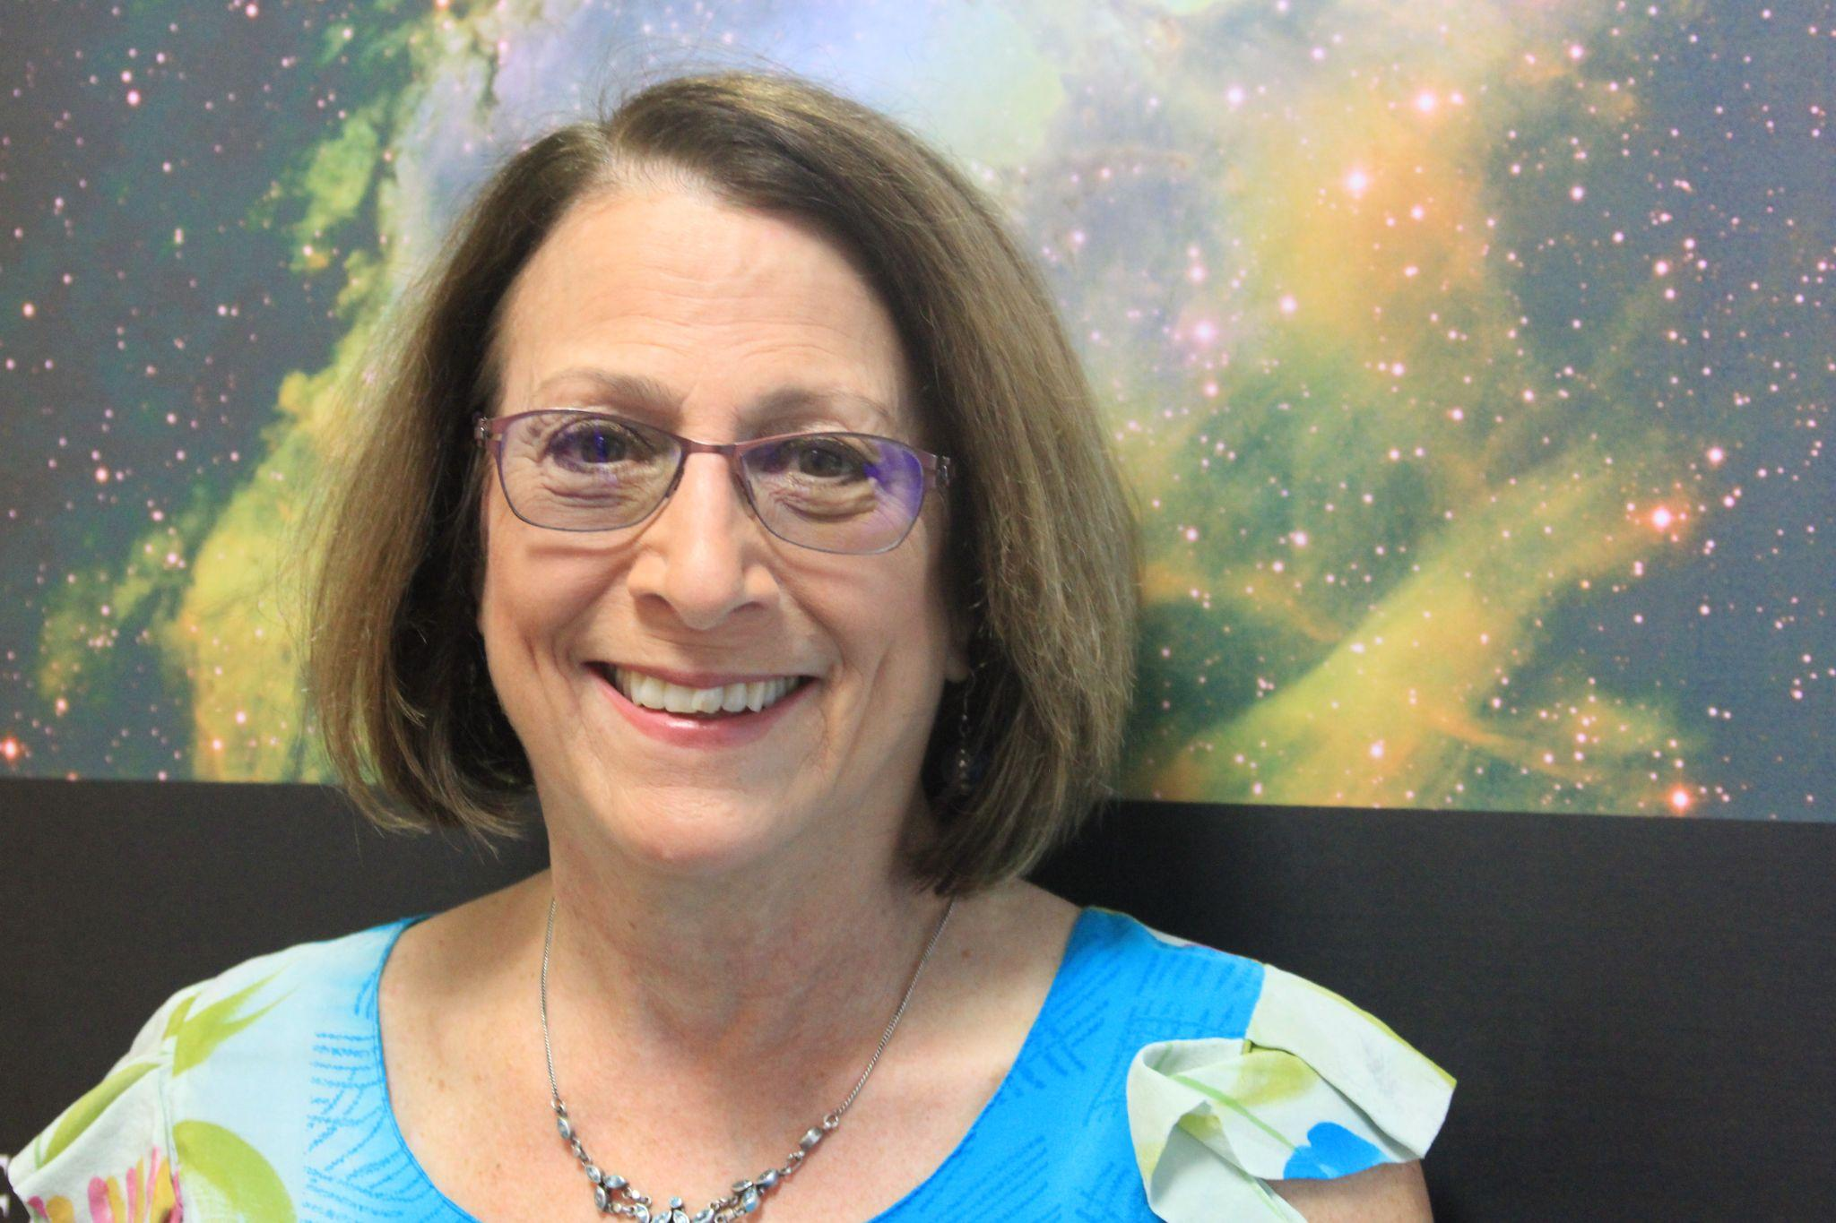
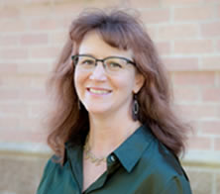
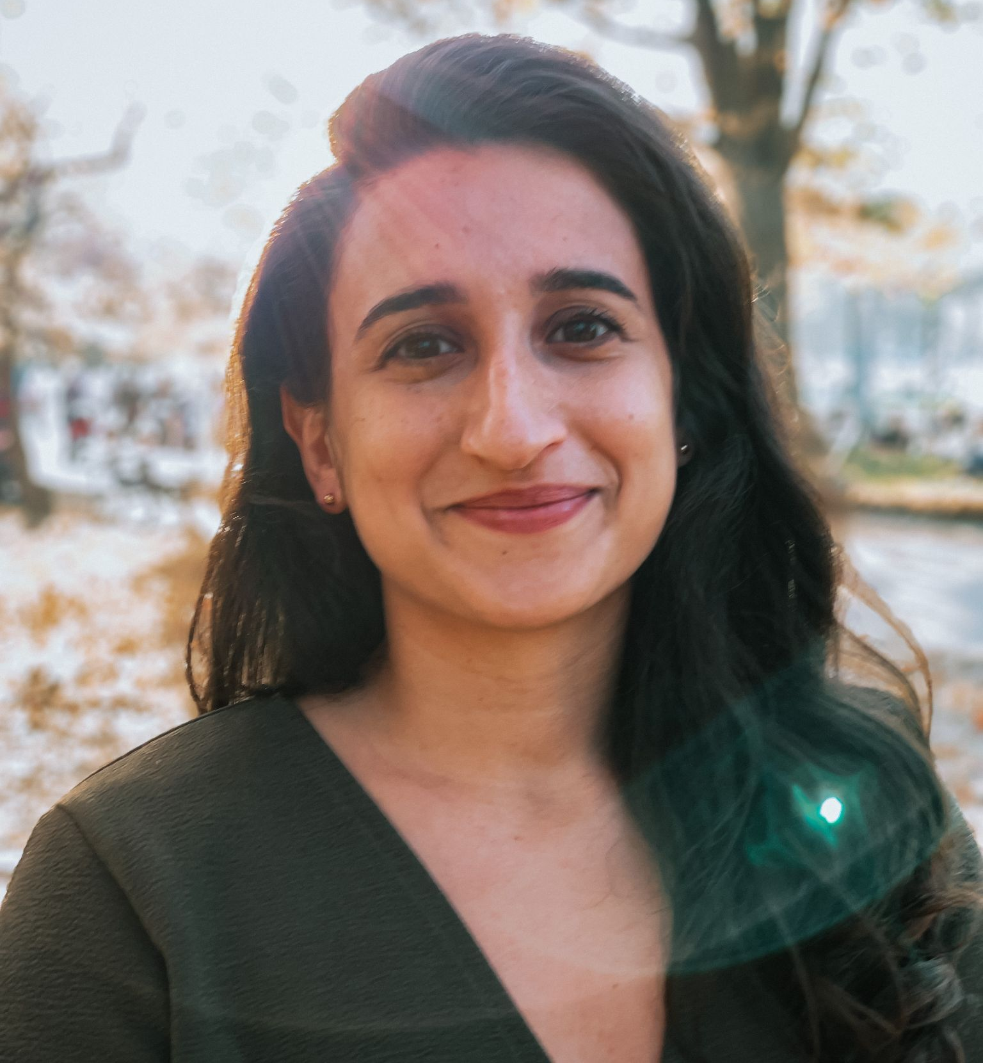
Today’s Presenters
Prof. Lynn Cominsky
PI, NASA’s
Neurodiversity Network
Director, EdEon STEM Learning
Sonoma State University
Fermi Co-investigator since 1999
Dr. Anne Holland
Director of Education
and Learning Research
Space Science Institute
#actuallyautistic
Dr. Ariana Riccio Arista
Research Staff, N3
Research Scientist,
Education Development Center
Christine Shupla
Science Engagement Manager
Lunar and Planetary Institute

Slide 3
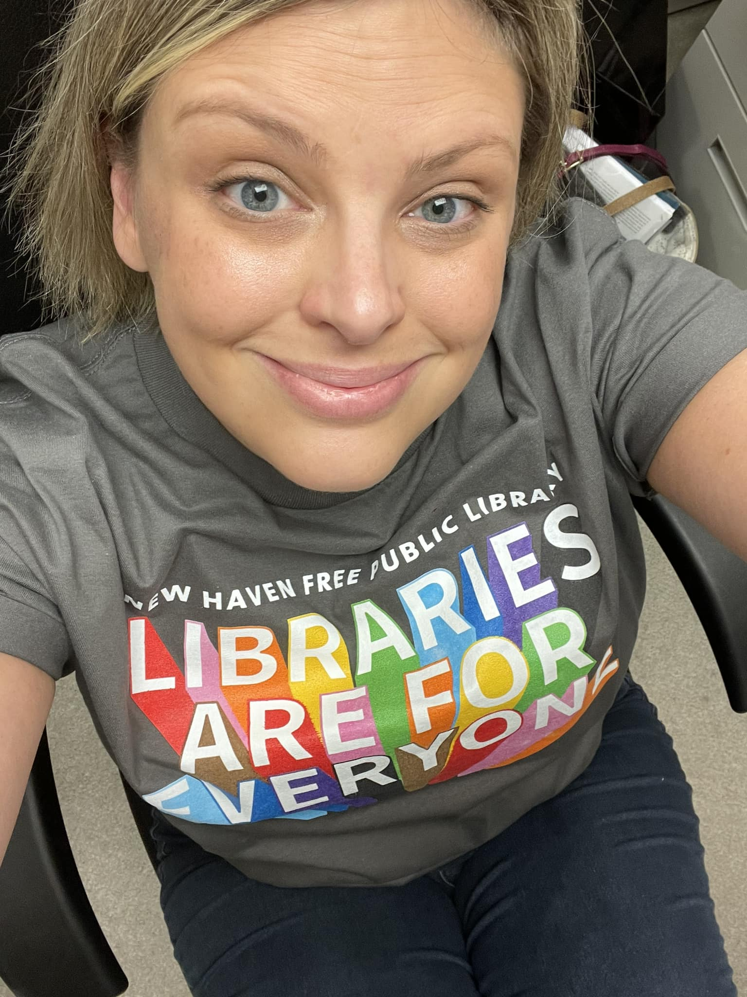
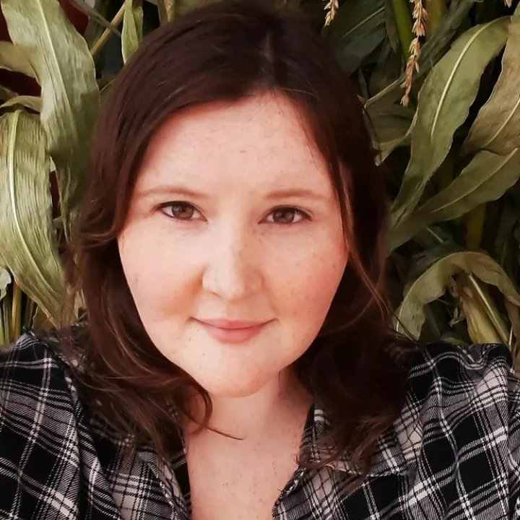
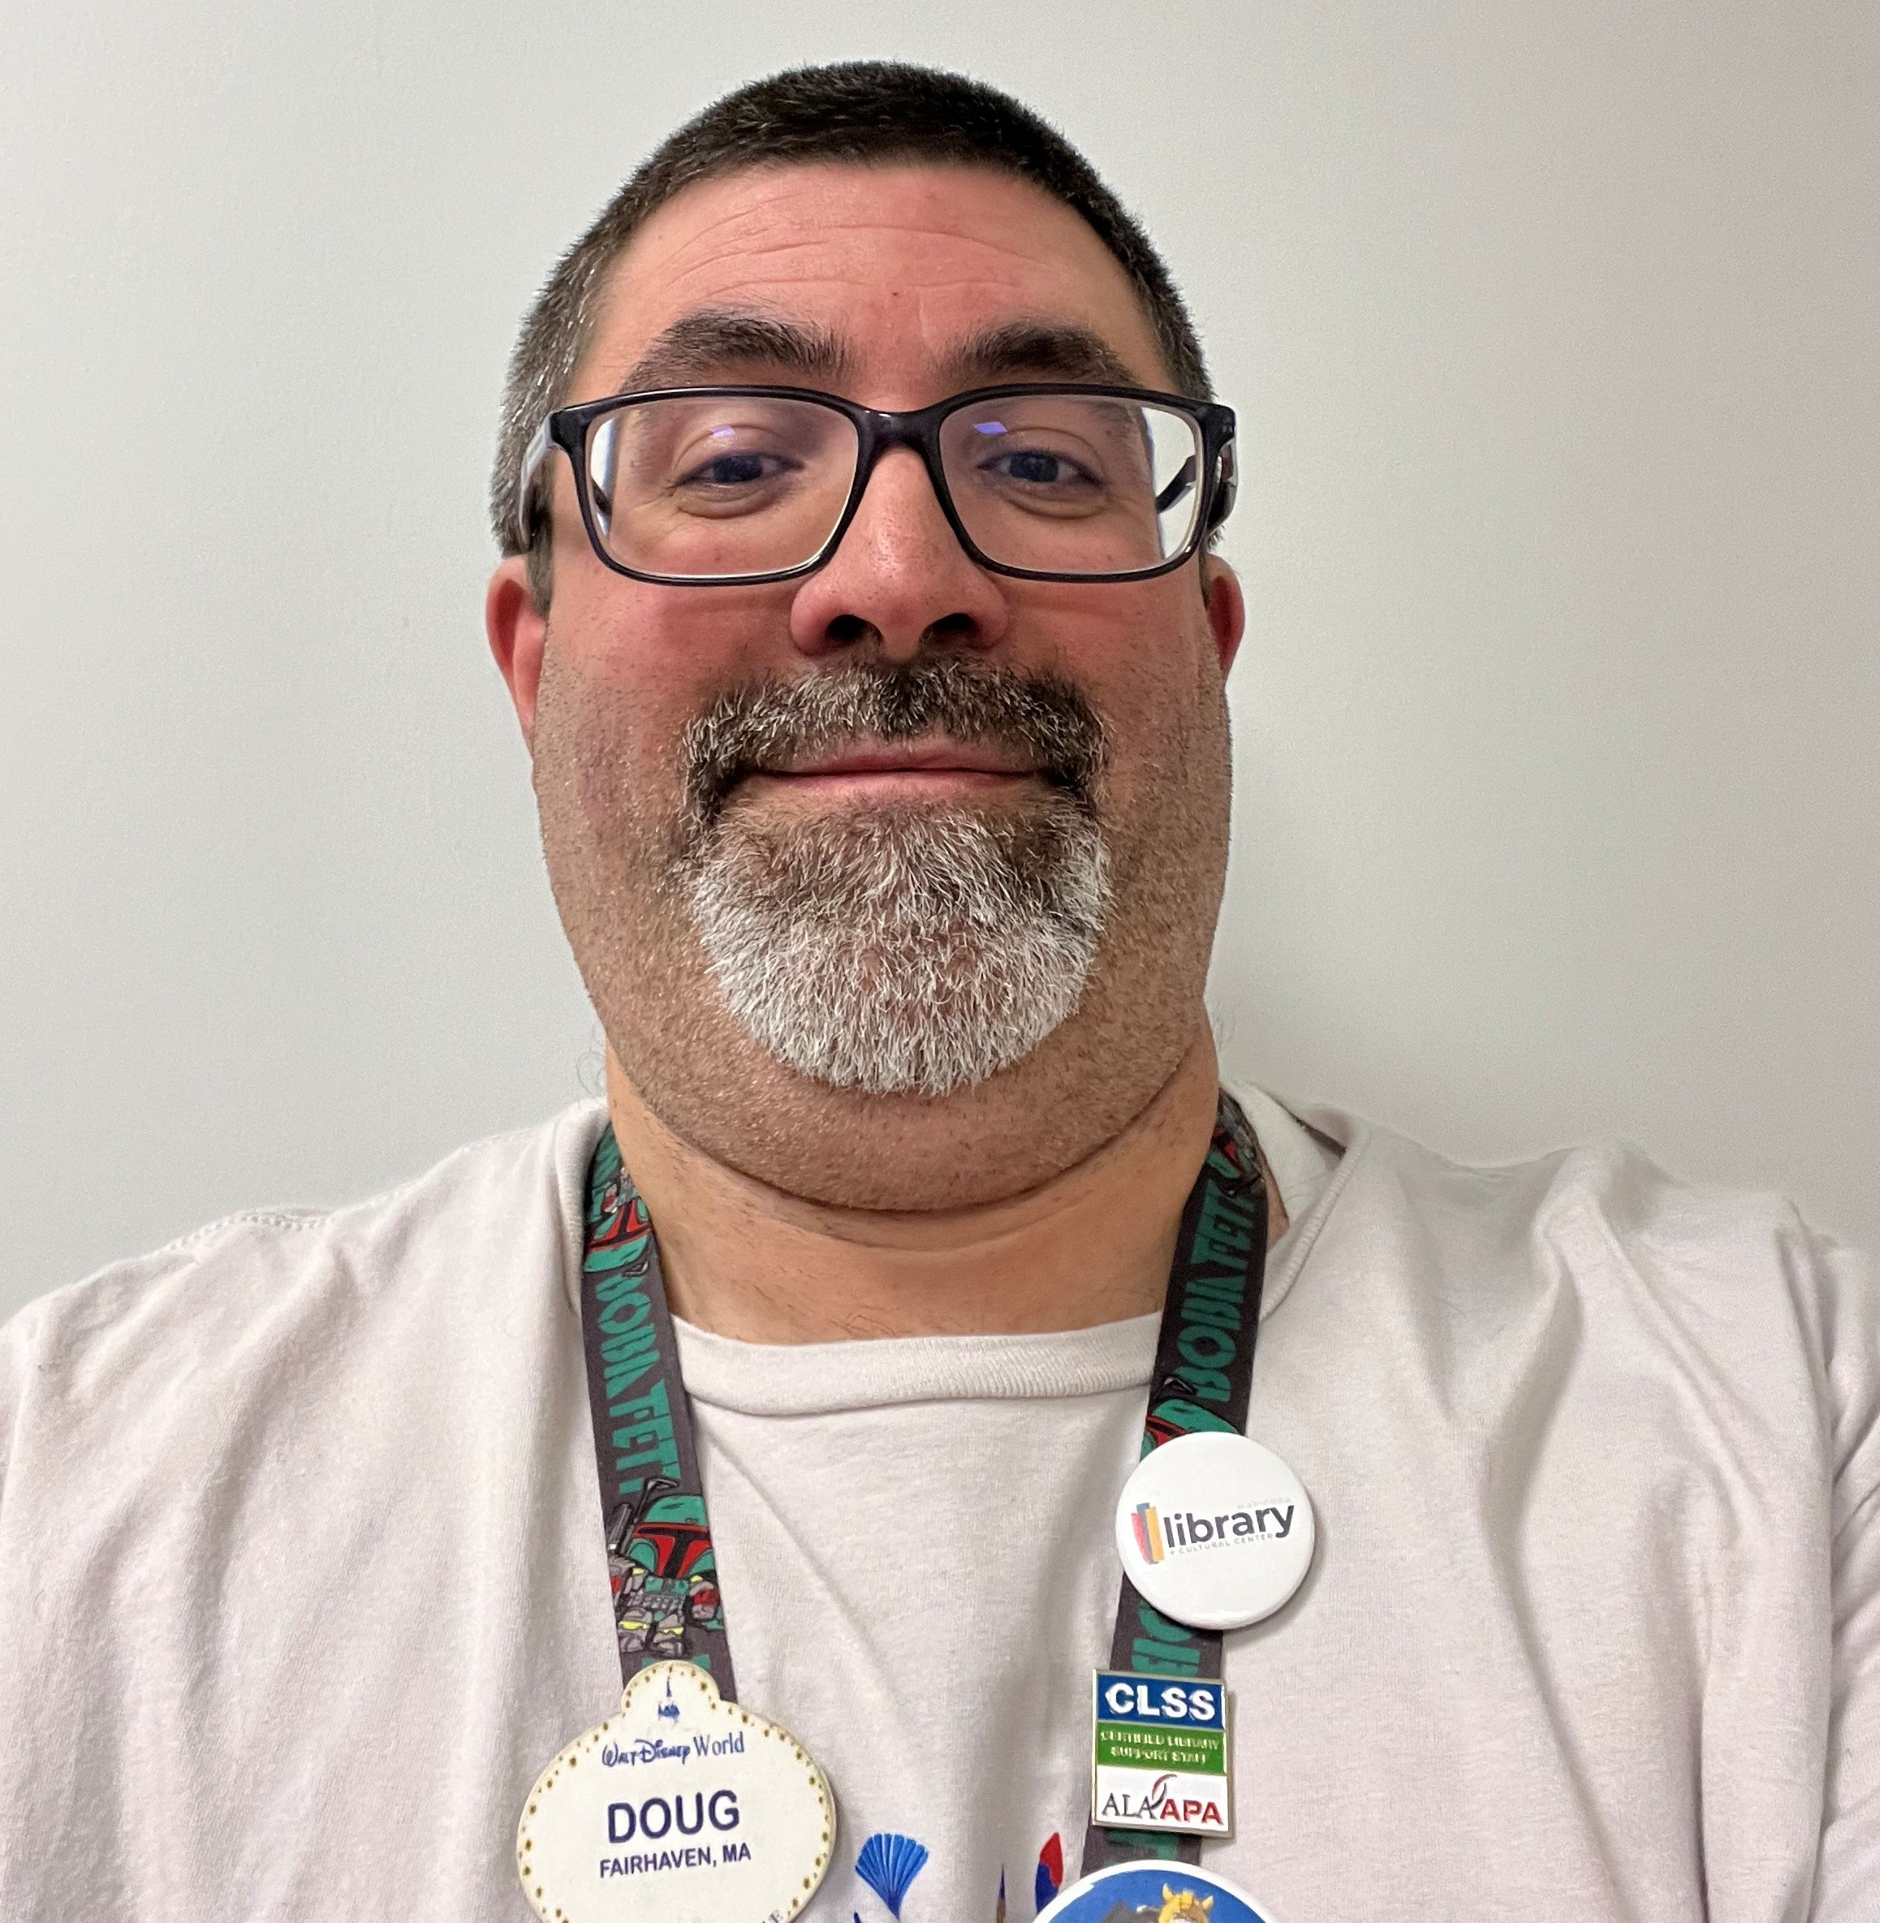
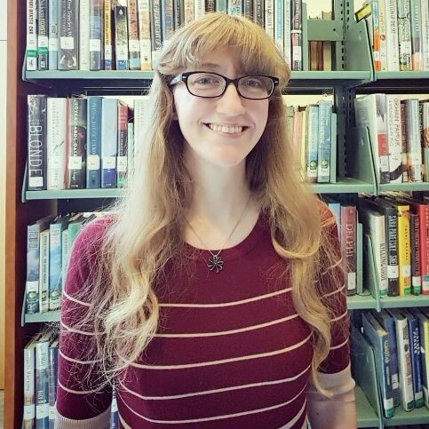
Panelists
Panelists
Molly Creveling, MLIS
Vestal Public Library
Douglas Fortunato
Maricopa Library
Rory Martorana
New Haven Free
Public Library
Tenille Miller, MLS
Rockwall County
Library
Dr. Courtney Tsahalis
Millbrook Library

Slide 4
Resources to use throughout our presentation
Blog post with slides and other resources is available here and in chat:
Do you need additional accommodations?
Please send a private chat to Ariana or raise your hand!
Do you have a question?
We will be monitoring the chat and raised hands throughout the presentation

Slide 5
About Our Projects

Slide 6
N3 Program Goals, 2021-2025
Providing a pathway to NASA participation and STEM employment for neurodiverse learners, with a focus on those on the autism spectrum.
Enabling STEM education for a segment of the population that is significantly underserved by co-redeveloping existing NASA resources with autistic learners.
Improving scientific literacy for this underserved population by providing authentic NASA experiences
Providing internships, mentored by NASA Subject Matter Experts, to selected neurodiverse learners.

Slide 7
Autism Self-Advocacy Movement
“Nothing for us or about us without us”
Autistic people should be included in the development of autism supports
We are co-designing and co-redeveloping existing NASA resources with autistic learners and adults using a strengths-based approach.
The internship program is also being developed with input from autistic youth and young adults.

Slide 8
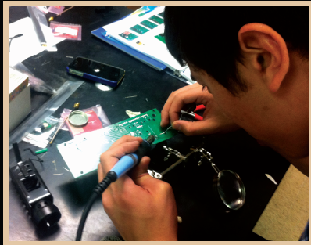
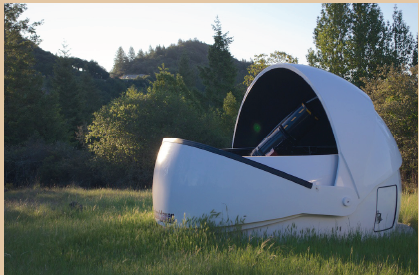
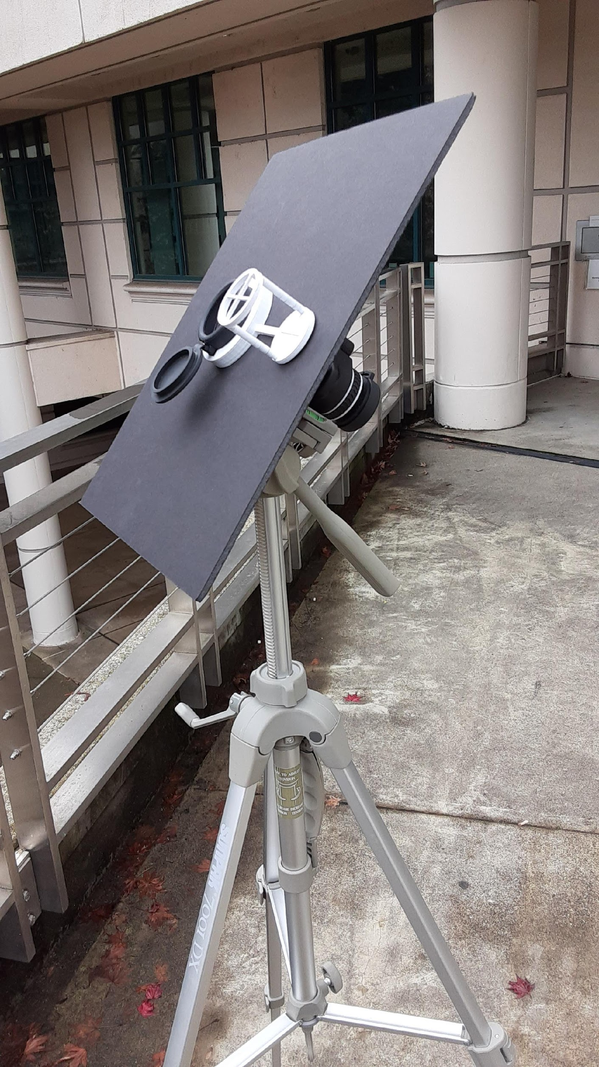
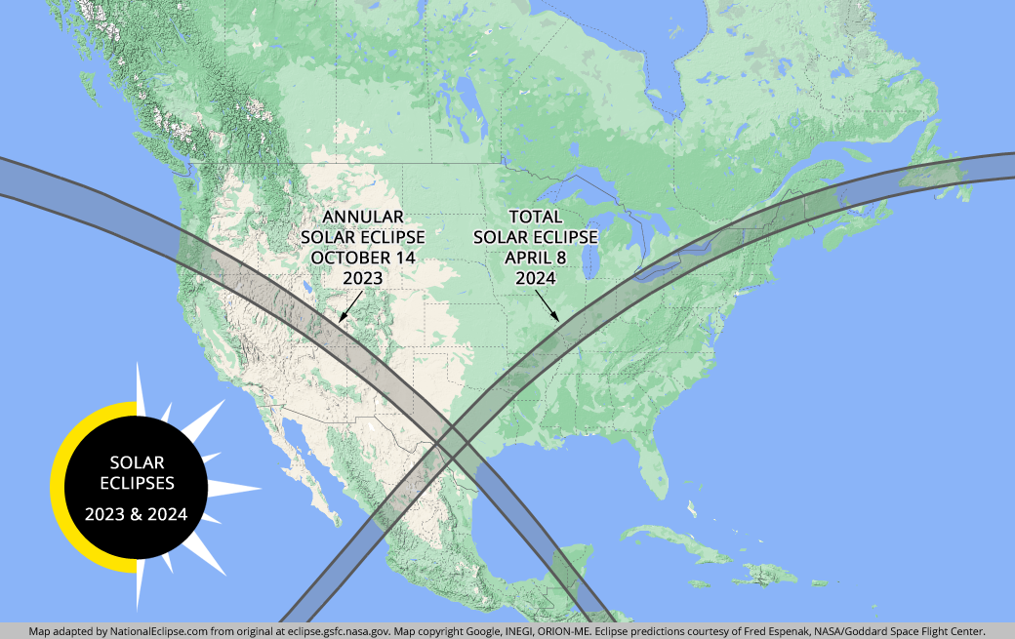
Initial resources targeted for co-redevelopment
2021
Photometry activities on AfH were developed as part of NASA’s Universe of Learning in an informal learning pathway that starts with image analysis using MicroObservatory
2022
Model rocketry and payload development program for URM community college students
2023
Heliophysics activities that include building a sun spotter and getting ready to observe eclipses in 2023 (annular) and 2024 (total) or partials.
Credit: https://nationaleclipse.com/maps/map_2023_2024.html

Slide 9
https://www.starnetlibraries.org
Notes:
NASA Science Mission Directorate education objectives support the Nation’s education efforts to improve science literacy and to inspire the next generation of scientists and engineers. One institution that can accomplish both of these outcomes, for people of all ages and in every region of the country, is our public library system – the central focus of the NASA@ My Library project.

Slide 10
Let’s Connect!
Please use the chat to share your personal experiences with neurodiversity.
Do you have a neurodiverse family member?
Do you identify as neurodiverse/neurodivergent?
What would you like to learn about supporting neurodiverse colleagues?
Share whatever you’re most comfortable with!

Slide 11
What is Neurodiversity?
The diversity or variation of cognitive functioning in people. Everyone has a unique brain and therefore different skills, abilities, and needs.
Examples of Neurodivergence
Autism
Attention-Deficit / Hyperactivity Disorder (ADHD)
Dyslexia
Synesthesia
Dyspraxia
Dyscalculia
Dysgraphia
Depression/Anxiety
Hyperlexia
Tourette's Syndrome
Obsessive-Compulsive Disorder (OCD)
PTSD/CPTSD

Slide 12
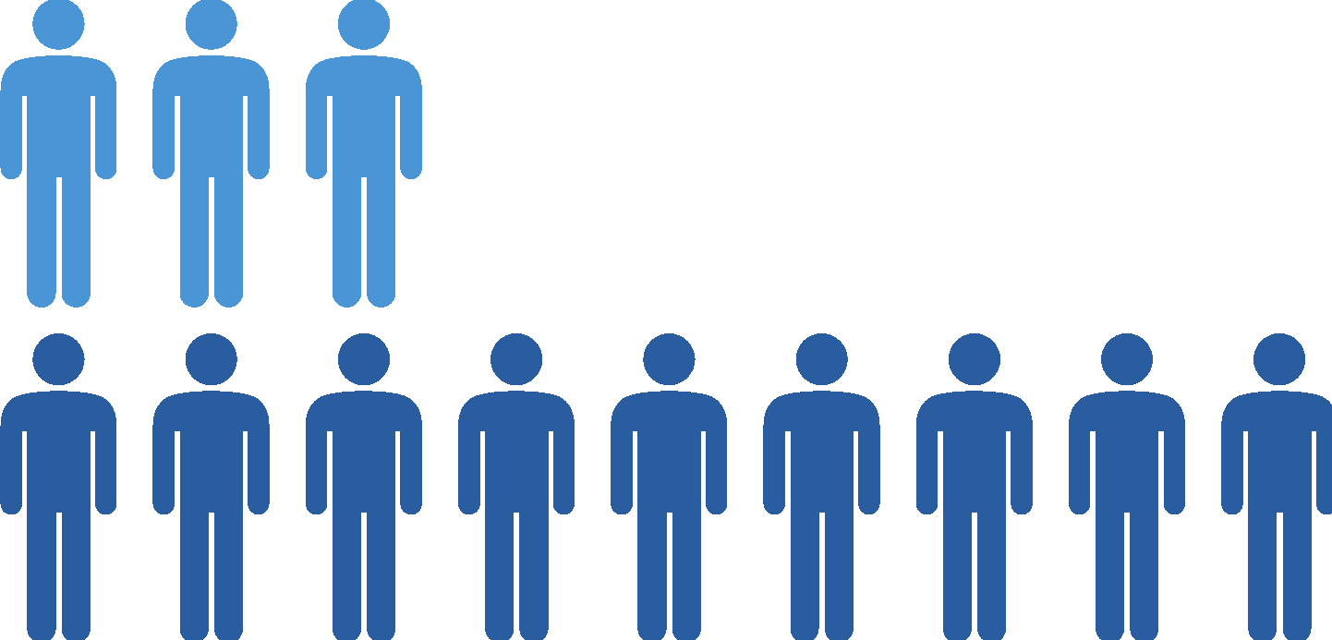
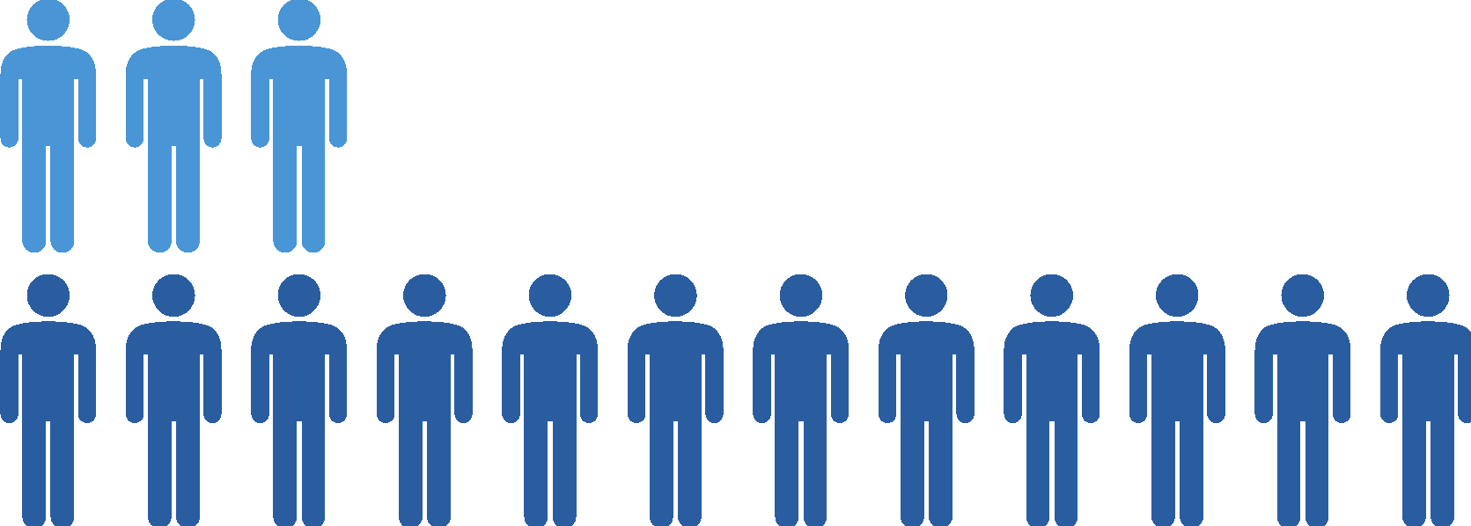
Mental Health Statistics
Anxiety
Depression
Diagnosis is
2 to 3 times higher
Diagnosis is
4 times higher
Suicide
2/3
of us considered
1/3
have attempted

Slide 13
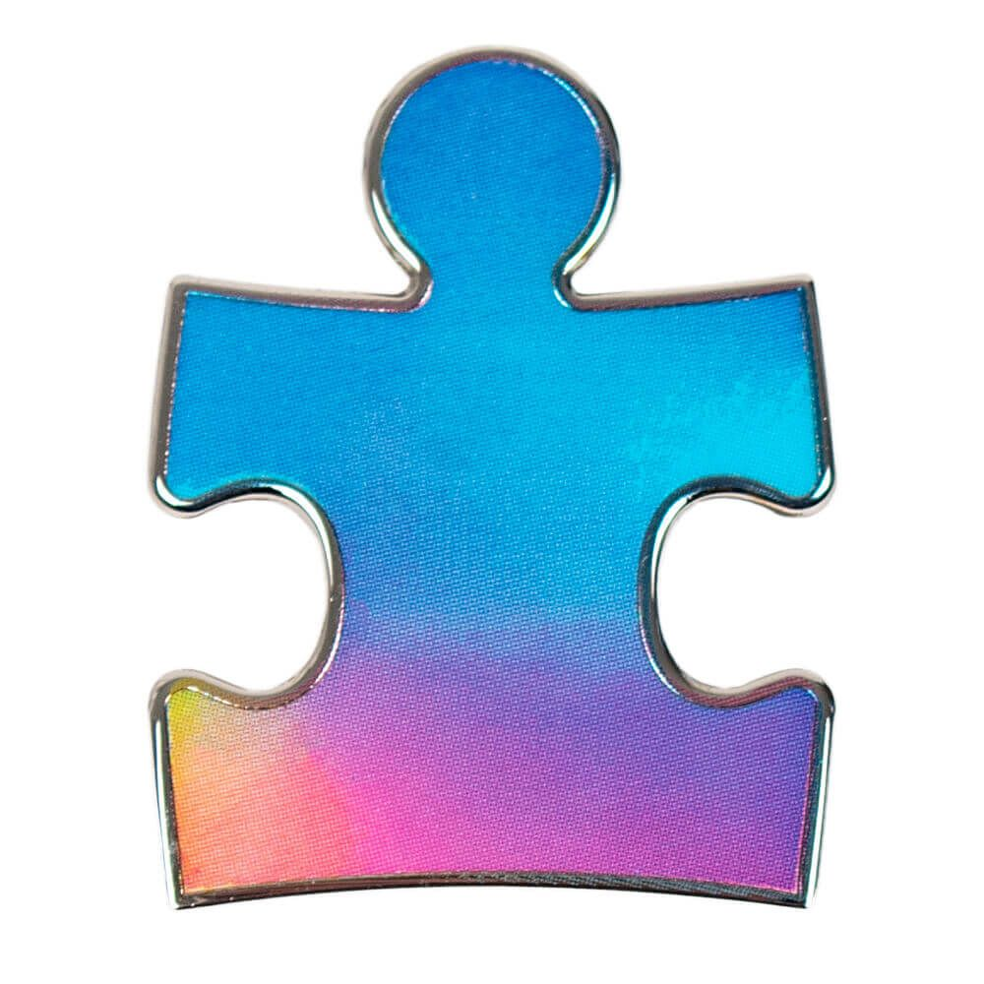
A note about language:
"Autism isn’t something a person has, or a “shell” that a person is trapped inside. There’s no normal child hidden behind the autism. Autism is a way of being. It is pervasive; it colors every experience, every sensation, perception, thought, emotion, and encounter, every aspect of existence. It is not possible to separate the autism from the person–and if it were possible, the person you’d have left would not be the same person you started with.”
- Jim Sinclair (1993)

Slide 14
A note about labels:
Although some autistic people identify as “high-functioning,” many autistic people (and researchers) say it is time to leave the terms “high-functioning” and “low-functioning” behind. Asperger’s Syndrome is another diagnostic term that is no longer used.
These terms are very poorly defined. While some use “functioning” to refer to intelligence, some mean language skills, some mean autism symptoms, and some don’t specify which they mean.
This imprecision can promote the misconception that people who don’t speak struggle to think. This is inaccurate. How all people function varies across contexts.
More informative terms relating to the supports people require such as “high support needs” or “low support needs” can replace these terms.
Sequenzia, 2013

Slide 15
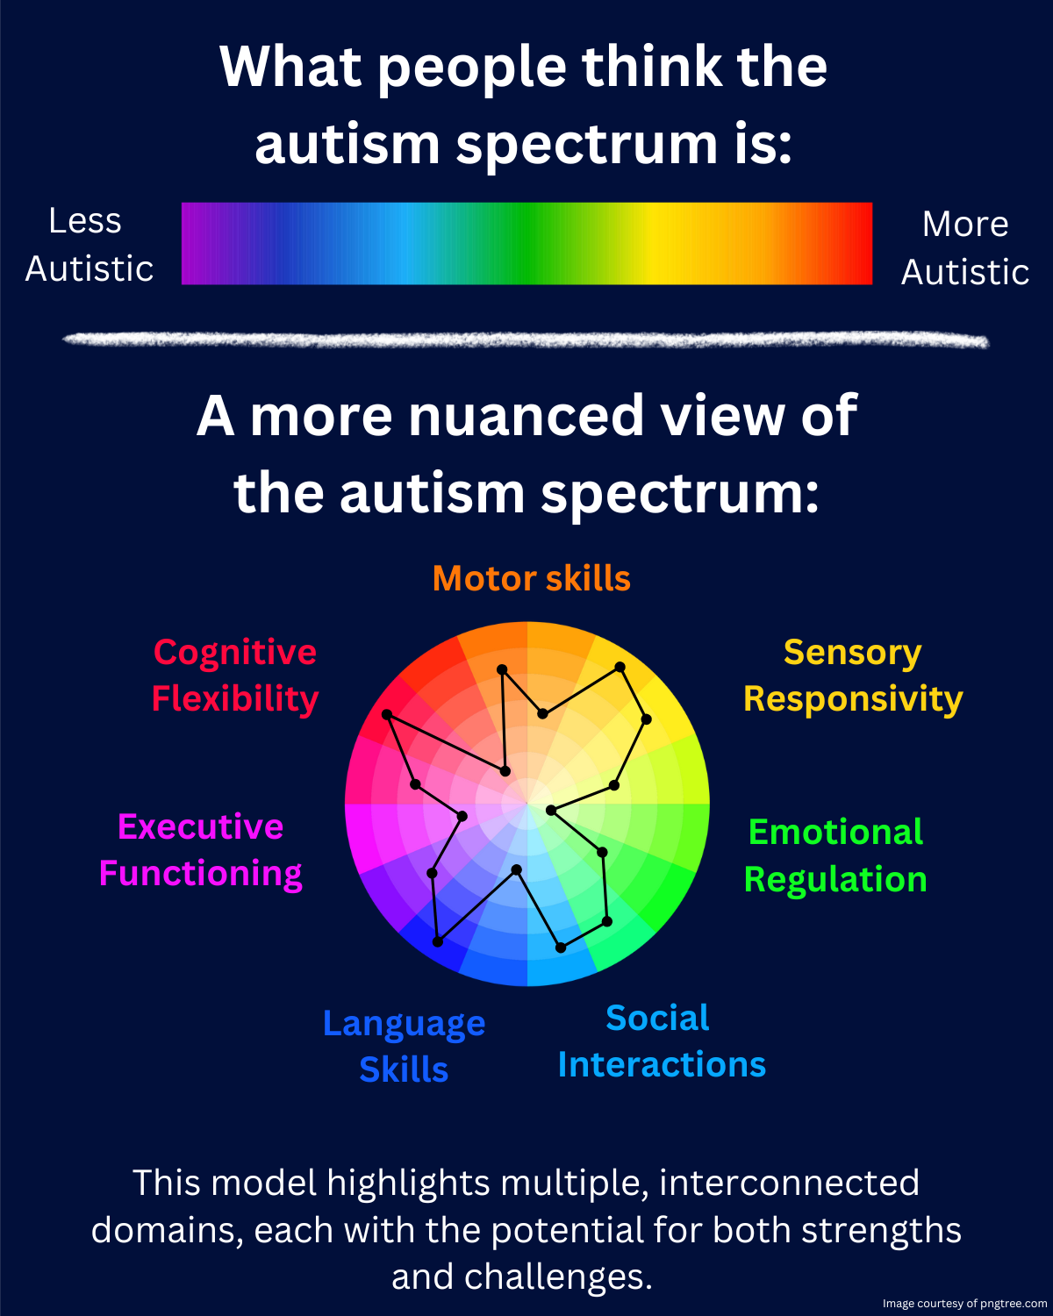

Slide 16
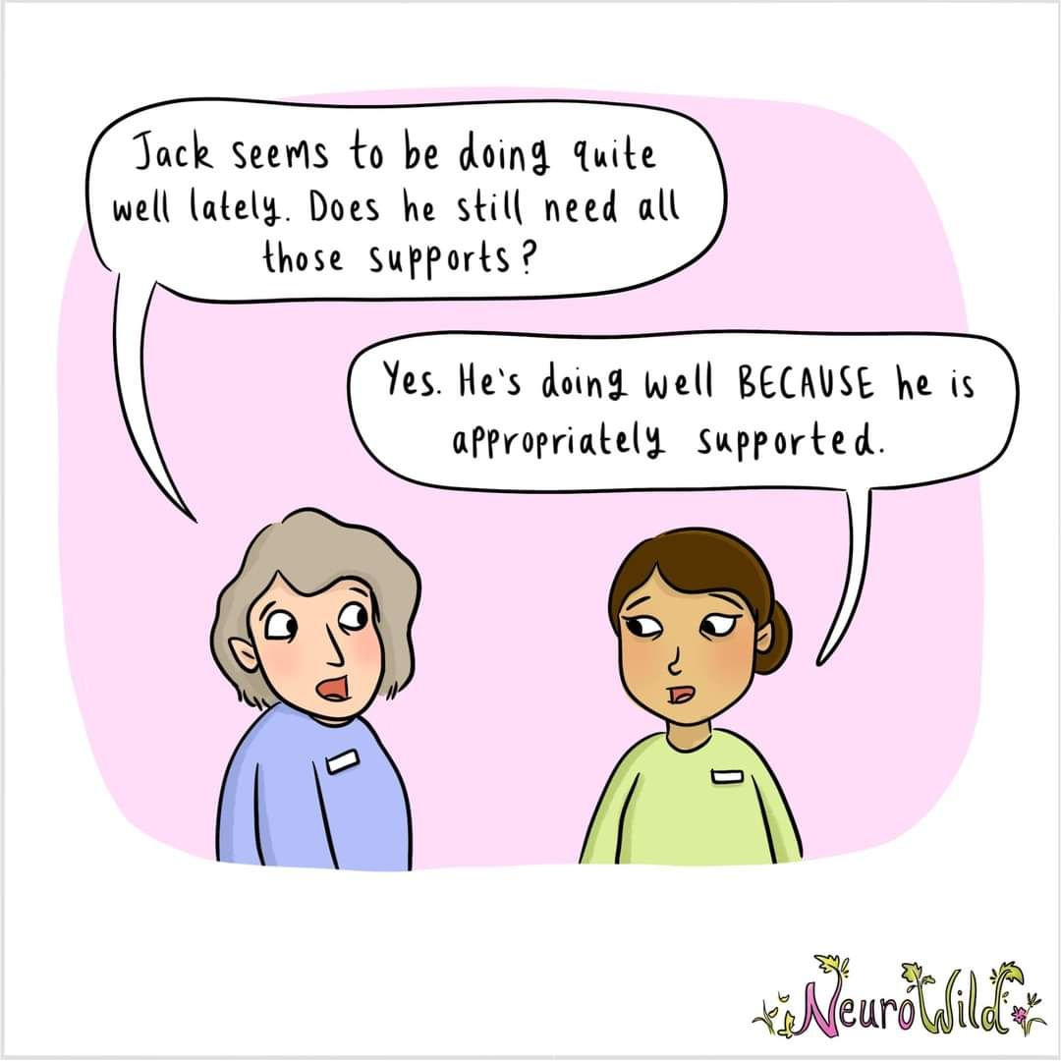

Slide 17
Socialization Differences
Autistic communication prioritizes information
Neurotypical (NT) communication prioritizes social relationships
“If a person's behavior doesn't make sense to you, it is because you are missing a part of their context. It's that simple.”
- Devon Price

Slide 18
Creating a More Inclusive Workspace and Program Space

Slide 19
Supporting Neurodivergent colleagues (and patrons) supports EVERYONE

Slide 20
Tips for working with ND learners
Provide a visual schedule
Prime students and colleagues for what’s to come so they understand the context and process for their learning
Embed interests
Establish clear expectations. Be direct and set guidelines.
Provide supportive visuals and/or other reference materials

Slide 21
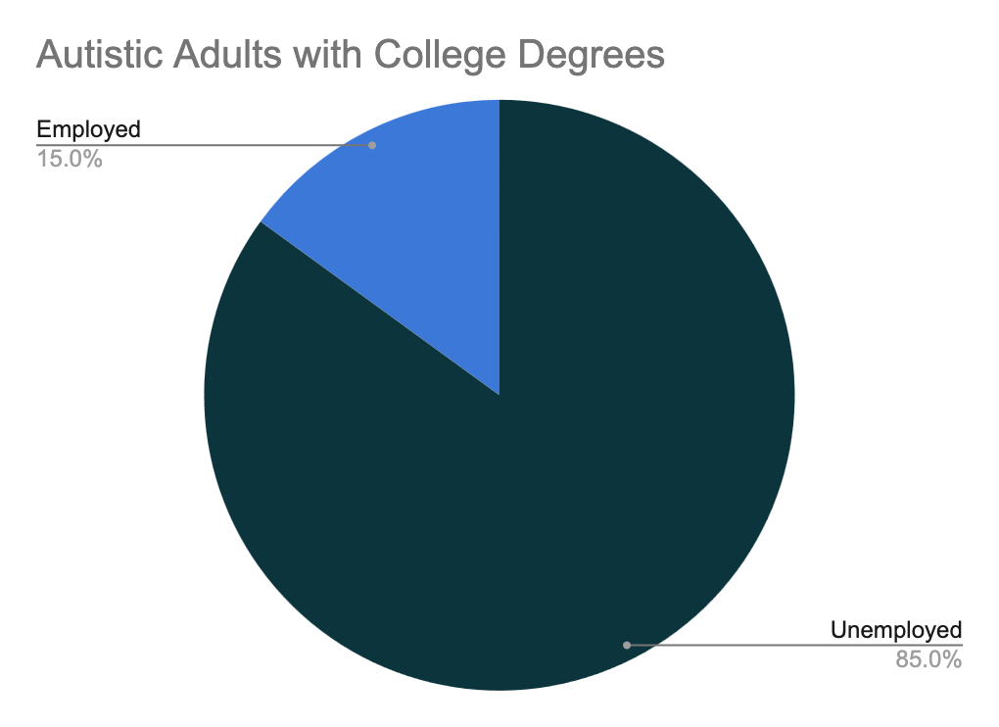
Barriers to Successful Employment
Neurodivergent people who are employed have generally gotten there by masking
Risk of masking
Not healthy or sustainable
Leads to burnout (often dropping out of the workforce)
Unable to contribute to the full extent of ability
Risks of not masking

Slide 22
Creating space for a Neurodiverse team
Understand your organization's policies and speak with HR when appropriate
Review interview processes and performance metrics
Ask
Flexibility
What to do when someone discloses

Slide 23
Basic Etiquette
When someone discloses that they are autistic or neurodivergent
Things NOT to say:
I’m sorry to hear that.
You don’t look ______.
I never would have known / you hide it really well.
No wonder you’re so good at math / why aren’t you better at math.
I have a _____ who’s ______.
Anything about Temple Grandin / Sheldon Cooper / etc.
Anything about Autism Speaks.
We’re all a little autistic.
Notes:
Mention FAQ form here
Additional etiquette

Slide 24
Panelist Breakout Sessions
Panelist | Topic | Room
Anne | Nuts & Bolts of supporting neurodiverse colleagues | Anne
Lynn and Ariana | Lessons Learned from N3 – how you can best support ND learners & their mentors + building a co-designed project for your community | Lynn & Ariana
Molly | Multi-sensory instruction and learning tools: Personal experience as neurodivergent person/librarian. Adapting and running youth programs with neurodiversity in mind. | Molly
Courtney | My research on ADHD: How to support patrons with ADHD at your library | Courtney
Douglas | Adapting existing programs for neurodivergent participants | Douglas
Tenille | Beginning a program: My experience as a teacher and librarian with and advocacy for inclusive education and programming for the neurodivergent population | Tenille
Rory | Ask me anything: ask your questions about neurodivergent people | Rory
Christine and Claire | NASA Stuff: Just chat with us | Stay in main room

Slide 26
In the Chat - Let’s Connect!
Please use the chat to share:
What new information did you learn today?
How might you use this information to create a more inclusive space in your community?

Slide 27
Wrap up and Questions

Slide 28
Thank you!
Prof. Lynn Cominsky, Sonoma State University
lynnc@universe.sonoma.edu
Dr. Ariana Riccio Arista, Education Development Center
aarista@edc.org
This material is based upon work supported by the National Aeronautics and Space Administration under cooperative agreement No. NNX16AE30A. This work was also assisted and supported by the Space Science Institute, which was the recipient of the cooperative agreement. Any opinions, findings, and conclusions or recommendations expressed in this material are those of the author(s) and do not necessarily reflect the views of NASA or the Space Science Institute.
Dr. Anne Holland, Space Science Institute
aholland@spacescience.org
NASA’s Neurodiversity Network materials are based upon work supported by NASA under award number 80NSSC21M0004 to Sonoma State University, working in partnership with the Education Development Center (EDC), the New York Hall of Science, and WestEd. Any opinions, findings, and conclusions or recommendations expressed in this material are those of the author(s) and do not necessarily reflect the views of the National Aeronautics and Space Administration. Contact the N3 team by emailing edeon@sonoma.edu.

