Slide 1
Viewing Eclipses through Cultural Lenses
with Dr. Isabel Hawkins
The webinar will begin at 11 am MT and will be recorded

Slide 2
Agenda
Introduction/Icebreaker
Viewing Eclipses Through Cultural Lenses with Dr. Isabel Hawkins
Resources for Your Library
Q&A

Slide 3
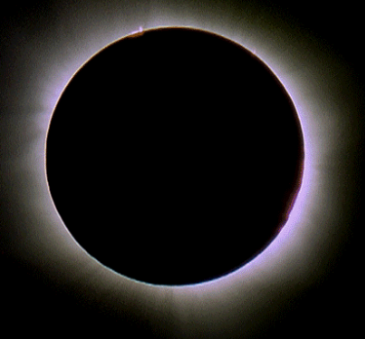
Viewing Eclipses Through Cultural Lenses
Isabel Hawkins, Ph.D.
Astronomer and Senior Scientist Exploratorium, San Francisco, CA
March 12, 2024

Slide 4
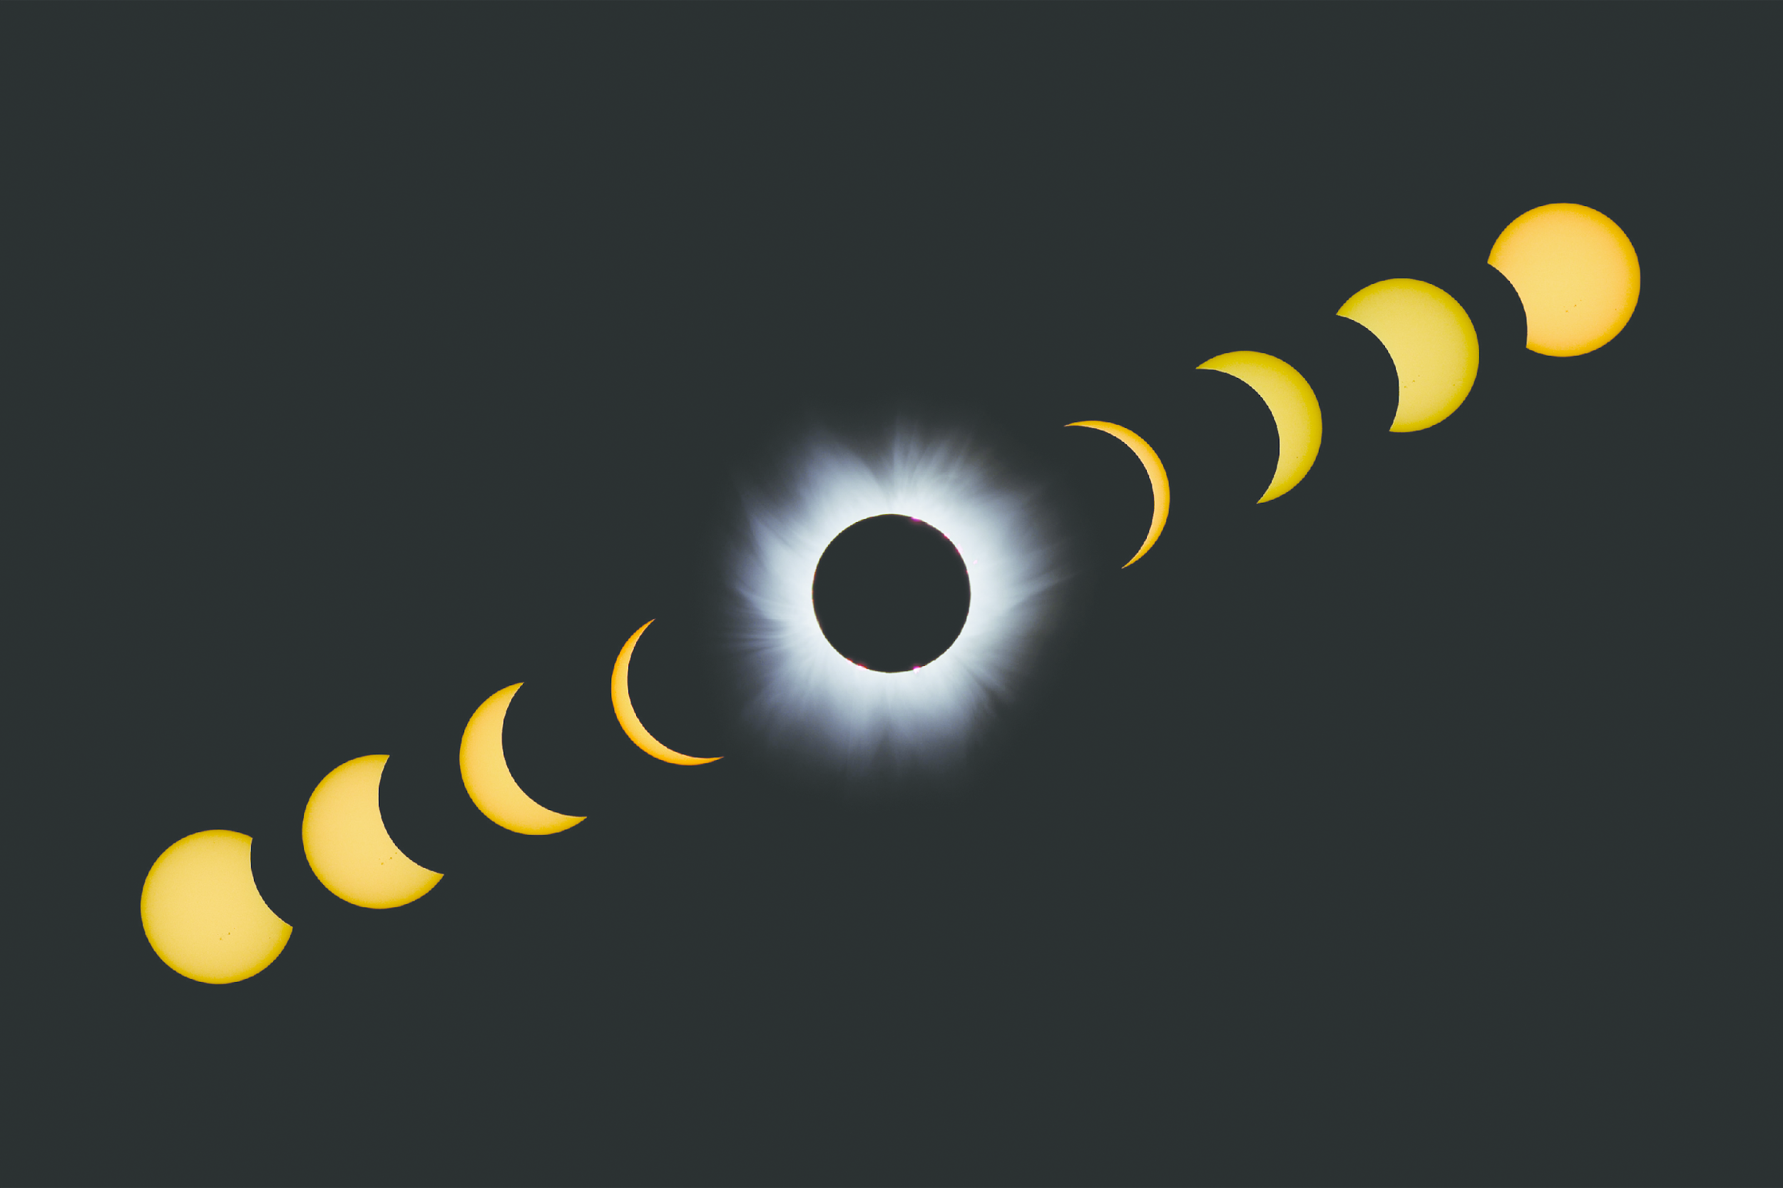
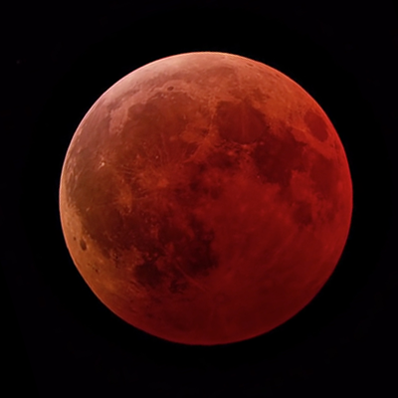
When it comes to eclipses… the experience can mean different things to different people.
Notes:
As you may know by having experienced an eclipse sometime in your lifetime, both lunar and solar eclipse experiences imply different interpretations and meaning, depending on our backgrounds. How we perceive eclipses is culturally dependent.

Slide 5
A few things to remember when working cross-culturally…
Learn about yourselves, your community or communities, and contexts…
by contacting cultural bearers.
Be reciprocal…
with your communities and the Earth.
Understand constraints…
and honor clear expectations for all involved.
Celebrate together…
to affirm collective wellbeing.
Mistakes will be made… If you make a mistake, apologize, learn from it, and keep up the good work.
Notes:
Working cross-culturally is not a contact sport, it is a life-long journey. The images and stories I am about to share are the result of more than 20 years of sustained collaborative work with Indigenous partners. I will share with you the knowledge that they have shared with me and given me permission to disseminate.
But cultural work is nuanced. There are people who will not be comfortable with me sharing *any* cultural knowledge no matter what. And then, others will be comfortable. The main thing is to be honest about your values and embody the recommendations in this slide with integrity.
What’s important, from my perspective, is to be continually guided by the cross-cultural collaborations that I am able to sustain over the years. It takes time, and it is important to continue the work beyond eclipses or other time-bound events.

Slide 6
Lunar Eclipse
Notes:
Lunar eclipses are safe to view with the naked eye. Please note how red the fully eclipsed Moon looks in this telescope image of a total lunar eclipse.

Slide 7
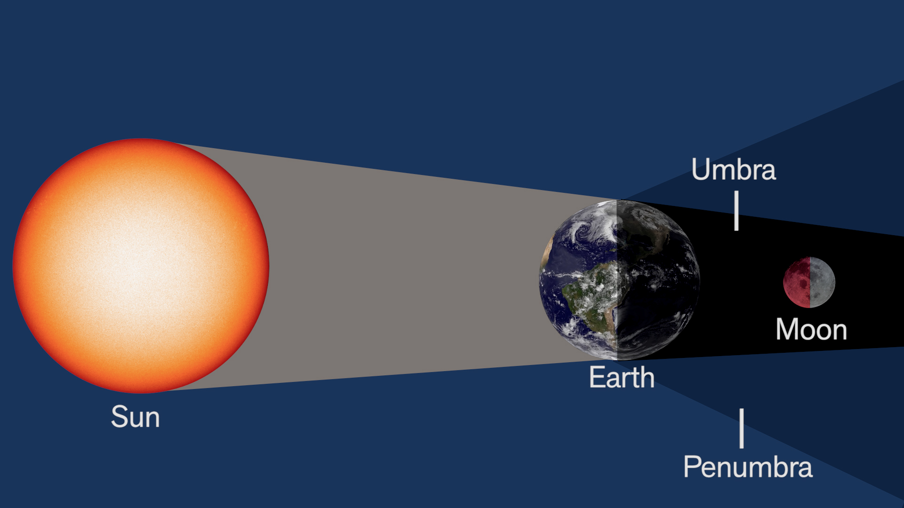
Lunar Eclipse
Notes:
What causes a lunar eclipse?
A lunar eclipse happens when Earth is directly between the Moon and Sun. Earth blocks the light coming from the Sun, casting a shadow on the Moon. The shadow makes the Moon appear much dimmer and sometimes turns the lunar surface a striking red. The Moon appears read because the Earth’s atmosphere refracts the solar rays and the red light of sunsets from all around the Earth fall on the Moon. Lunar eclipses can be seen from entire hemispheres (the dark side of the Earth).

Slide 8
Solar Eclipse

Slide 9
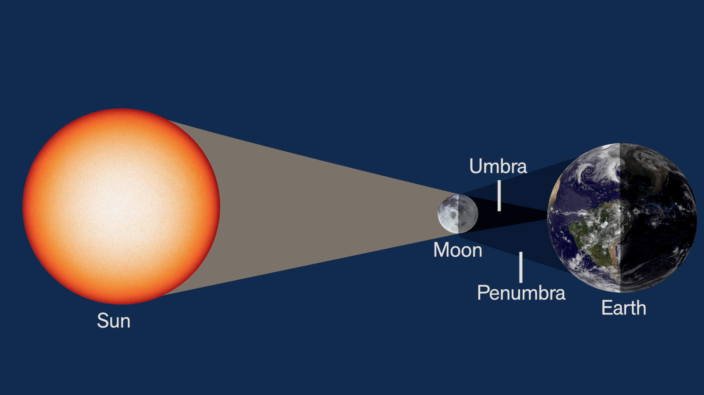
Solar Eclipse
Notes:
What causes a solar eclipse? A solar eclipse occurs when the Moon passes between the Sun and Earth, casting the moon's shadow on Earth. This only happens occasionally, because the moon doesn't orbit in the exact same plane as the Sun and Earth do. The orbit of the Moon is tilted 5 degrees with respect to the orbit of the Earth around the Sun.

Slide 10
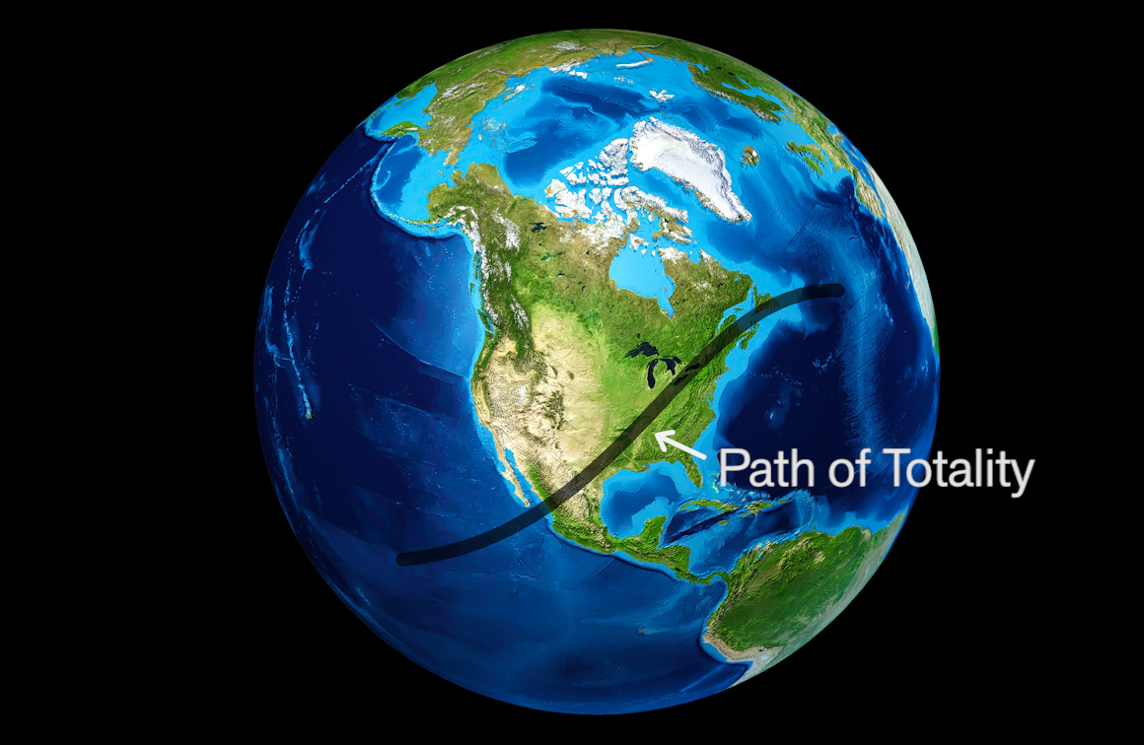
Solar Eclipse
April 8, 2024
Notes:
On April 8, 2024, there will be a total solar eclipse in the Northern Hemisphere. Totality will only be visible in this thin swath called the “Path of Totality” – if you are outside this path, you will experience a partial solar eclipse.

Slide 11
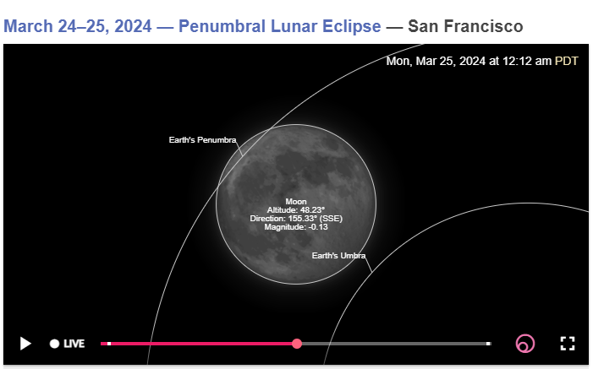
Image credit: timeanddate.com
Notes:
There is a penumbral lunar eclipse coming up March 24-25. It is the lunar eclipse that is paired with the April 8th total solar eclipse coming up later in the year. Solar and lunar eclipses come in pairs, but they are not always both total eclipses. Following the March 24-25 and April 8 eclipses, the next pair of eclipses falls on September 17-18 and October 2. The first pair of eclipses in 2025 are on March 13-14 (total lunar eclipse) and March 29 (partial solar eclipse).
The paths of the Sun and the Moon on the celestial sphere cross each other at an angle of about 5 degrees and have two intersections. When both the Sun and the Moon move near the intersection at the same time, two bodies are almost on the same line in space, the Moon will block the Sun as seen from the Earth causing a solar eclipse. Similarly, the Earth's shadow is cast on the Moon when the Earth is in the middle of the Sun and the Moon near the intersection, causing a lunar eclipse.

Slide 12
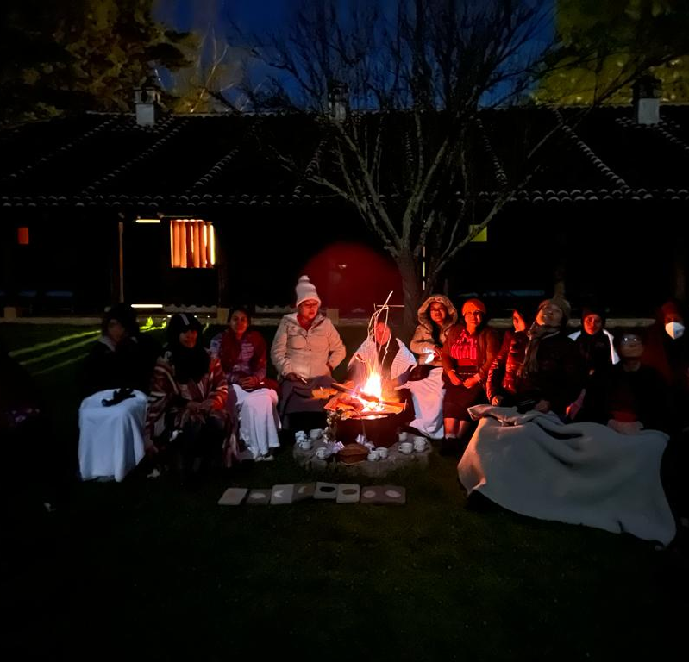
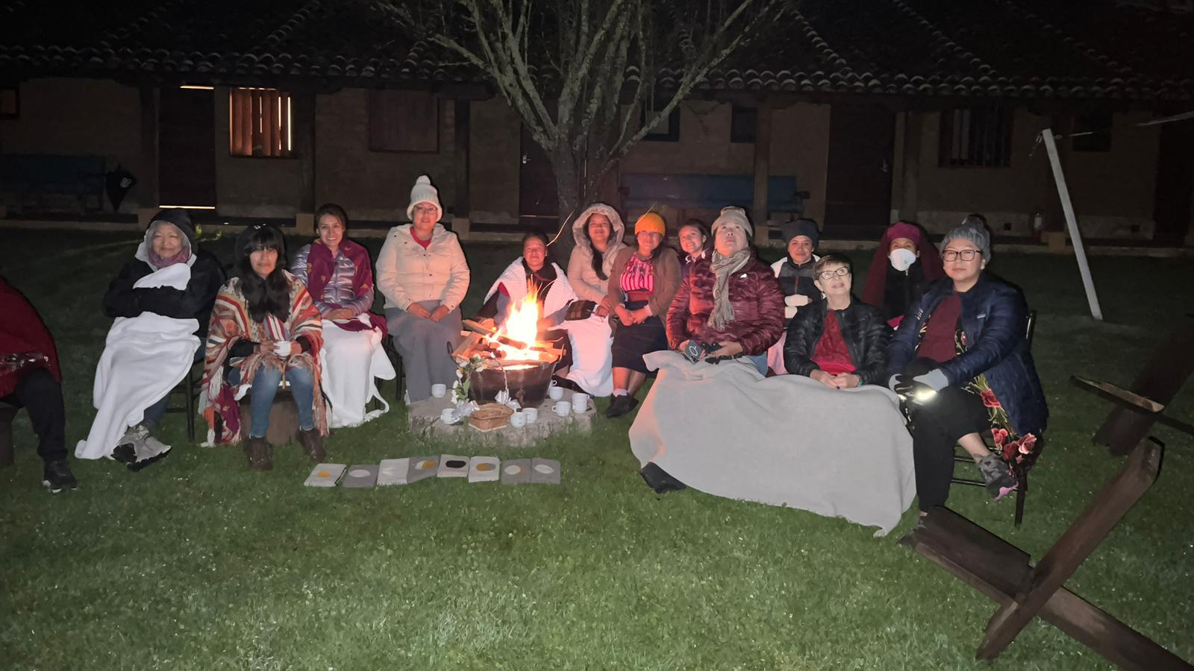
Mother Moon participants observing the total lunar eclipse of Nov 8, 2022
Notes:
Let me share with you an experience of observing a lunar eclipse on Nov 8, 2022, with a group of Indigenous women that belong to the “Mother Moon” project of an organization I volunteer for. We were in Chiapas, Mexico to observe the eclipse, with participants from Pueblos of NM, Navajo Nation, Zapotec women from Oaxaca, Mexico, and Maya women from Guatemala, Yucatan, and Chiapas, as well as non-Indigenous women astronomers. The participants followed their own cultural protocols and perspectives to observe the eclipse– some of them choosing not to view it during certain times and utilizing their own traditions.

Slide 13
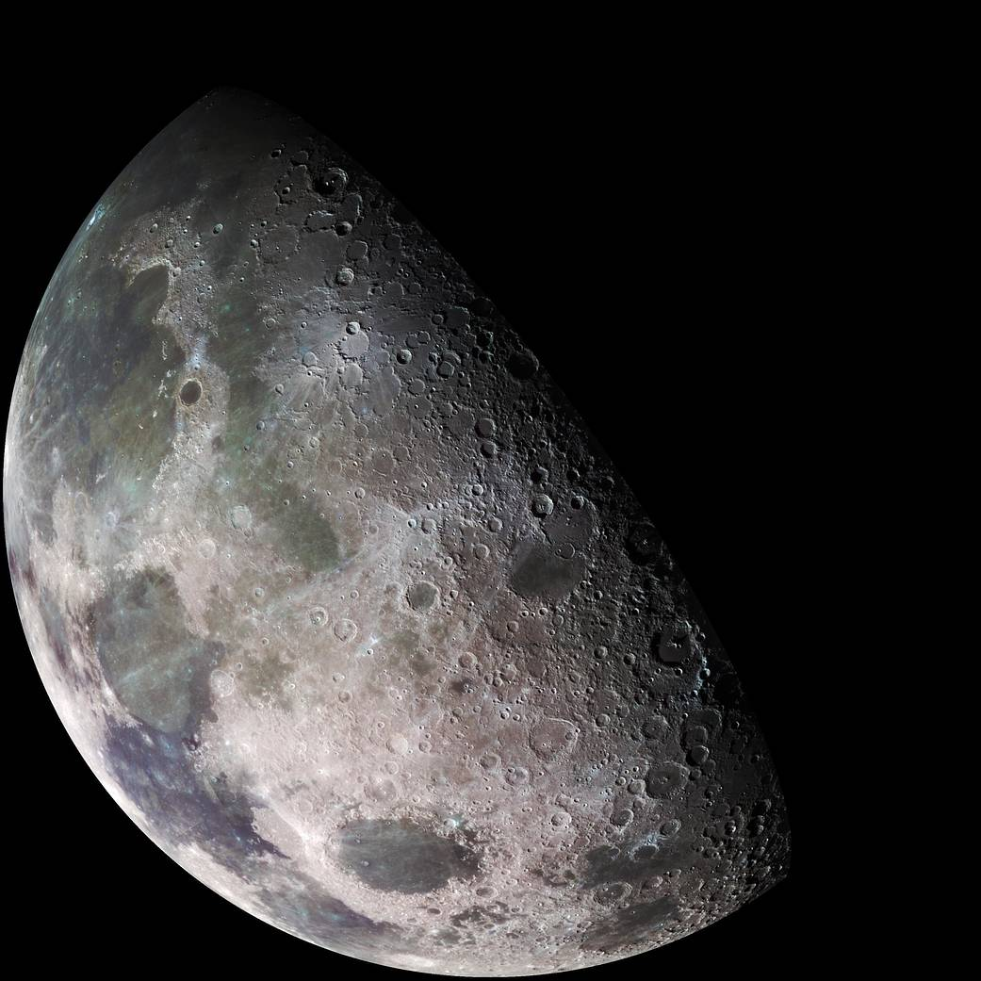
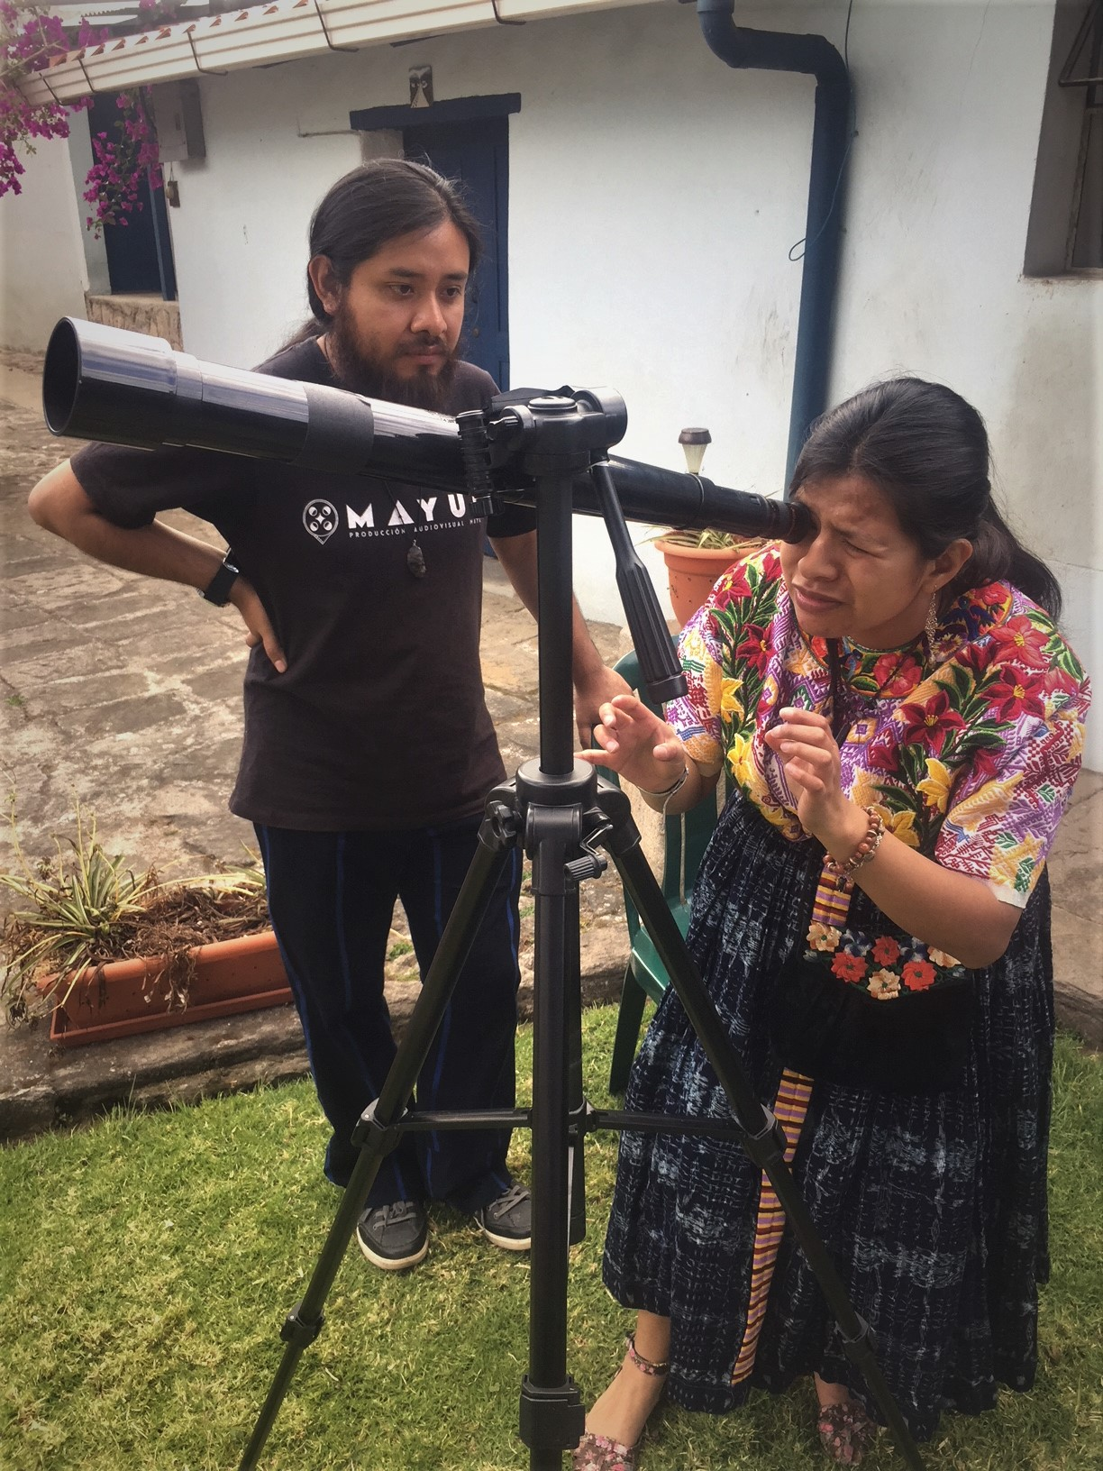
Observing the Moon during the day at the Ki’kotemal Maya Community School in Guatemala
Never Observe the Sun with a telescope or binoculars unless they have special solar filters – you can burn a hole in your retina!
Notes:
EYE SAFETY MESSAGE! Never look at the Sun directly with your naked eye. It can cause irreversible eye damage.
I have also collaborated with Maya colleagues in Guatemala on observation workshops, especially observing the Moon with various technologies, but starting with our own eyes! The Moon is most apparent in the sky at night, but as I am sure many of you have experienced, the Moon is also visible during the day. The Moon is safe to observe with a telescope or binoculars during day or night, since the light of the Moon is not harmful to the human eye. Each cultural group decides how and when to observe the Moon following their own cultural protocols.
In many cultures, the phases of the Moon guide cycles of plants and trees for food, construction, healing, and medicine.

Slide 14
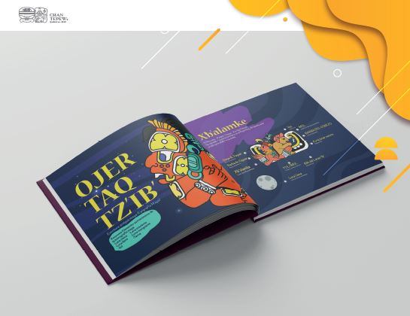
K’iche’ Mayan Language Astronomy Books for Children Written by K’iche’ Maya People
Notes:
This is an example of how people are using multilingual resources to enhance the experience of eclipses in their own communities. This is a book written in the K’iche’ Mayan language.

Slide 15
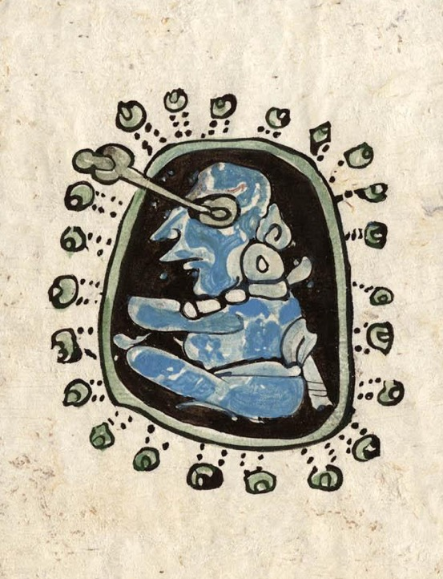
Maya Astronomer
Notes:
The Maya astronomical legacy is well known around the world. I have spent more than twenty years doing collaborative research with Maya community knowledge holders, scientists both young adults and elders from Mexico and Guatemala.
Their astronomical knowledge is expressed through sky traditions that are alive today and held in their historical legacy, native languages, ancestral cities, and cultural protocols.
This is a figure from the Madrid Codex, a Maya pre-Columbian book. It depicts what most scholars interpret as a star gazer, or Maya astronomer, a female. The image vividly depicts a deep connection between humans and the stars.

Slide 16
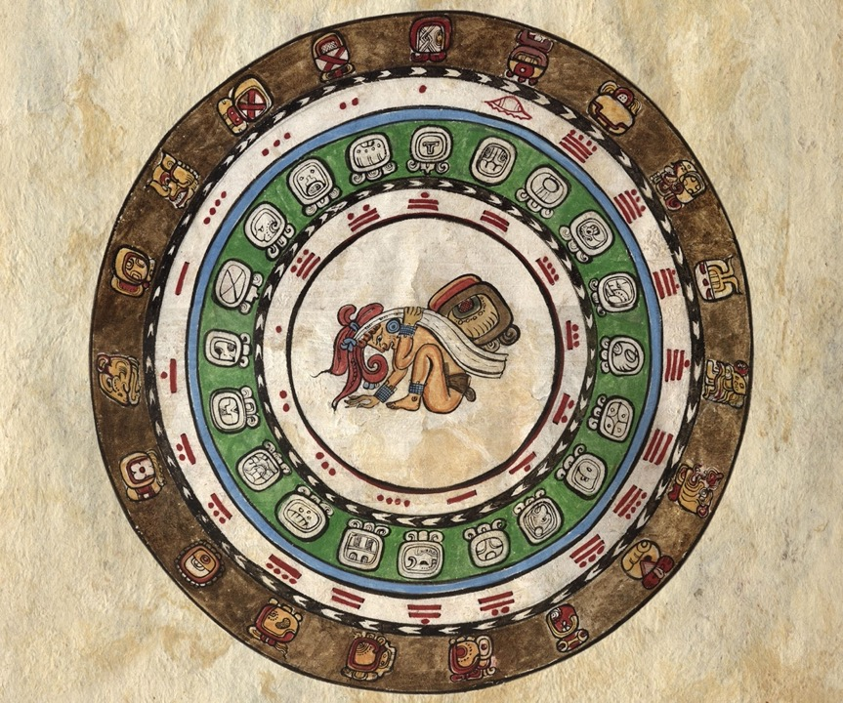
Maya Calendars
Notes:
Image of the agricultural and ceremonial Maya Calendar systems. More than 20 calendars are still curated today by Maya people in Mesoamerica.

Slide 17
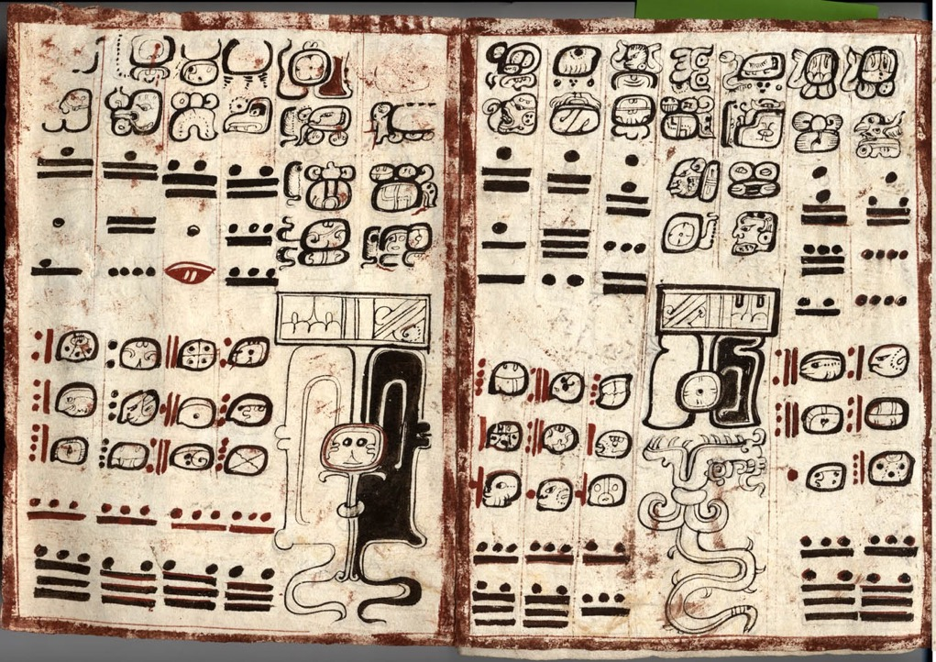
Maya Eclipse Tables
Notes:
Image of the eclipse tables in the Dresden Codex. (Lunar eclipse on the left, solar eclipse on the right).

Slide 18
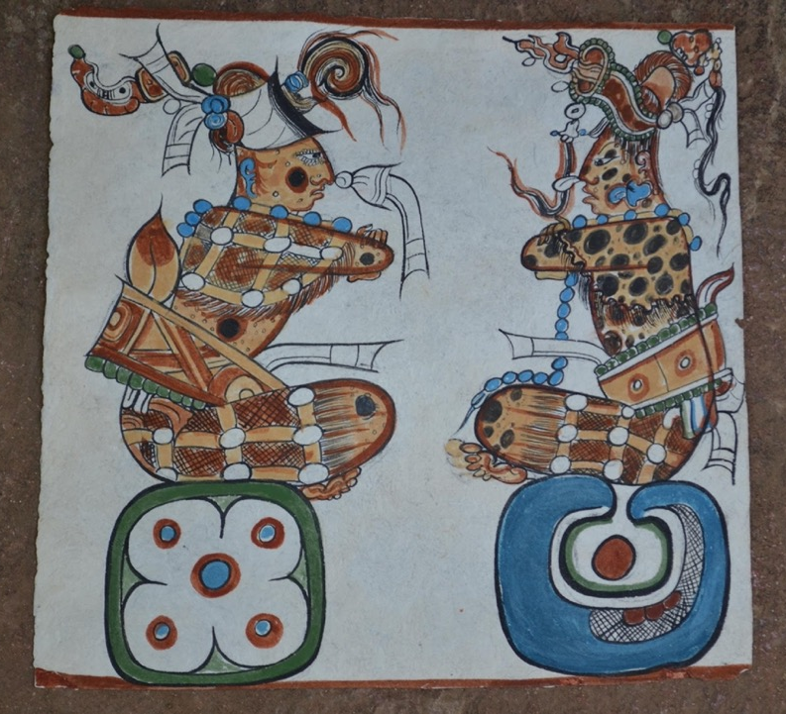
The Sun and the Moon in the Popol Vuj Maya Origin Story
Notes:
The relationship between the Sun and the Moon is acknowledged in the Popol Vuj, the Maya origin story.

Slide 19
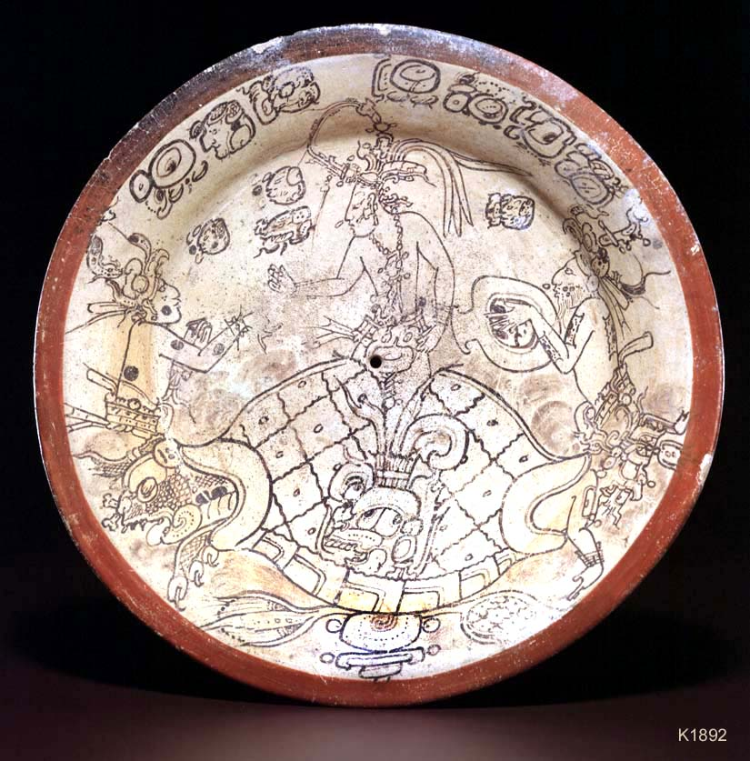
A Maya Funerary Plate is an Astronomical Chart
Notes:
Amplifying our perspective of where and how astronomy knowledge is curated cross-culturally. Example of this “Creation Plate” housed at the Boston Museum of Art; A Maya classic period earthenware plate. This image is from Justin Kerr’s Mayavase.com website.
Explain the scene. The funerary context is through the “ritual killing” of the plate’s function.

Slide 20
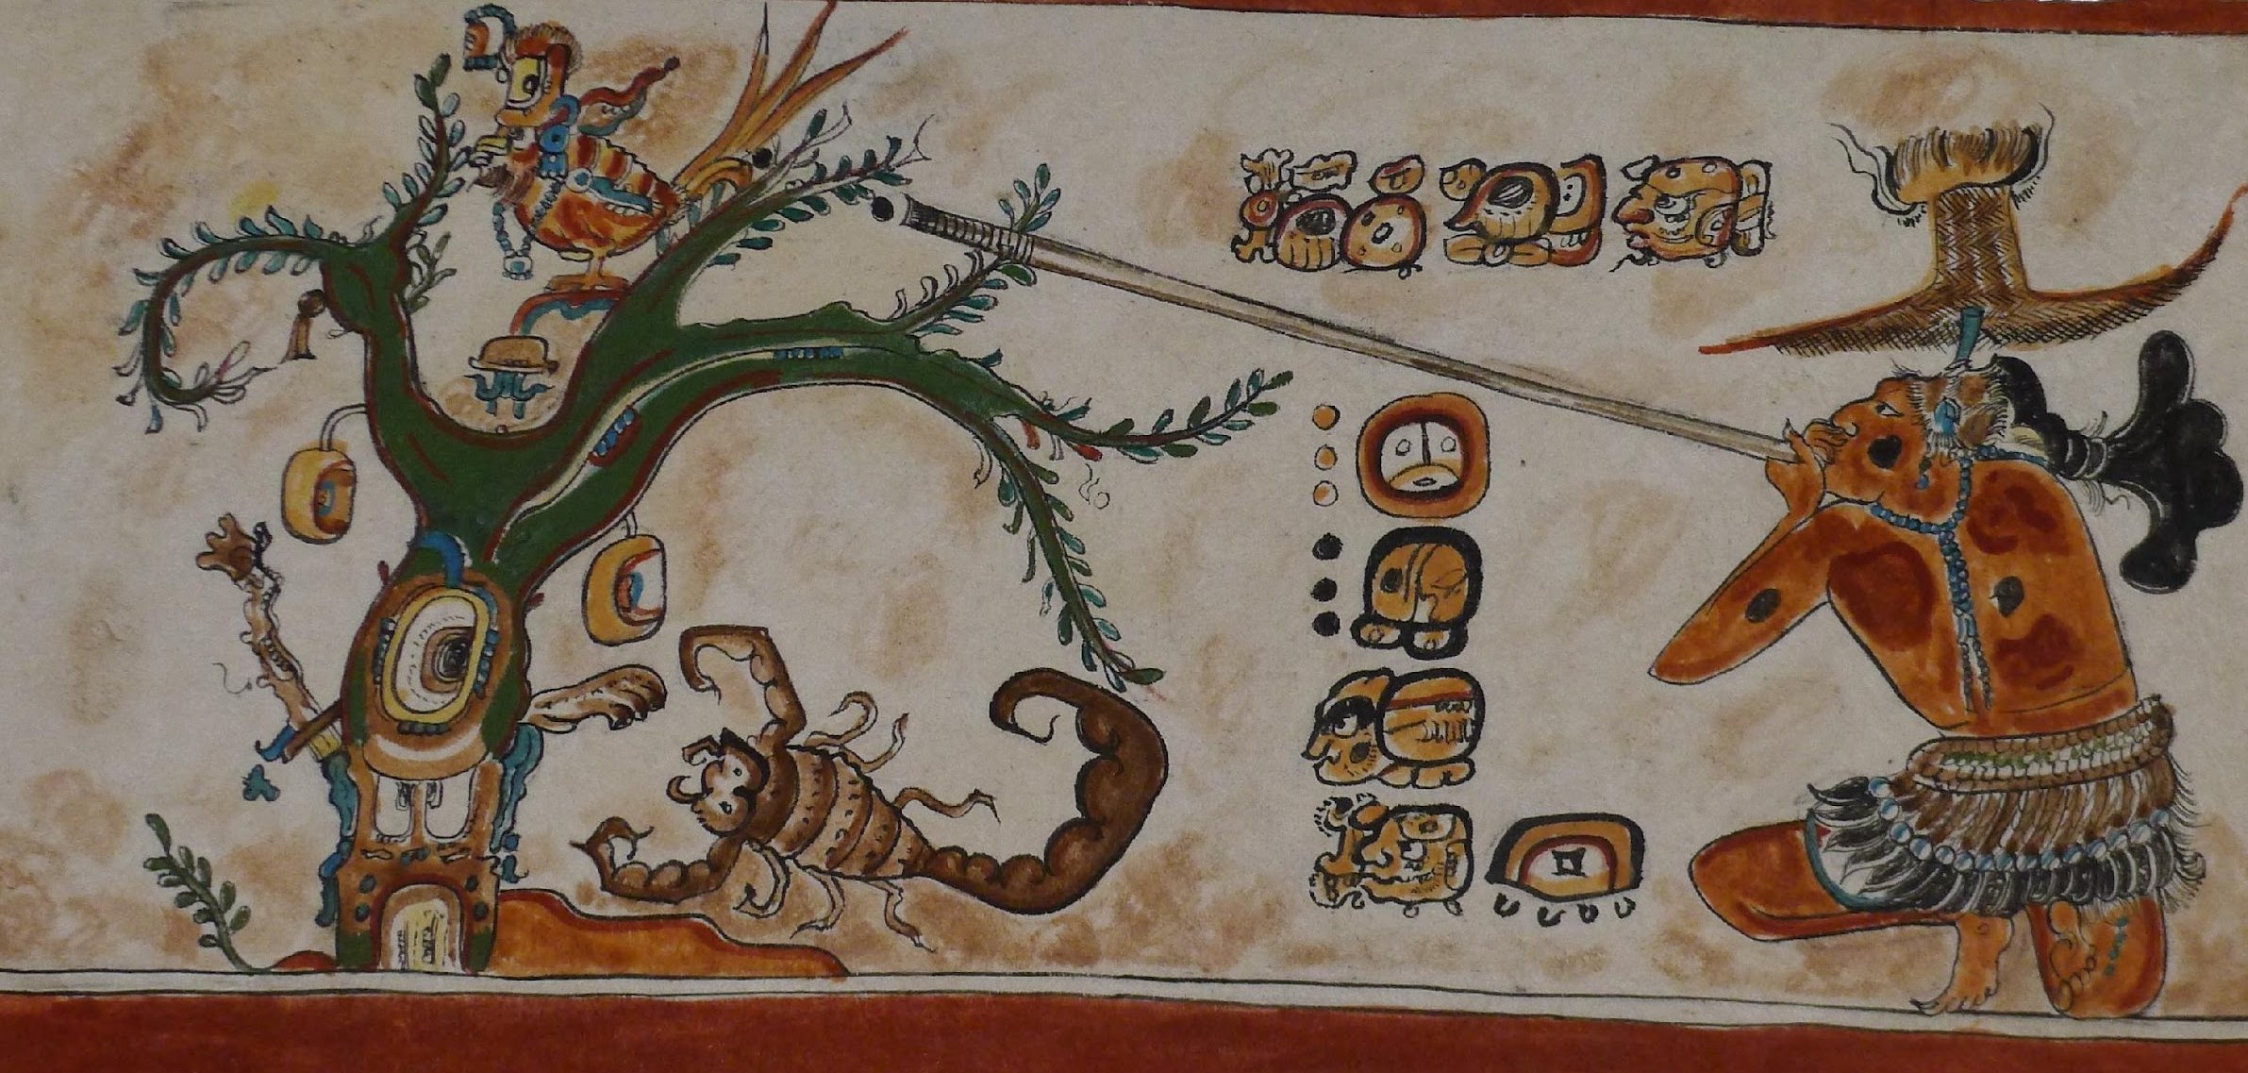
A Maya Vase is an Astronomical Chart
Notes:
Here is another example….
Image is by Patricia Martin Morales, Yucatec Maya, Mexico. Explain the scene and astronomical meaning.

Slide 21
Notes:
A total solar eclipse is one of the most memorable experiences of my life. I have seen two so far in person (Turkey in 2006 and Casper, WY in 2017), but I have experienced many others through the Exploratorium’s live eclipse transmissions in partnership with NASA Heliophysics Division, since 1998. I look forward to seeing the total solar eclipse on April 8th this year from Texas, where our eclipse team will be located.

Slide 22
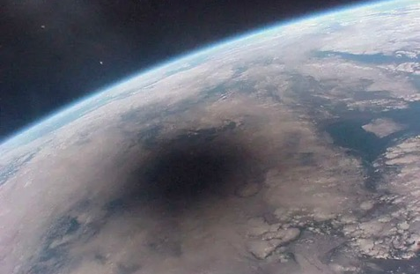
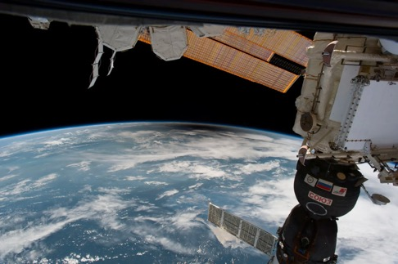
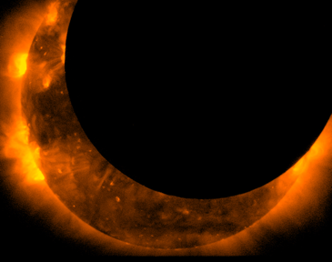
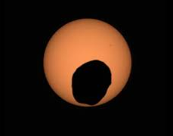
Notes:
I also want to share with you a few solar eclipse views as seen using various technologies:
From space in Earth’s orbit:
International space station
Mir space station
Hinode spacecraft, May 2012
Ground based telescope on Earth’s surface
Mars Perseverance sees solar eclipse, as its moon Phobos crosses in front of the Sun in Aug 2022

Slide 23
Look up!
View indirectly or with protection
View indirectly or with protection
Notes:
Let’s talk about eye safety. During a total solar eclipse, and only during totality, when the Moon completely covers the brilliant photosphere of the Sun, we can look up at the fully eclipsed Sun and see the corona. It is safe to do so because the corona is only as bright as the full Moon so it cannot hurt our eyes. During partial phases of a solar eclipse, and during an annular eclipse, which is a partial eclipse after all, we should never look up at the Sun without proper eye protection.

Slide 24
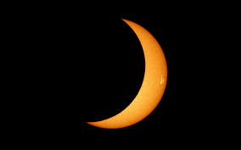
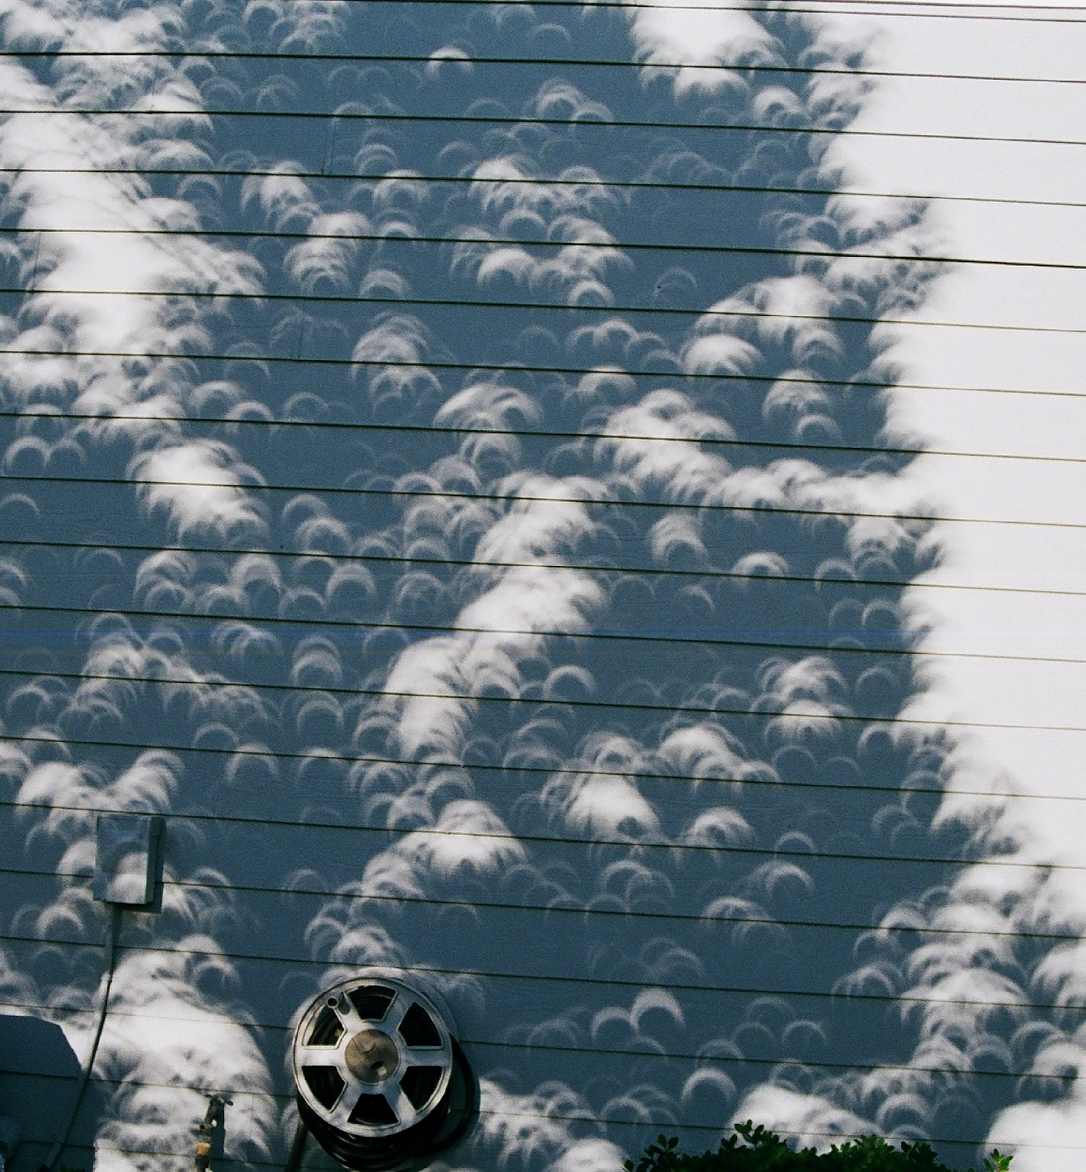
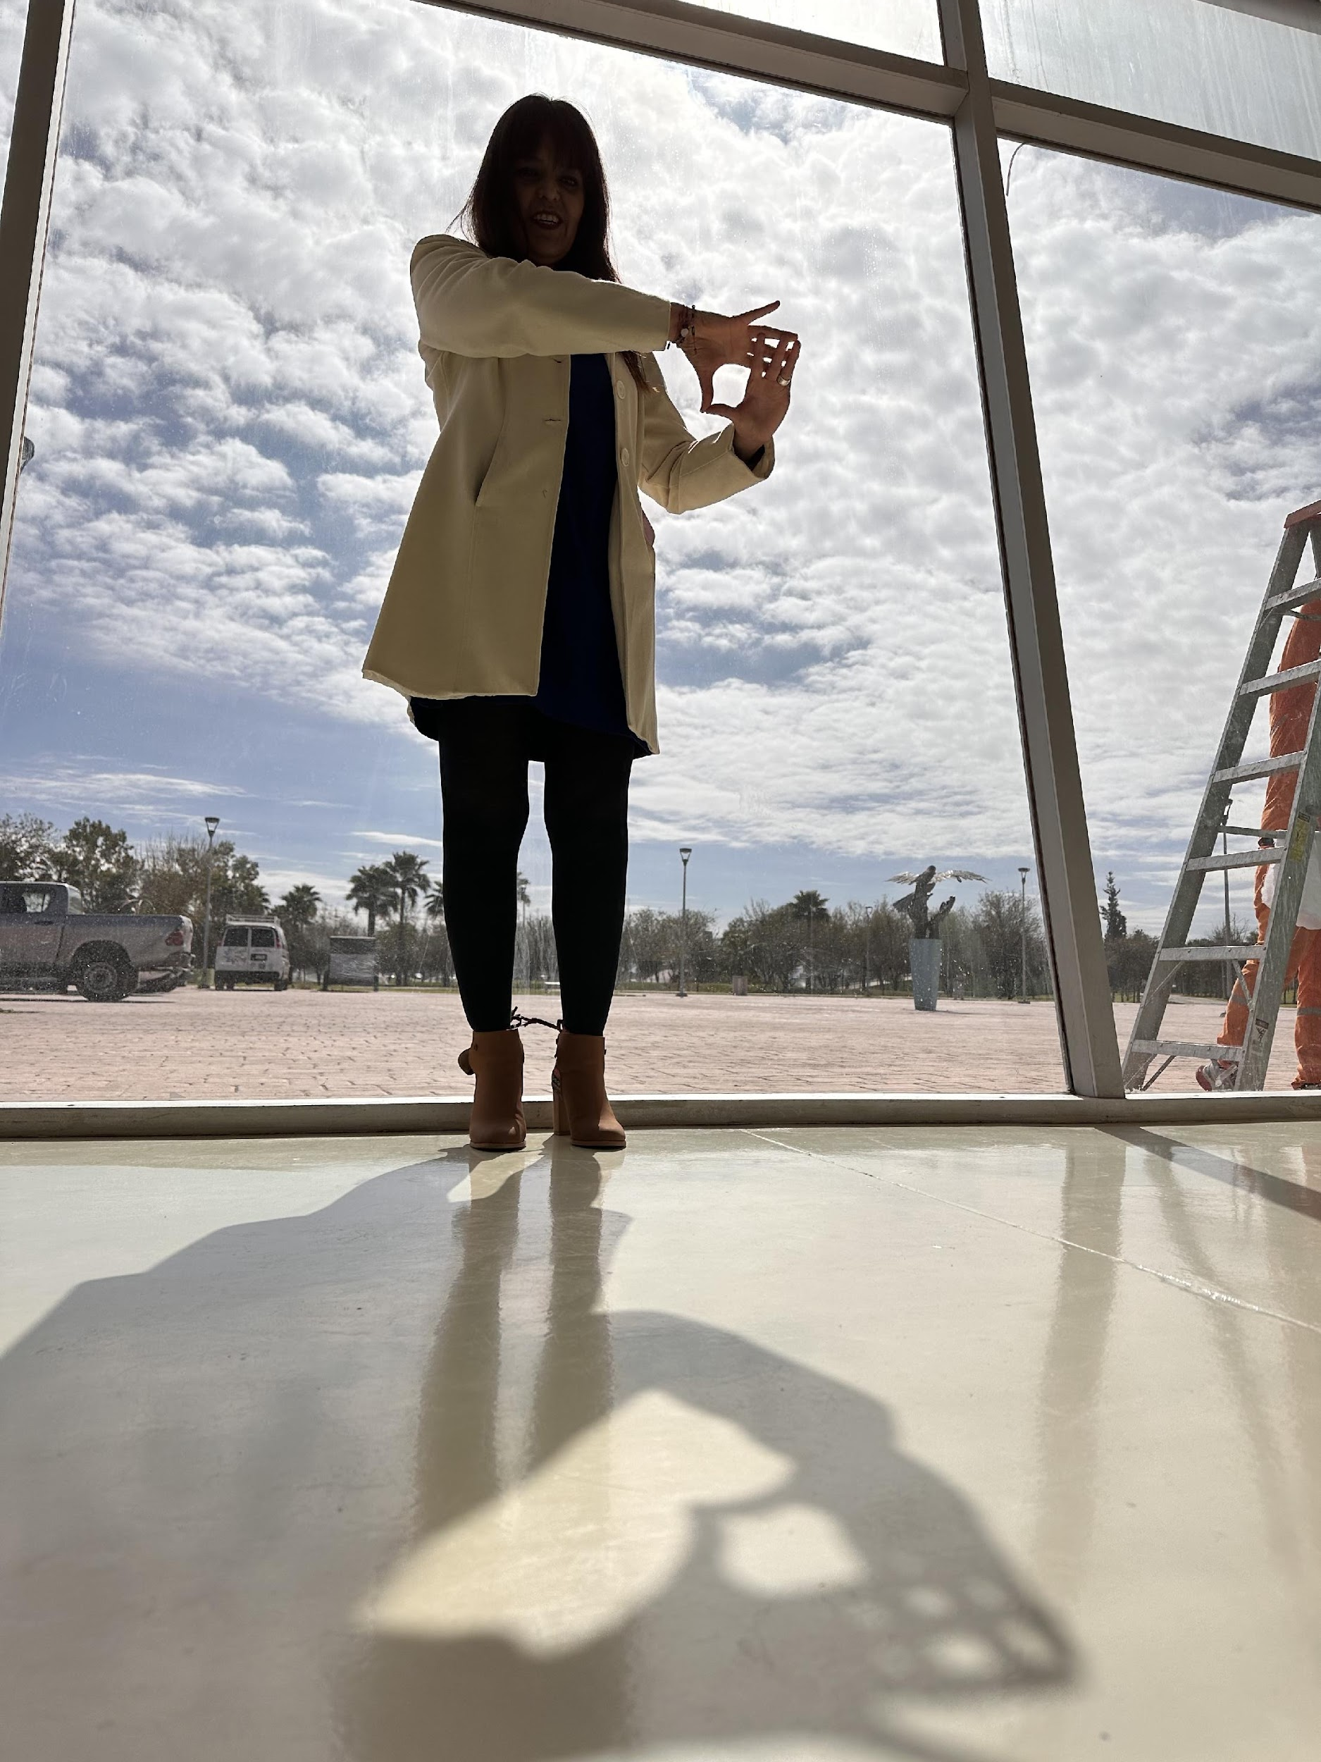
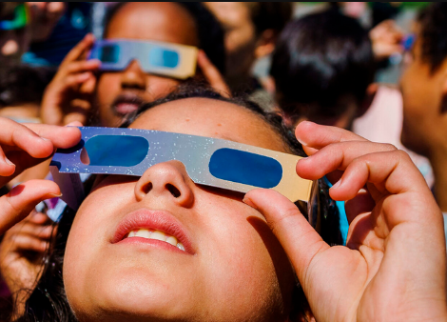
Safe Observations of a Partial Solar Eclipse
Notes:
To safely view the partial phases of the eclipse, you can use these indirect ways using “pinholes” or looking up with a set of special eclipse glasses. Our Exploratorium website (listed in the resources that Dillon will share at the end of this presentation) shares trusted sources where you can get these solar eclipse glasses.

Slide 25
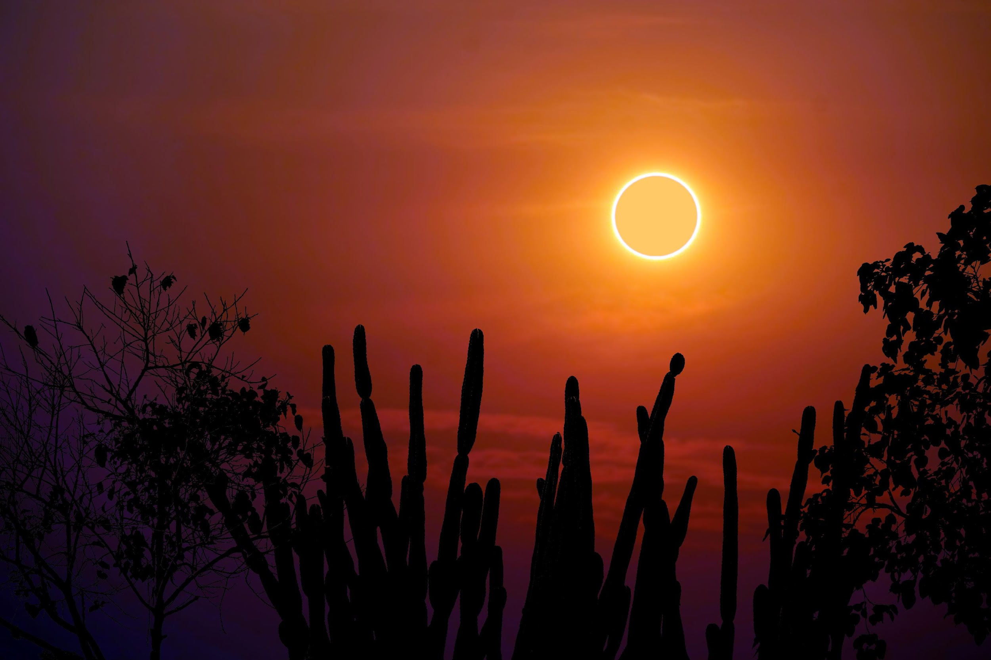
Notes:
An annular eclipse is a type of partial eclipse. We experienced an annular eclipse in North and Central America this past October 14th, 2023.

Slide 26
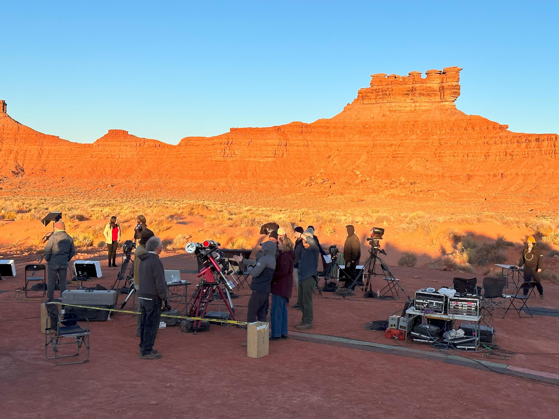
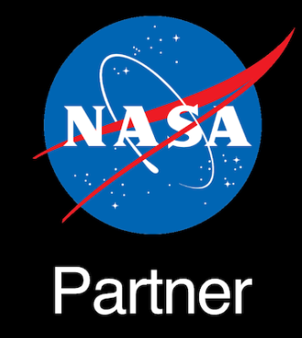
Live Solar Eclipse Production and Transmission
Notes:
The Exploratorium and NASA produced a live annular eclipse webcast from Valley of the Gods in Bears Ears National Monument, Utah. Many tribes have historical and cultural ties to this region, including:
Navajo Nation
Hopi Tribe
Ute Mountain Ute Indian Tribe
Uintah and Ouray Ute Indian Tribe
Zuni and other Pueblos of NM

Slide 27
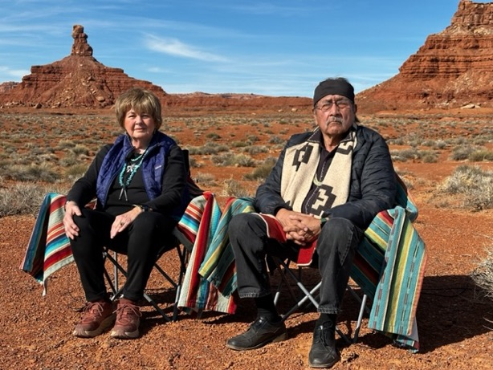
Featured Collaborators
Nancy Maryboy, Ph.D. Diné (Navajo) and Tsalagi (Cherokee) Navajo Astronomer President, Indigenous Education Institute (IEI) Affiliate Professor, U. Washington
David Begay, Ph.D. Diné (Navajo) and Pueblo Navajo Astronomer Vice President, Indigenous Education Institute (IEI) Associate Professor, U. New Mexico

Slide 28
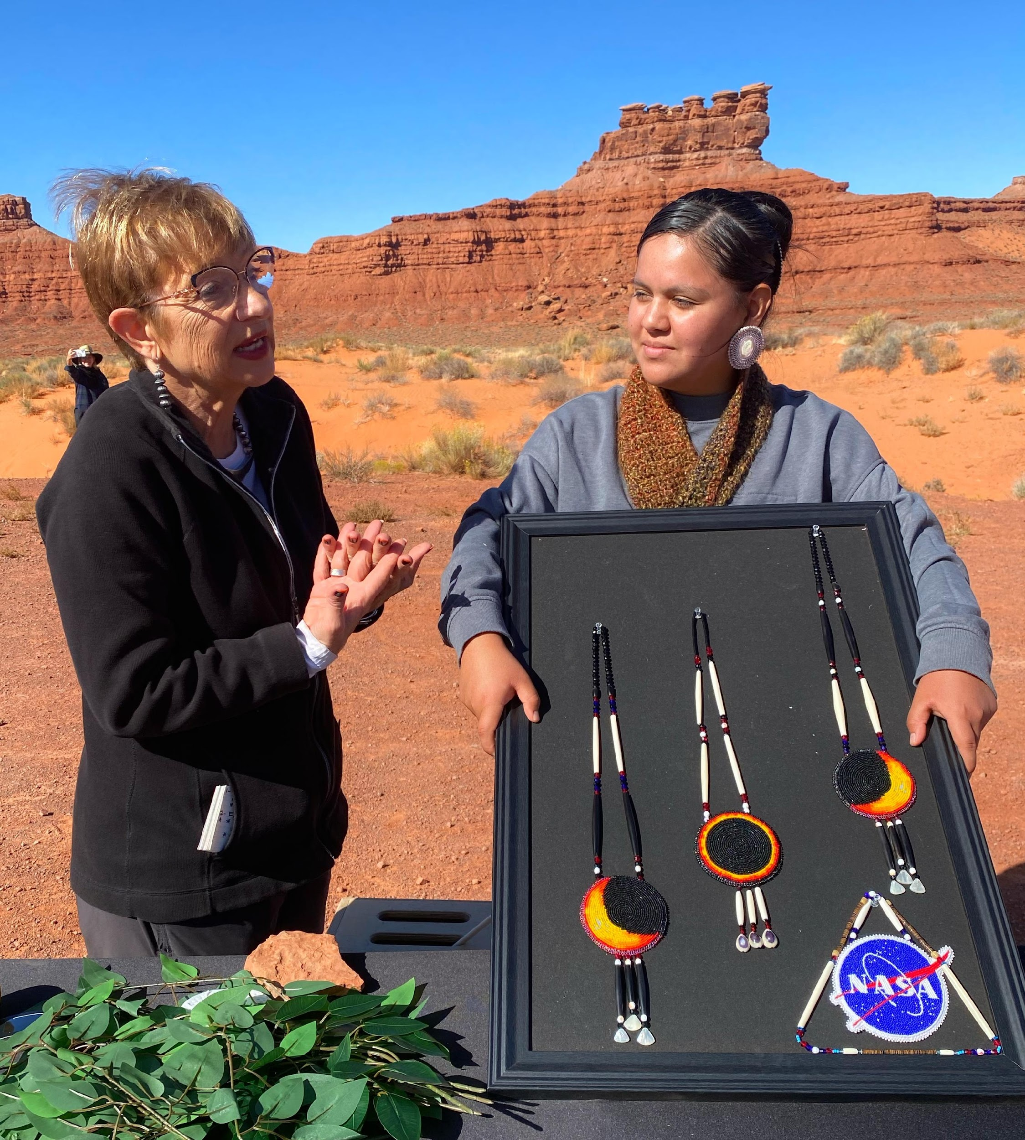
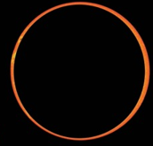
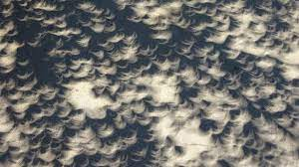

Slide 29
Diné (Navajo) Worldview of the Universe
Observation, place-based knowing
Knowledge lives in traditional language
Process – a world in motion
Inter-relationship of all things

Slide 30
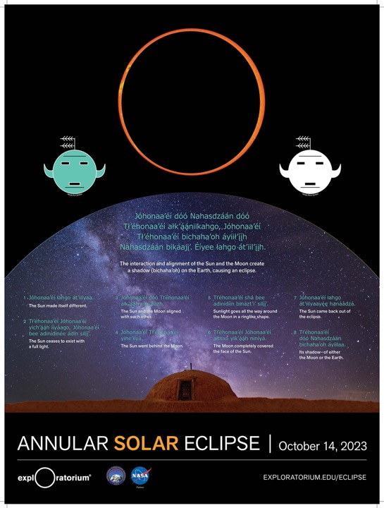
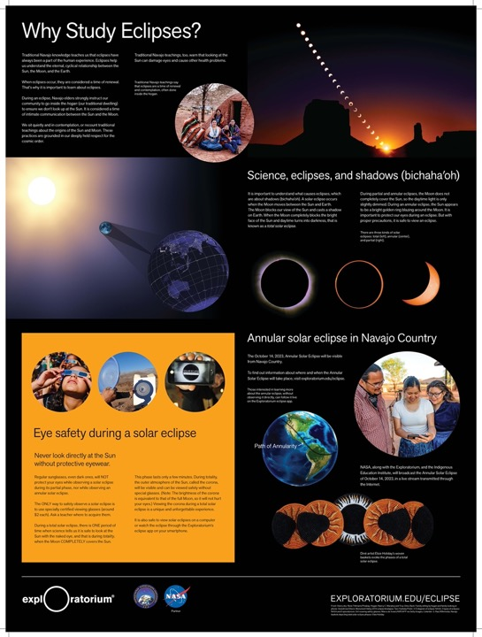

Slide 31
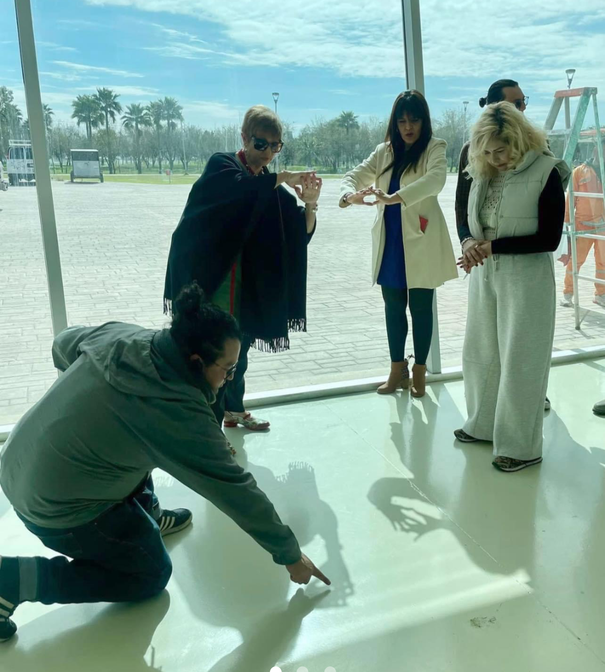
Pinhole cameras made by your crossed fingers
You can make pinholes!
Images of the Sun

Slide 32
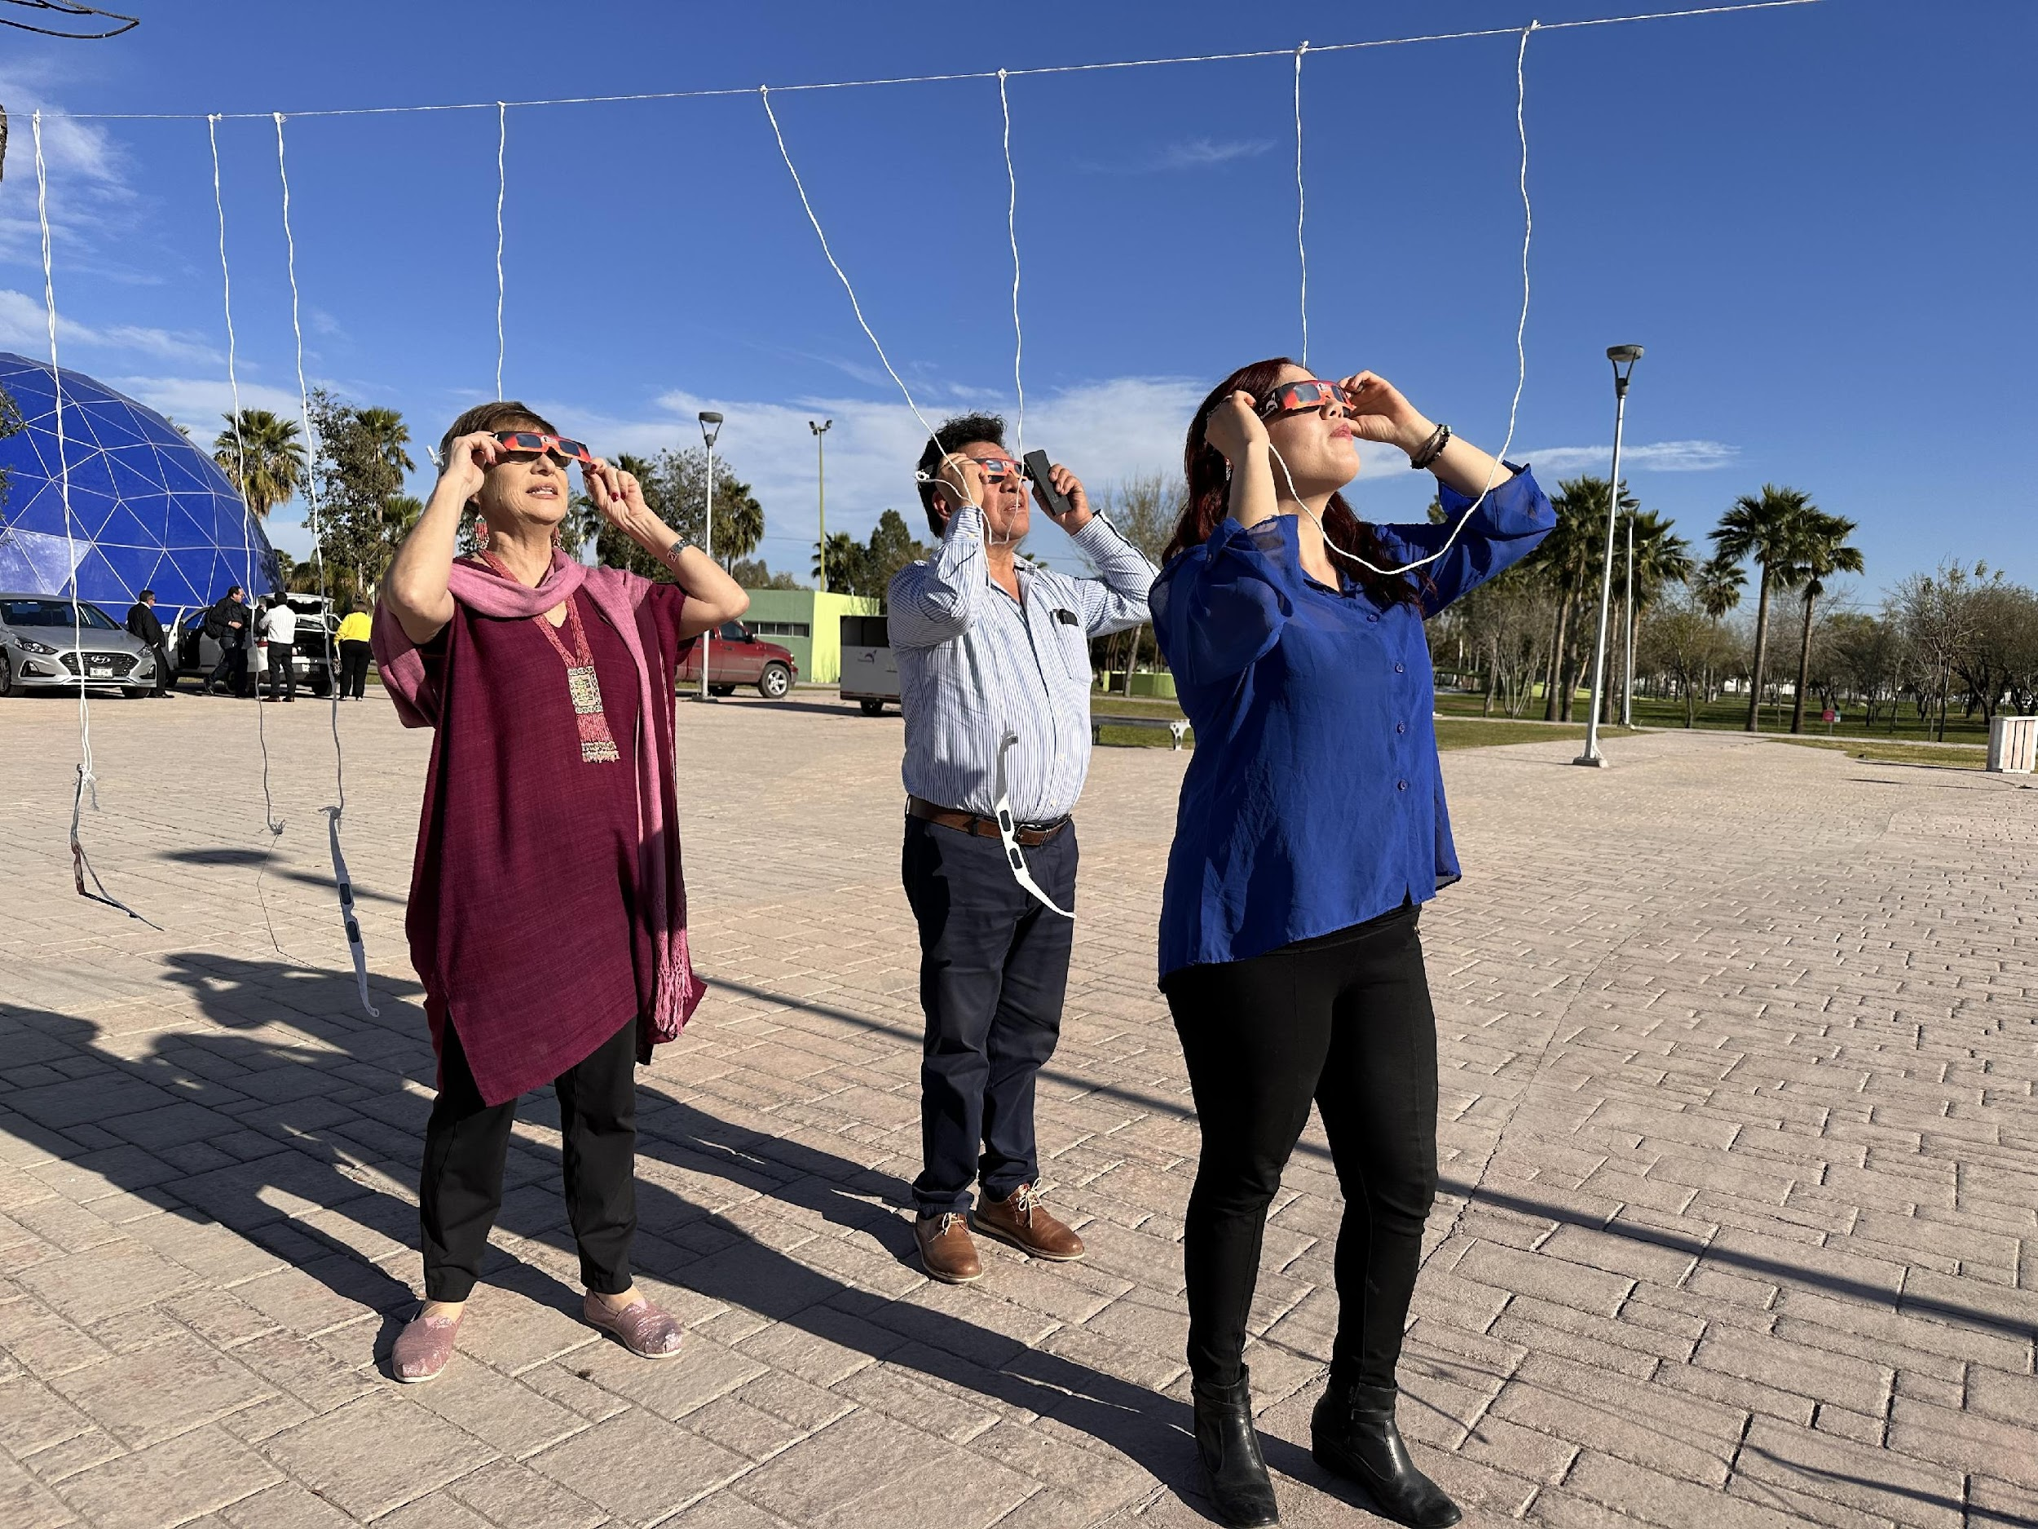
Eclipse glasses clothesline!

Slide 33
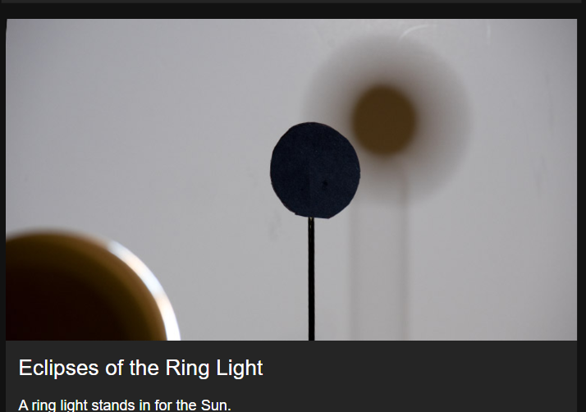
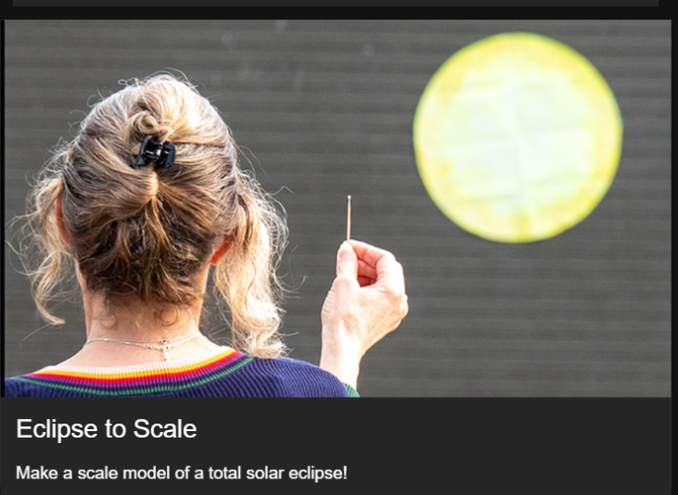
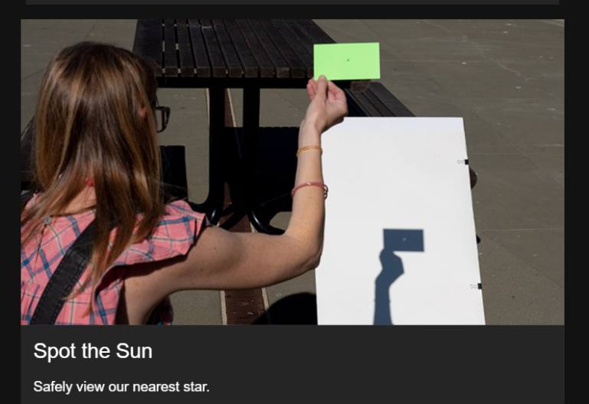

Slide 34
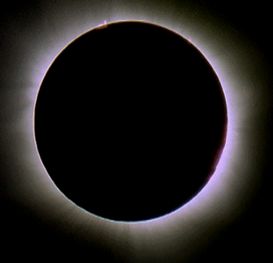
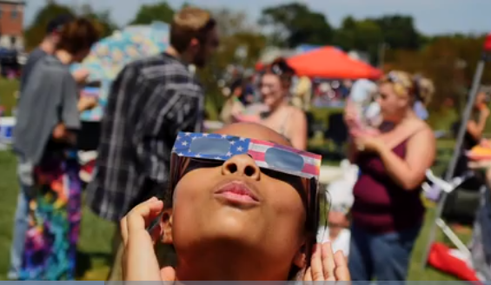
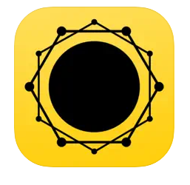
TOTAL SOLAR ECLIPSE
April 8, 2024
3 Free LIVE Transmissions
- Telescope only (no narration)
- Educational program – English
- Educational program - Spanish
exploratorium.edu/eclipse
Torreón, Coahuila, MX
& Junction, TX, USA
Free Eclipse App Android and iOS

Slide 35
Thank you!
exploratorium.edu/eclipse

Slide 36
Resources for
Your Library

Slide 37
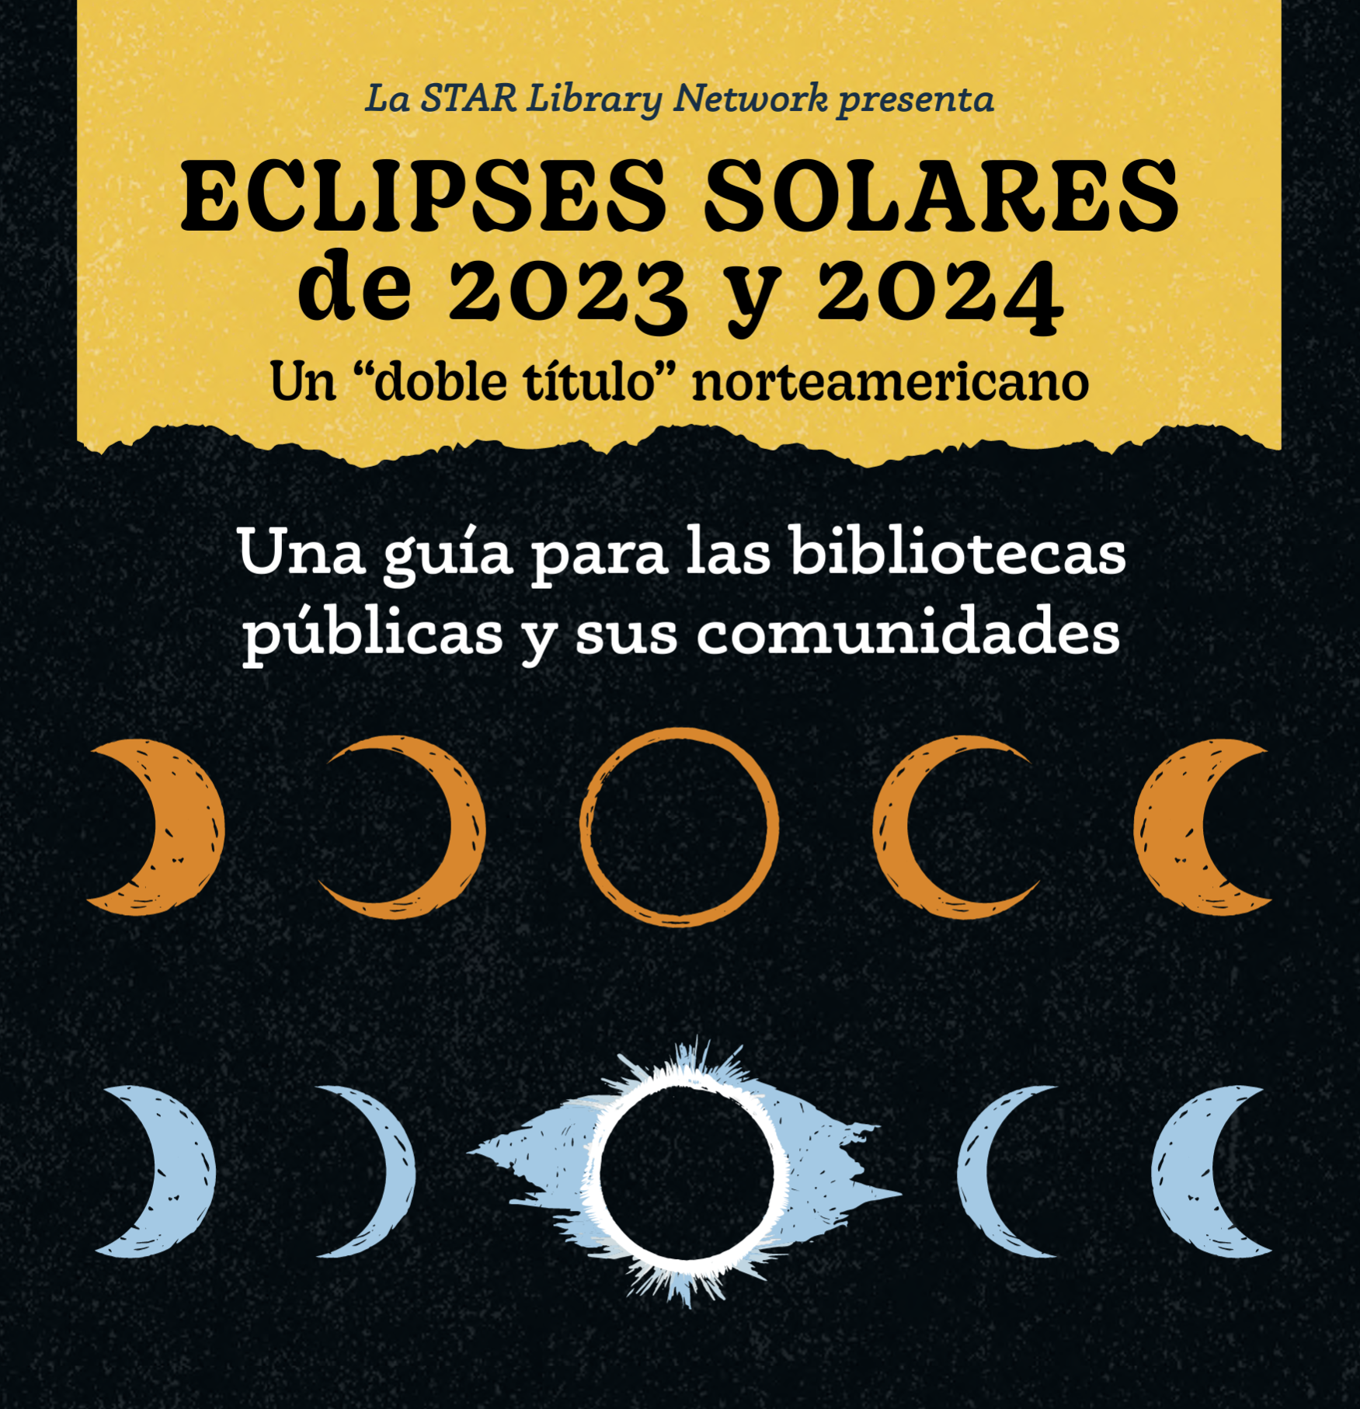

Slide 39
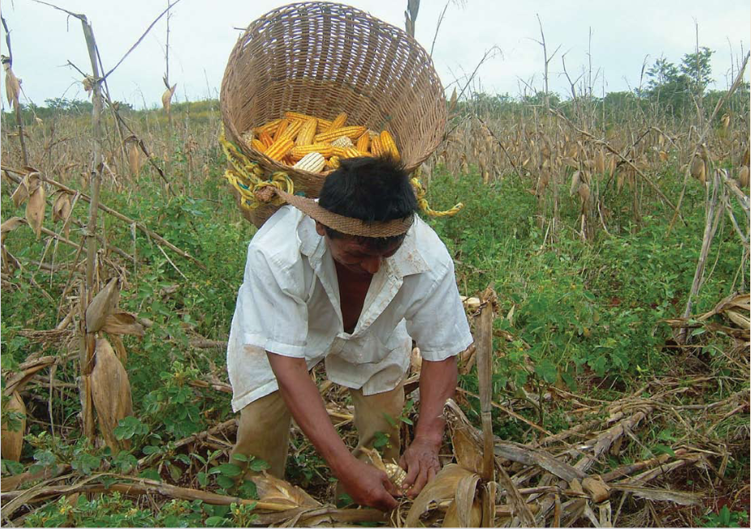
Traditions of the Sun
eBooks
A Photographic Journey to the Yucatán
Trilingual (Yucatec Mayan, Spanish, English)
Tsotsil Mayan
The Sun-Earth Connection at Chaco Culture National Historical Park
English
Spanish

Slide 41
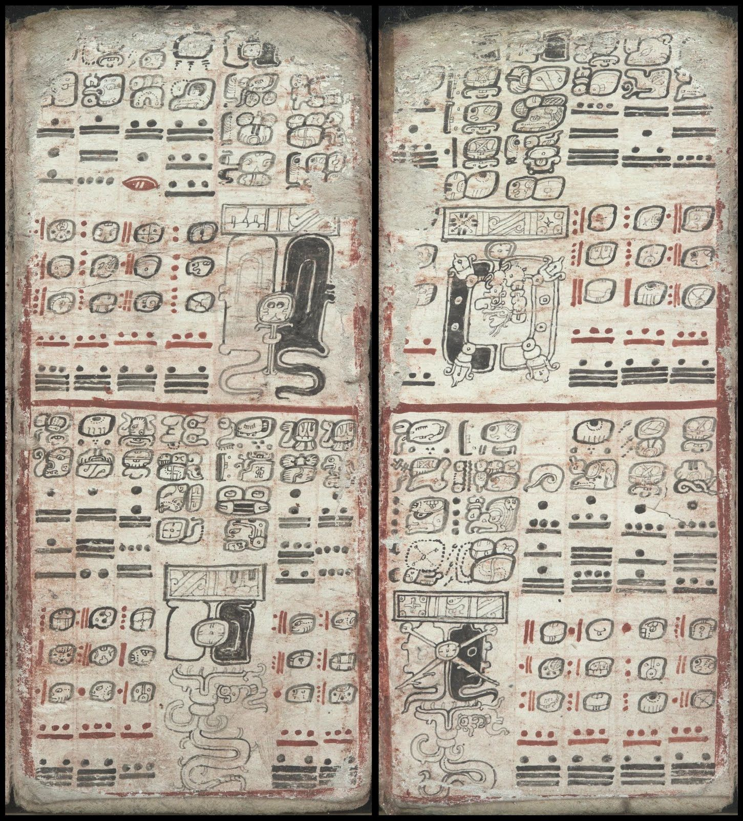
Learn
and
Share
Native Skywatchers Virtual Event on Mayan Astronomy
Dresden Codex
Mayan Eclipse Cycles
NASA Astronaut Jose Hernandez
Accompanying PDF Booklet
Popul Vuh Animated Documentary
Alexander Street Academic Video Online (English/Spanish)
YouTube

Slide 42
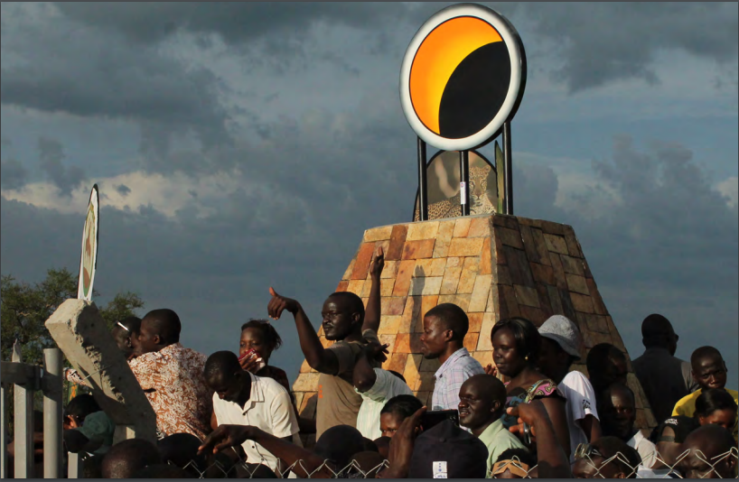
Ways of Knowing: Eclipses Around the World
Slides/Cards from Night Sky Network Eclipse Ambassadors
Images and eclipse stories from Mexico, Uganda, Korea, Chile, Scandinavia, and more

Slide 43
STAR Net Bilingual Eclipse Resources
English/Spanish resources from STAR Net
Webinar recording on STAR Net YouTube Channel
Bilingual hands-on activities, resources, and more
Link to recording and more in link bank

Slide 44
Q&A

