Slide 1
Citizen Science and the Solar Eclipse: Harness the Power of Your Community!
Notes:
Agenda: Citizen Science and the Solar Eclipse: Harness the Power of Your Community!
Agenda
Introduction/Icebreaker 5-10 minutes (Dillon)
Quick Overview of Eclipse Resources through SEAL 5 minutes (Dillon)
What is Citizen Science? What Counts? Who does it? 5-10 minutes (Tara)
Eclipse Citizen Science 10 minutes (Claire/Emma)
-Eclipse Soundscapes (w/ recipe card if available)
-GLOBE Observer (recipe card if available)
-Links to recordings of webinars
-Other projects: Aurorasaurus, Sunsketcher
Programming Ideas from the Clearinghouse 10 minutes (Dillon)
Citizen Science Month 5-10 minutes (Tara)
Q&A 10 minutes

Slide 2
Agenda
Introduction/Icebreaker
Overview of Eclipse Resources from STAR Net
What is Citizen Science? Who counts? Who does it?
Eclipse Citizen Science
Citizen Science Programming Ideas
Citizen Science Month
Q&A
Notes:
Agenda: Citizen Science and the Solar Eclipse: Harness the Power of Your Community!
Agenda
Introduction/Icebreaker 5-10 minutes (Dillon)
Quick Overview of Eclipse Resources through SEAL 5 minutes (Dillon)
What is Citizen Science? What Counts? Who does it? 5-10 minutes (Tara)
Eclipse Citizen Science 10 minutes (Claire/Emma)
-Eclipse Soundscapes (w/ recipe card if available)
-GLOBE Observer (recipe card if available)
-Links to recordings of webinars
-Other projects: Aurorasaurus, Sunsketcher
Programming Ideas from the Clearinghouse 10 minutes (Dillon)
Citizen Science Month 5-10 minutes (Tara)
Q&A 10 minutes

Slide 3
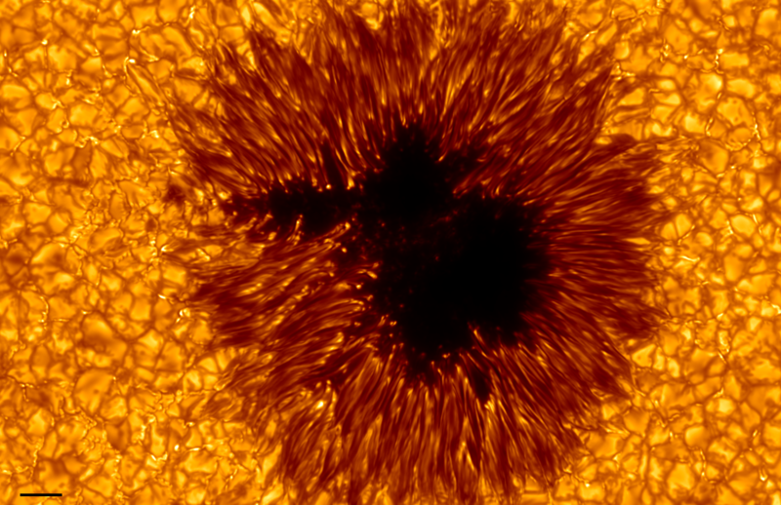
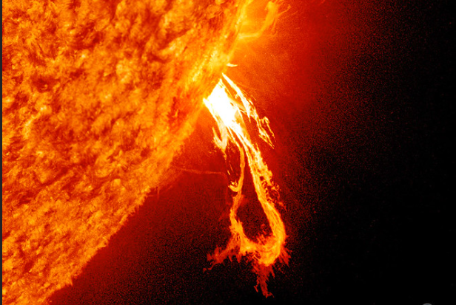
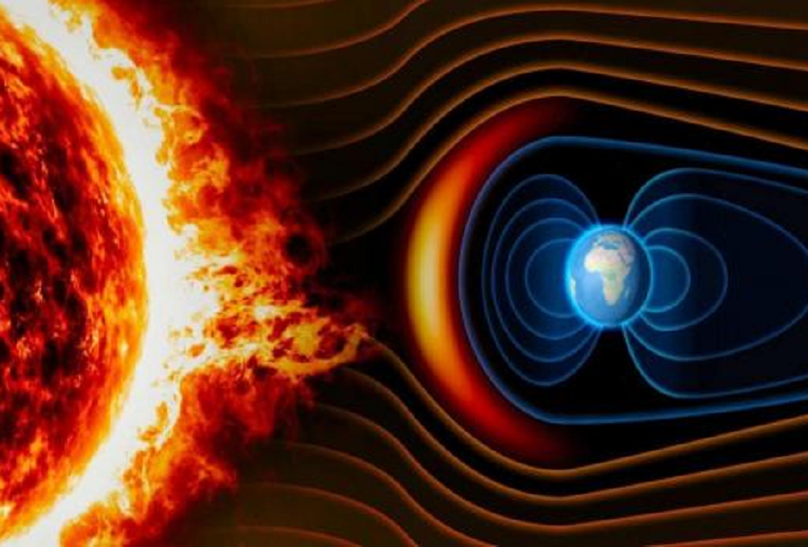
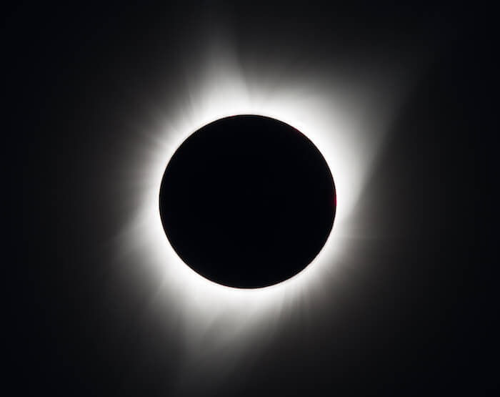
What solar feature do you feel like today?
Sunspot: (relatively) cool, calm, and collected; embracing change and transition
Solar Prominence: showy and bright, while also feeling grounded and connected
Coronal Mass Ejection: powerful and influential; ready to mess things up!
Sun's Corona: Gassy and Sassy. You won't let anybody's shadow dim your light.
Notes:
Agenda: Citizen Science and the Solar Eclipse: Harness the Power of Your Community!
Agenda
Introduction/Icebreaker 5-10 minutes (Dillon)
Quick Overview of Eclipse Resources through SEAL 5 minutes (Dillon)
What is Citizen Science? What Counts? Who does it? 5-10 minutes (Tara)
Eclipse Citizen Science 10 minutes (Claire/Emma)
-Eclipse Soundscapes (w/ recipe card if available)
-GLOBE Observer (recipe card if available)
-Links to recordings of webinars
-Other projects: Aurorasaurus, Sunsketcher
Programming Ideas from the Clearinghouse 10 minutes (Dillon)
Citizen Science Month 5-10 minutes (Tara)
Q&A 10 minutes

Slide 4
Eclipse Resources from STAR Net
Professional Development
Virtual Trainings
Recordings on the STAR Net YouTube channel
Topics include citizen science, preparing for eclipse day, eclipse books and authors, programming ideas, and more
In-person workshops
Upcoming: Illinois, Nevada, Virginia, Hawaii, American Samoa
Notes:
Agenda: Citizen Science and the Solar Eclipse: Harness the Power of Your Community!
Agenda
Introduction/Icebreaker 5-10 minutes (Dillon)
Quick Overview of Eclipse Resources through SEAL 5 minutes (Dillon)
What is Citizen Science? What Counts? Who does it? 5-10 minutes (Tara)
Eclipse Citizen Science 10 minutes (Claire/Emma)
-Eclipse Soundscapes (w/ recipe card if available)
-GLOBE Observer (recipe card if available)
-Links to recordings of webinars
-Other projects: Aurorasaurus, Sunsketcher
Programming Ideas from the Clearinghouse 10 minutes (Dillon)
Citizen Science Month 5-10 minutes (Tara)
Q&A 10 minutes

Slide 5
Eclipse Resources from STAR Net
Get Connected
SEAL Community on the STAR Net Community site
Registration and join request required
Talk with other librarians planning for the eclipse
Connect with scientists and subject matter expert volunteers for in-person and virtual programming
Keep up to date with SEAL and STAR Net
Solar Science Circulation Kits
Telescopes, books, activities
Contact your state library for circulation info
Notes:
Agenda: Citizen Science and the Solar Eclipse: Harness the Power of Your Community!
Agenda
Introduction/Icebreaker 5-10 minutes (Dillon)
Quick Overview of Eclipse Resources through SEAL 5 minutes (Dillon)
What is Citizen Science? What Counts? Who does it? 5-10 minutes (Tara)
Eclipse Citizen Science 10 minutes (Claire/Emma)
-Eclipse Soundscapes (w/ recipe card if available)
-GLOBE Observer (recipe card if available)
-Links to recordings of webinars
-Other projects: Aurorasaurus, Sunsketcher
Programming Ideas from the Clearinghouse 10 minutes (Dillon)
Citizen Science Month 5-10 minutes (Tara)
Q&A 10 minutes

Slide 6
Eclipse Resources from STAR Net
Programming Resources
SEAL Collection on the STEM Activity Clearinghouse
STAR Net YouTube channel (@STARNetLibraries)
Webinar recordings
Eclipse music playlist
STEAM Strategies Videos
Blog posts on the STAR Net community site
Bilingual and Spanish Eclipse Resources
Getting Started with SEAL
Explaining Eclipses to Little Kids
Make Your Own Eclipse History Exhibit
Notes:
Agenda: Citizen Science and the Solar Eclipse: Harness the Power of Your Community!
Agenda
Introduction/Icebreaker 5-10 minutes (Dillon)
Quick Overview of Eclipse Resources through SEAL 5 minutes (Dillon)
What is Citizen Science? What Counts? Who does it? 5-10 minutes (Tara)
Eclipse Citizen Science 10 minutes (Claire/Emma)
-Eclipse Soundscapes (w/ recipe card if available)
-GLOBE Observer (recipe card if available)
-Links to recordings of webinars
-Other projects: Aurorasaurus, Sunsketcher
Programming Ideas from the Clearinghouse 10 minutes (Dillon)
Citizen Science Month 5-10 minutes (Tara)
Q&A 10 minutes

Slide 7
What is
citizen science?
A global movement that enables people from all walks of life to collaborate with scientists by participating in real scientific research. It’s how people can make an impact on issues they care about!
scistarter.org/citizen-science

Slide 8
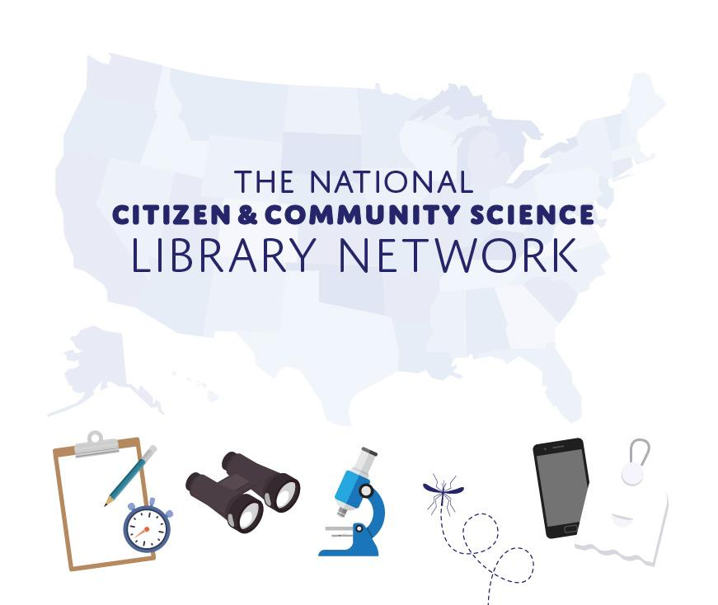
The National Citizen and Community Science Library Network
A growing network of libraries and other community-based organizations dedicated to engaging their communities in citizen science managed by Arizona State University, SciStarter and the National Girls Collaborative Project.
Sign-up at scistarter.org/library-network

Slide 9
Citizen Science Month
We aim to make a collective impact of One Million Acts of Science where our goal is to collectively generate over one million data points to featured projects.
Notes:
Tara

Slide 10
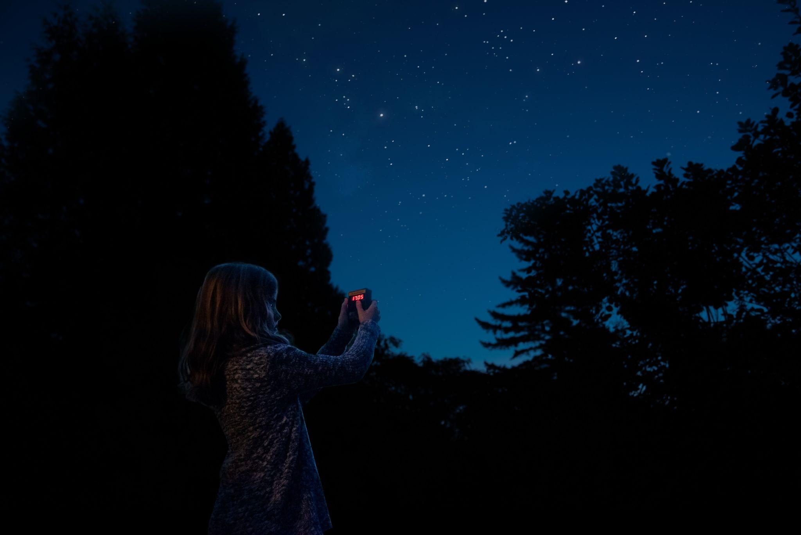
What counts as an act of science?
Attend or host an online or in-person event
Join a project to play games that accelerate medical research
Analyze online images to help make discoveries
Share pictures of nature to help scientists spot biodiversity trends
Use your smartphone to monitor your environment
Notes:
Tara

Slide 11
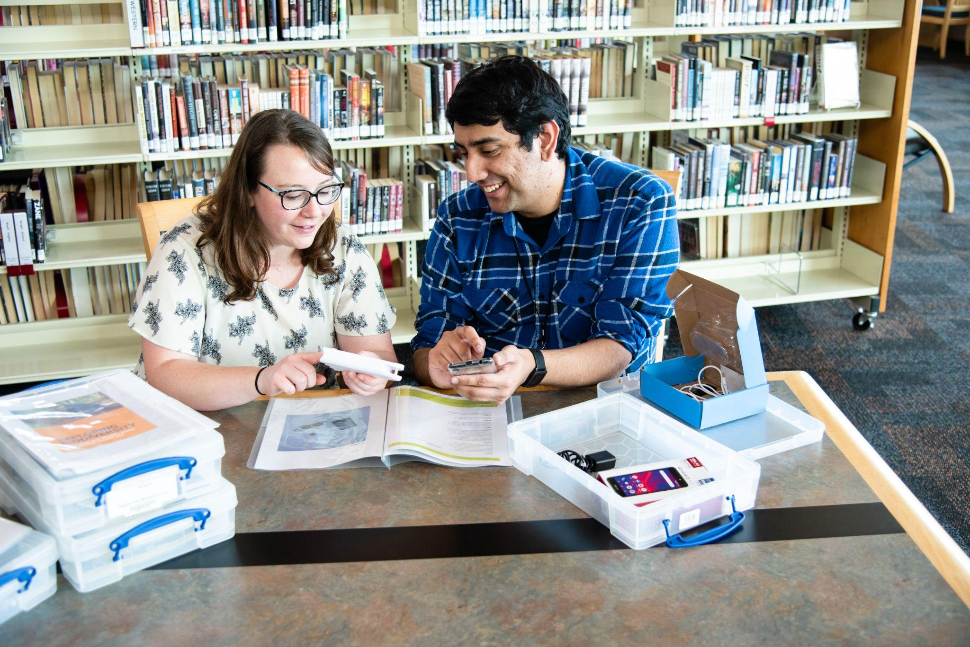
Sign up to participate!
For Participants - Participate in at least one citizen science project or event on SciStarter.org between April 1 - April 30, 2024
For Event Hosts and Organizations - Host and promote an event or program in April and add the event/program to SciStarter.org/add-event
Reply to our survey, by May 15, 2024, with the estimated # of Acts of Science you/your community performed and name(s) to appear on the CitizenScienceMonth.org website and on your digital certificate for helping us reach One Million Acts of Science!
Notes:
Tara

Slide 12
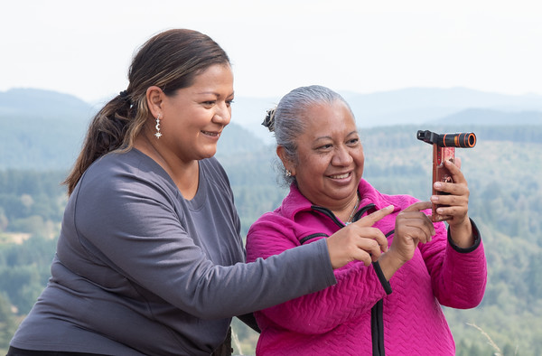
Planning for Citizen Science Month
Prepare
Plan
Participate
Notes:
Tara

Slide 13
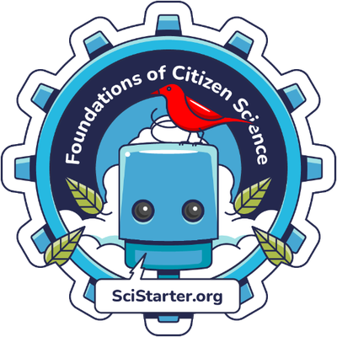
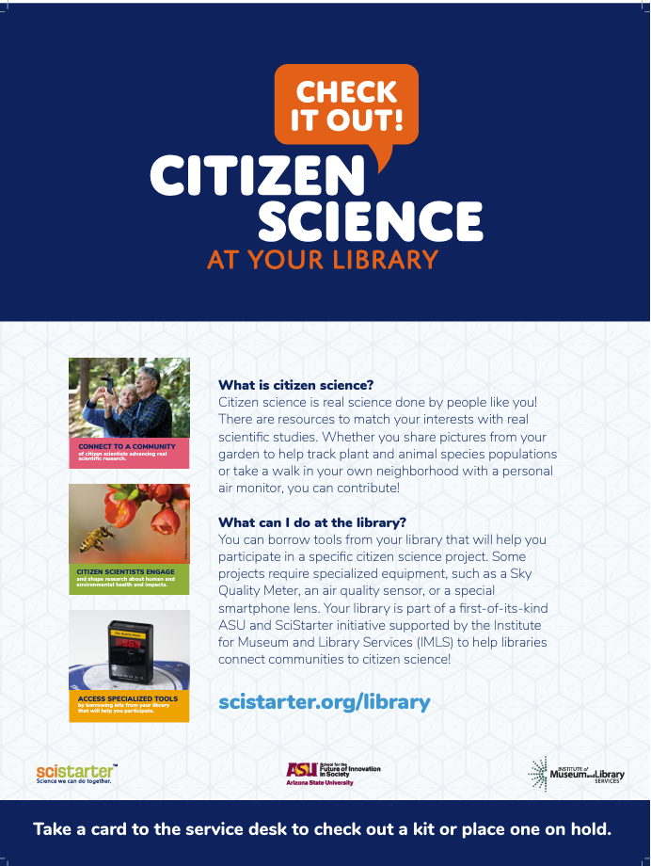
Prepare
Online, Self-guided Training Tutorials
Monthly Live Webinars
Guides and Turnkey Resources
Foundations of Citizen Science
Libraries as Community Hubs for Citizen Science
Others
Receive a Digital Badge!
SciStarter.org/training
Relevant topics like pollinators, STEM, summer reading
Speakers with examples of programs in action
SciStarter.org/library-events
Event guides
Kit building guides
Promotional materials (bookmarks, rack cards, fliers)
Facilitator slides for programs
SciStarter.org/
library-resources
Notes:
Tara

Slide 14
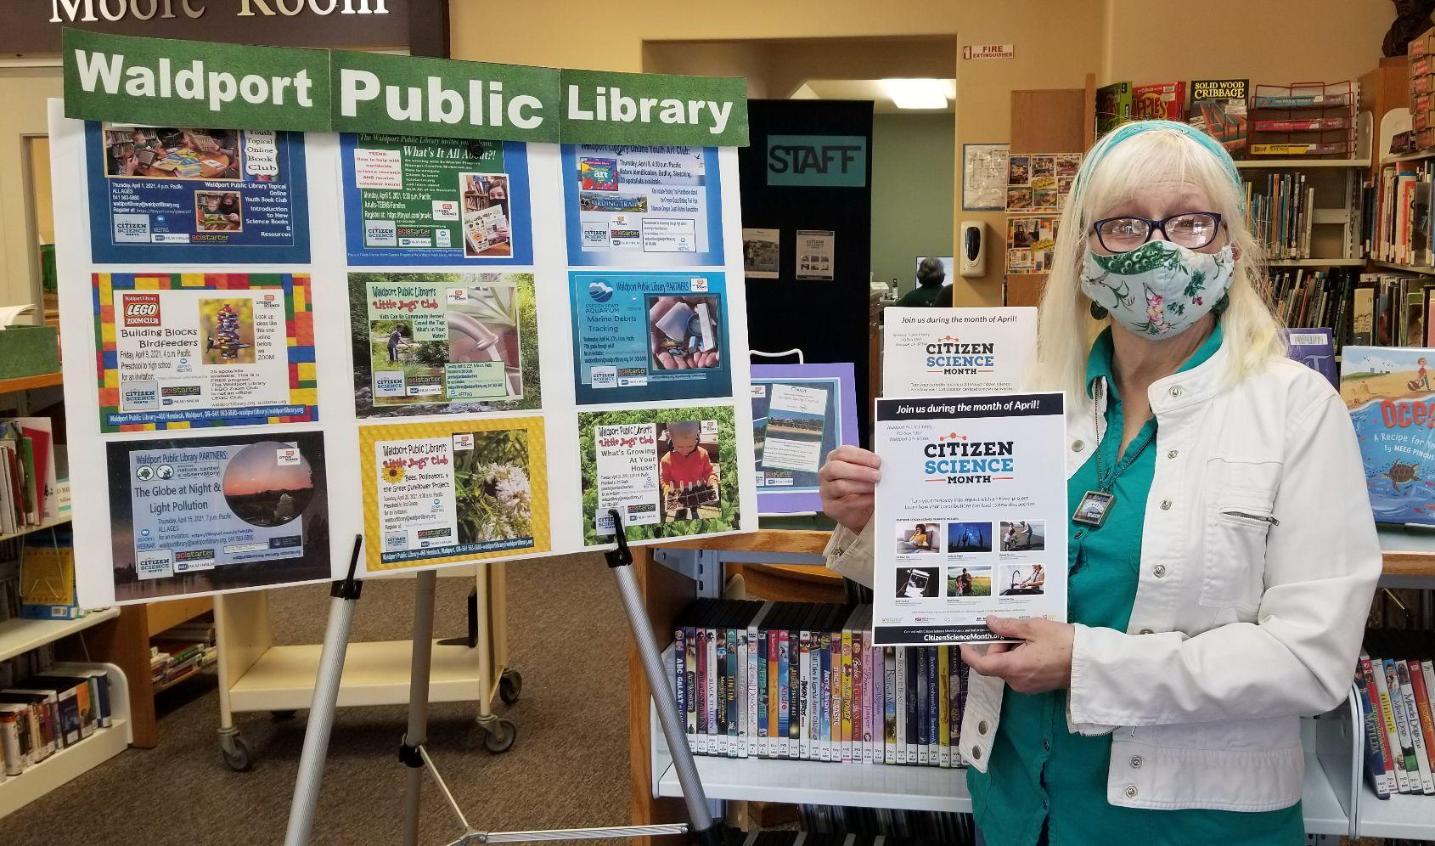
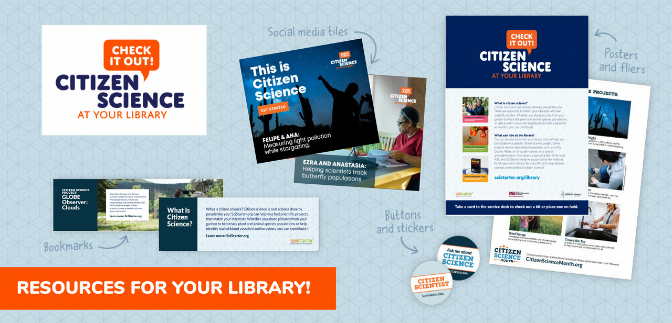
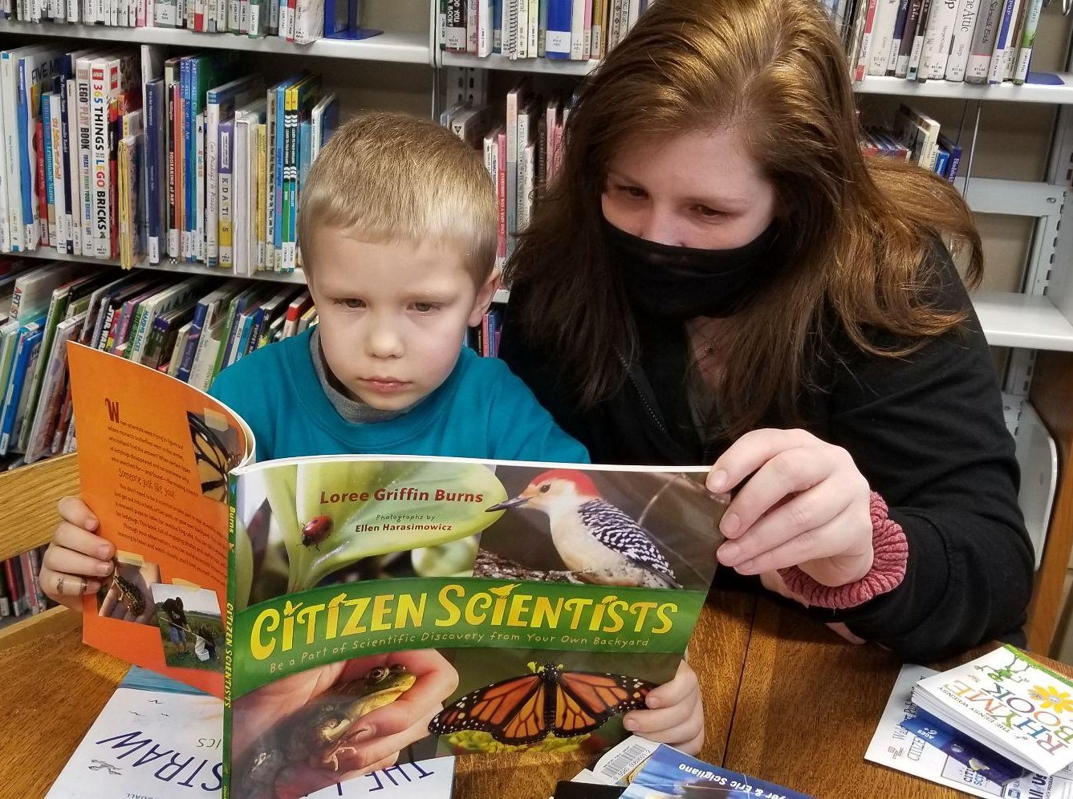
Sparking Interest
Book Displays, Inquiry Posters,
Rack Cards, Book Clubs
Promotional Resources
https://scistarter.org/library-promotional-resources
Notes:
Use these assets to bring awareness and promote citizen science to the community. Outreach events like community festivals, STEM/STEAM school events, retirement communities are all ways to let people who may not be library users know about a new and unique library opportunities.

Slide 15
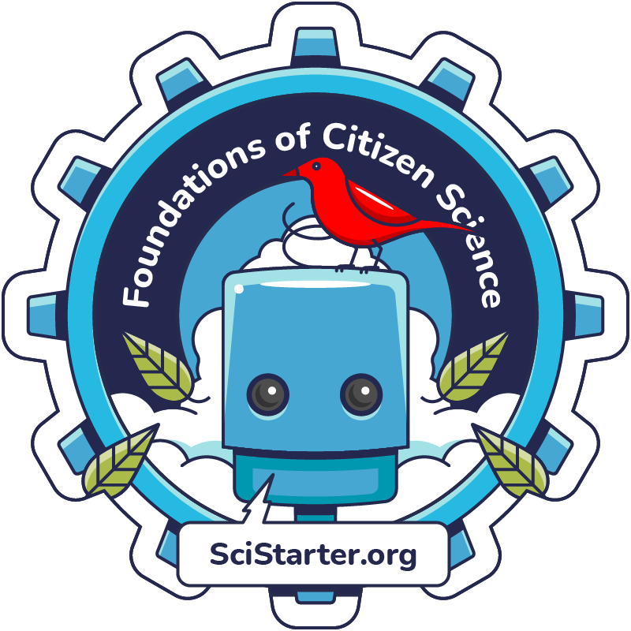
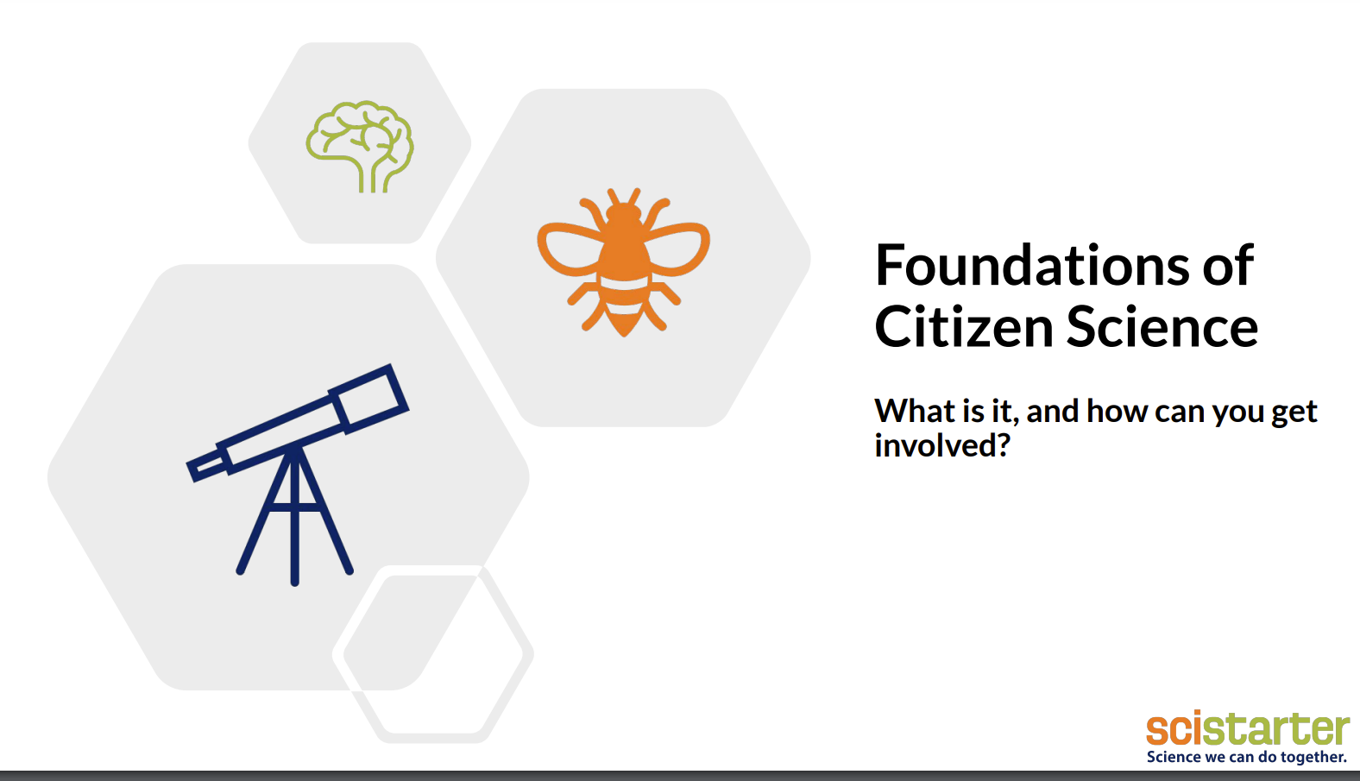
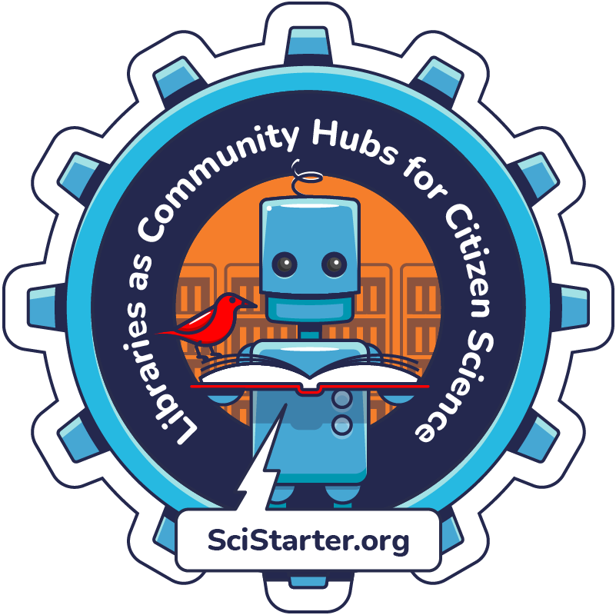
Promote the training!
SciStarter.org/training
Slides and speaker’s notes to facilitate an introduction to citizen science event. Cobrand or adapt to fit your needs.
Online, interactive module created by instructional designers at Arizona State University.
SciStarter.org/library-training
Part 2 for library facilitators

Slide 16
Plan
Prompting citizen science engagement during the 2024 Eclipse
Notes:
Emma

Slide 17
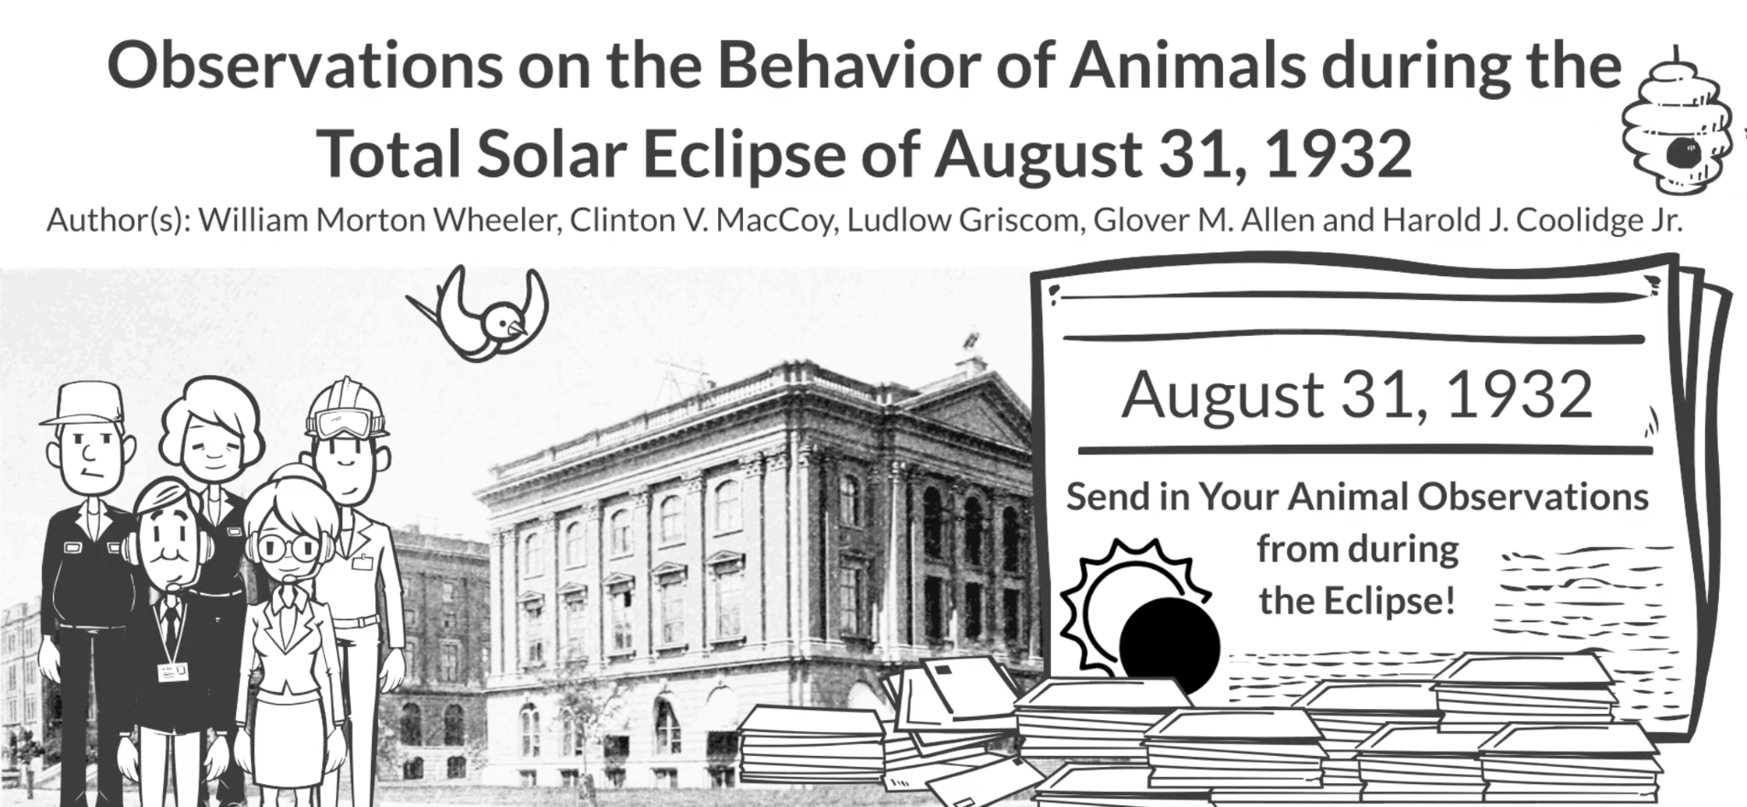
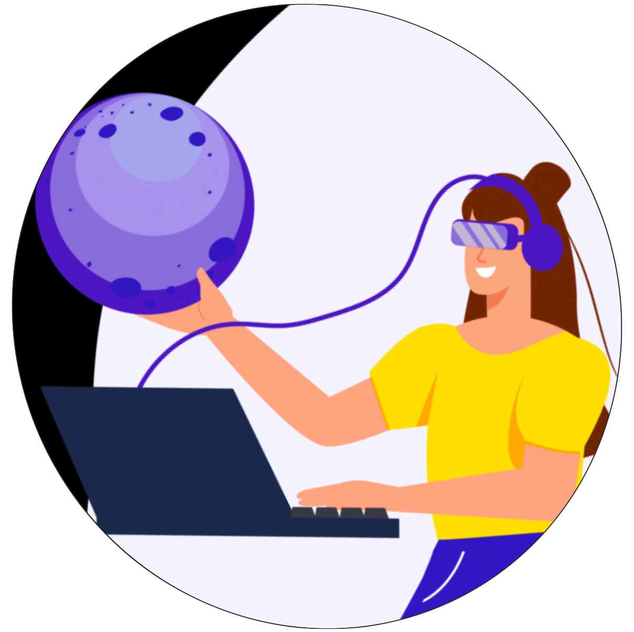
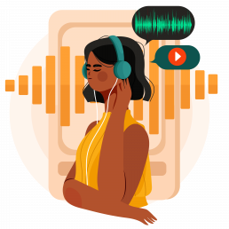
Collect & analyze observations and sound data from the October 14, 2023, annular eclipse and the April 8, 2024, total solar eclipse to help us understand the impact of solar eclipses on various U.S. ecosystems.
Online
ANY Location
70%+ Eclipse Path
Online
FREE
FREE
Equipment Required
FREE
APPRENTICE
(Online Eclipse Learning)
OBSERVER
(Eclipse Day Activity)
DATA COLLECTOR
(Eclipse Week Activity)
DATA ANALYST
(Online Data Activity)
Learn about solar eclipses via free online learning and earn a certificate of completion.
During the 2023 annular eclipse or the 2024 total eclipse path, go outside and observe with all of the senses available to you. Then share these observations with the ES team via the ES website!
Collect data using an AudioMoth Recorder along or near (70%+) the 2023 annular eclipse path or the 2024 total eclipse path. Then share the data with the ES team by mailing the MicroSD card and submitting location info online!
Analyze sound data in 2024 and 2025 alongside scientists on the ES website. (Coming end of 2024)
Eclipse Soundscapes is supported by NASA award No. 80NSSC21M0008
Notes:
The Eclipse Soundscapes Project is studying how life on Earth, specifically wildlife, is affected by solar eclipses.
During a solar eclipse the Moon slowly creeps in front of the Sun blocking the Sun's light from reaching the Earth, and during the minutes before, during, and after eclipse maximum, when most or all of the Sun is blocked, it's going to seem like dusk or night has come early. What does nature think of this, specifically animals and insects?
This is something scientists have been wondering for a while. Almost 100 years ago a scientist named Wheeler asked people to mail letters to him and his colleagues with their eclipse observations. Their observations included visual and sound observations on how the 1932 total solar eclipse affected nature, showing that eclipses can be studied in a multi-sensory way.
The eclipse soundscapes project revisits Wheeler’s 100 year old study with modern means of communication and modern technology.
We are collecting everyone's observations, this time online via a webform and we are also using scientific audio recorders called AudioMoths to record sound data. We need your help! We are looking for Observers AND Data Collectors for the 2024 total solar eclipse.

Slide 18
Eclipse Soundscapes - Observer
Background: This NASA Science Activation project is focused on the following science question: How does life on Earth, specifically wildlife, respond to eclipses? Participants will observe during the eclipse and then submit their observations on the project website about whether or not they noticed changes in animal behavior and sounds during the total solar eclipse. You do not need to be on the eclipse path. Solar eclipses can be multi-sensory experiences! We hope to receive observations about what people hear, see, feel, etc.
Age group: All ages, children 13 and under will need an adult to help submit data
Event timing and location: In or out of the path of totality, anywhere in North America.
Preparation:
Review the project protocol & Take the 15-30 minute training
Gather materials.
Observation worksheet
Eclipse glasses
Notes:
Emma

Slide 19
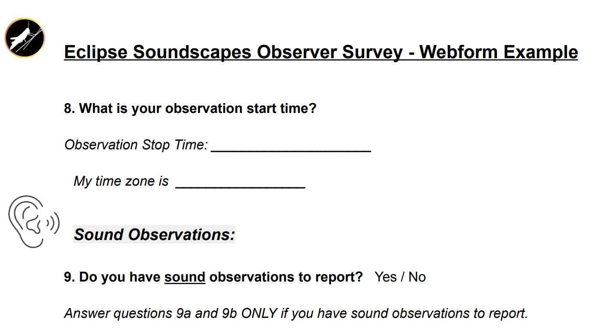
Program Description
Set the Stage
Collect Data
Take Action
Introduce the concept of citizen science using Foundations of Citizen Science facilitator slides and guide.
Have participants create accounts on SciStarter.org.
Direct participants to https://scistarter.org/eclipse-soundscapes to view the instructions for the project.
Educate your audience about Solar eclipses. There are many resources for this. For resources connected to Soundscapes, visit https://eclipsesoundscapes.org/.
Perform a practice round with your patrons prior to optimal eclipse setting. I.e. prior to totality or the highest % of coverage based on your location
Pass out fresh observation data sheets and writing utensils and/or encourage recording devices (easily done with a smartphone) to those who will record verbal observations.
Notify the participants when you are about to enter optimal eclipse experiencing setting. Assist participants in collecting data as needed.
Debrief! What did everyone experience? What changes did you sense?
Encourage participants to take their observations (via the worksheet or recording devices) and submit them via the Eclipse Soundscapes project website:
https://eclipsesoundscapes.org/observer/
If you have a computer lab, you can have them submit observations before they leave.

Slide 20
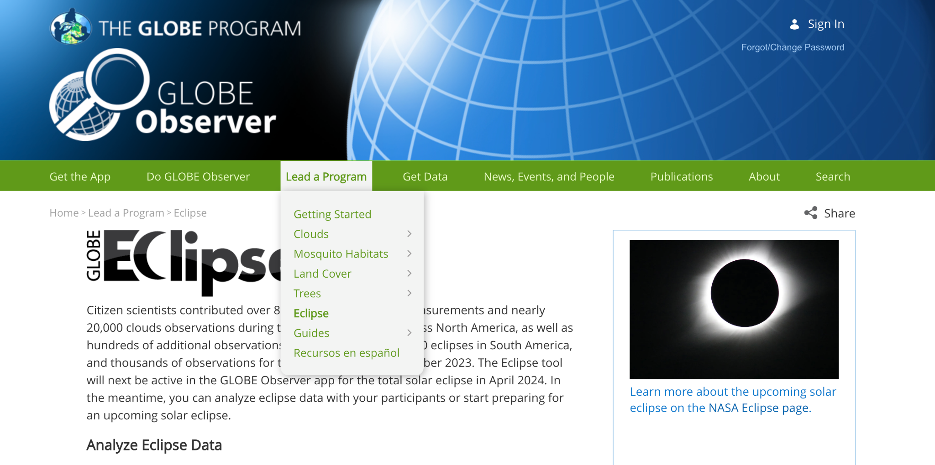
Where to Find Eclipse Resources
https://observer.globe.gov/toolkit/eclipse-toolkit

Slide 21
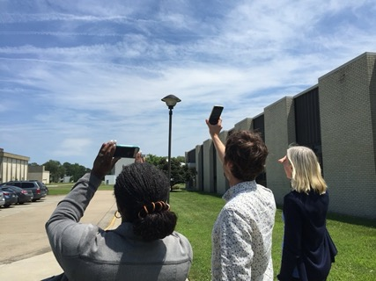
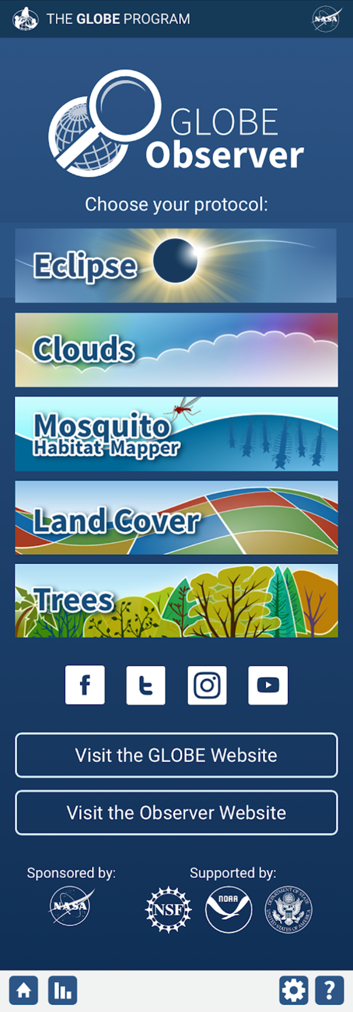
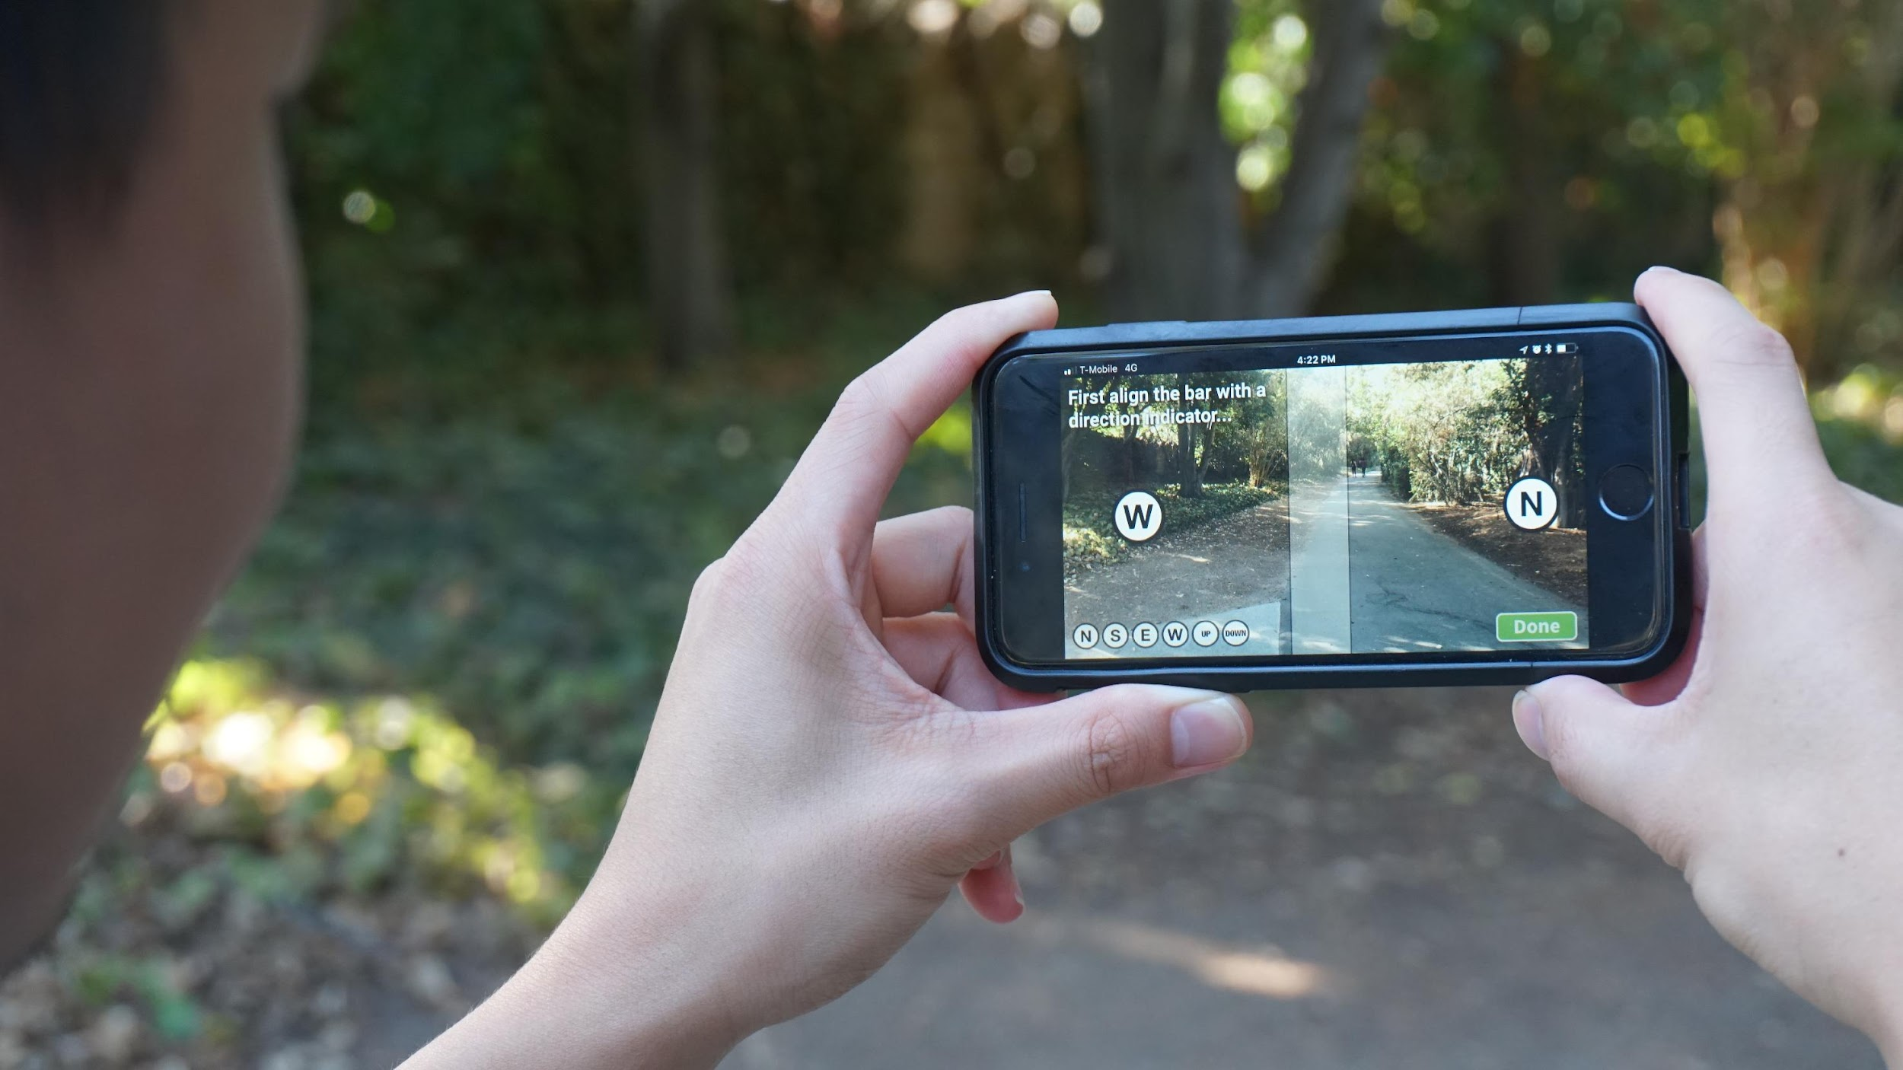
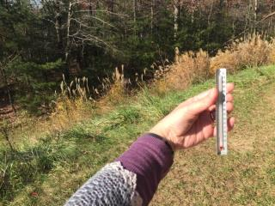
GLOBE Eclipse
One of 5 projects volunteers can do using the GLOBE Observer app.
Energy from the Sun warms our planet, and changes in sunlight can also cause changes in temperature, clouds, and wind. What happens when the Sun is blocked by the Moon during an eclipse?
GLOBE Eclipse Library Kit (Virtual Kit)
Links to resources to support your program
Sky Windows
Science Storybook: Do You Know that Clouds Have Names?
GLOBE Eclipse card with pinhole
+ Online activities, resources, videos, and promotional resources for the eclipse and beyond.
GLOBE Observer is funded under NASA award NNX16AE28A
Notes:
GLOBE Eclipse is one of 5 projects that volunteers can do using the GLOBE Observer mobile app. There are 4 projects that are always available: Clouds, Mosquito Habitat Mapper, Land Cover, and Trees - these all can complement and help interpret NASA and other satellite observations. GLOBE eclipse is a temporary project that opens in the app if you are in an area that is experiencing a solar eclipse. The meteorological effects of eclipses has been long-term interest to atmospheric scientists. And because we are already have tools to monitor clouds and sky conditions in GLOBE Observer - eclipses provide a great opportunity - that’s not going to happen again until 2044 - to get a volunteer community engaged and monitoring what happens to clouds and temperature when the sun is blocked by the moon. We have a collection of resources to help with taking observations and for learning about and promoting GLOBE Eclipse - include digital thermometer, sky windows, science storybook, and eclipse card. There are also many online resources on observer.globe.gov for your eclipse programming and beyond.

Slide 22
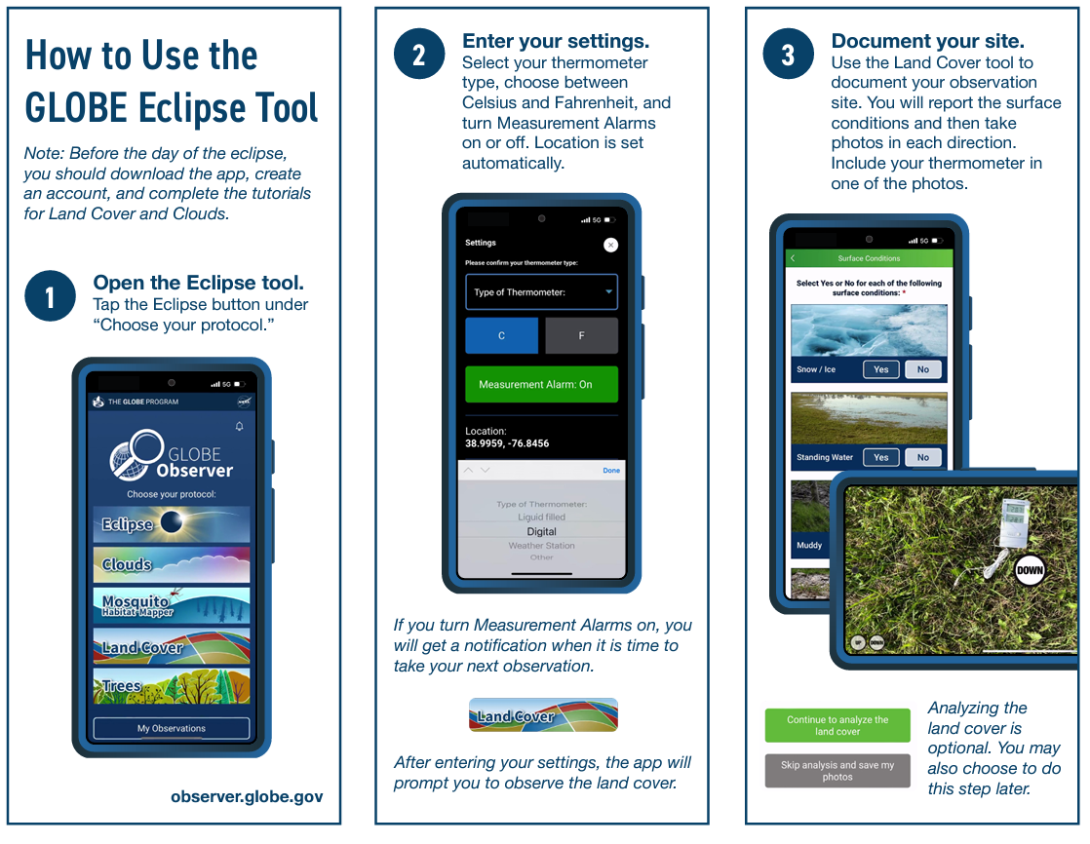

Slide 23
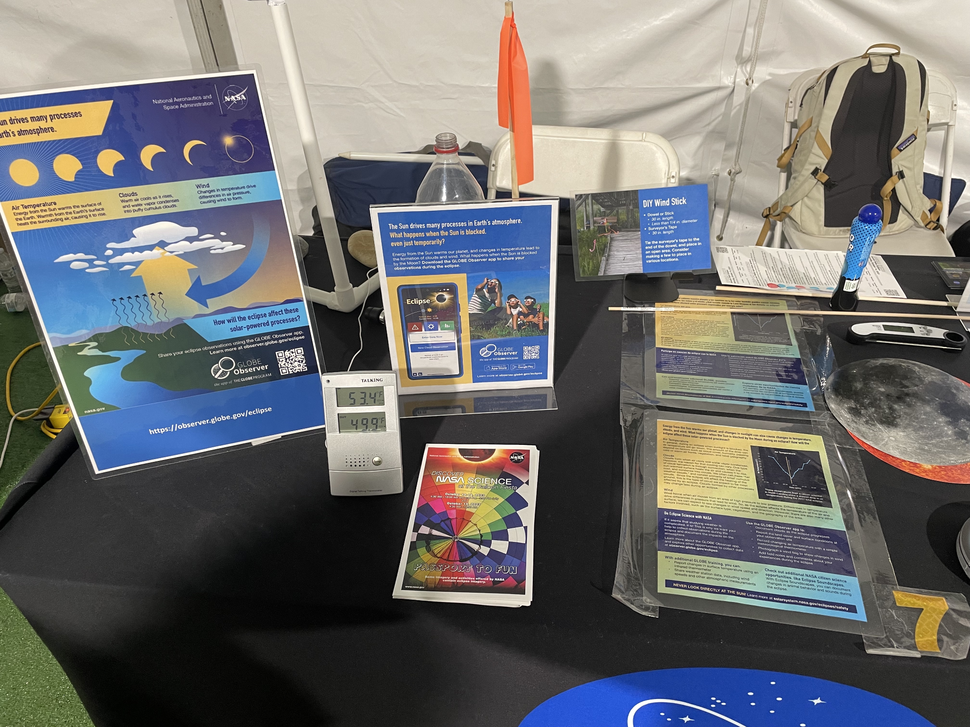
GLOBE Eclipse Display Resources
GLOBE Eclipse Tabletop signs
GLOBE Atmosphere one-pager
How-To Guide
GLOBE Eclipse Poster
Elementary GLOBE Storybook: Do you know that clouds have names?
GLOBE Eclipse graphic assets
NASA’s Solar Eclipse Map

Slide 24
Programming Ideas
Daytime Star Party
Check out the step-by-step guide on the STAR Net YouTube channel
Pair citizen science with hands-on activities, crafts, and/or guest speakers
Heliophysics Big Year
Hold events before and after eclipse
NASA solar science programming all year round
STEM Activity Clearinghouse
500 vetted activities for informal learning environments
Library-specific guides and how-tos
SEAL Collection

Slide 25
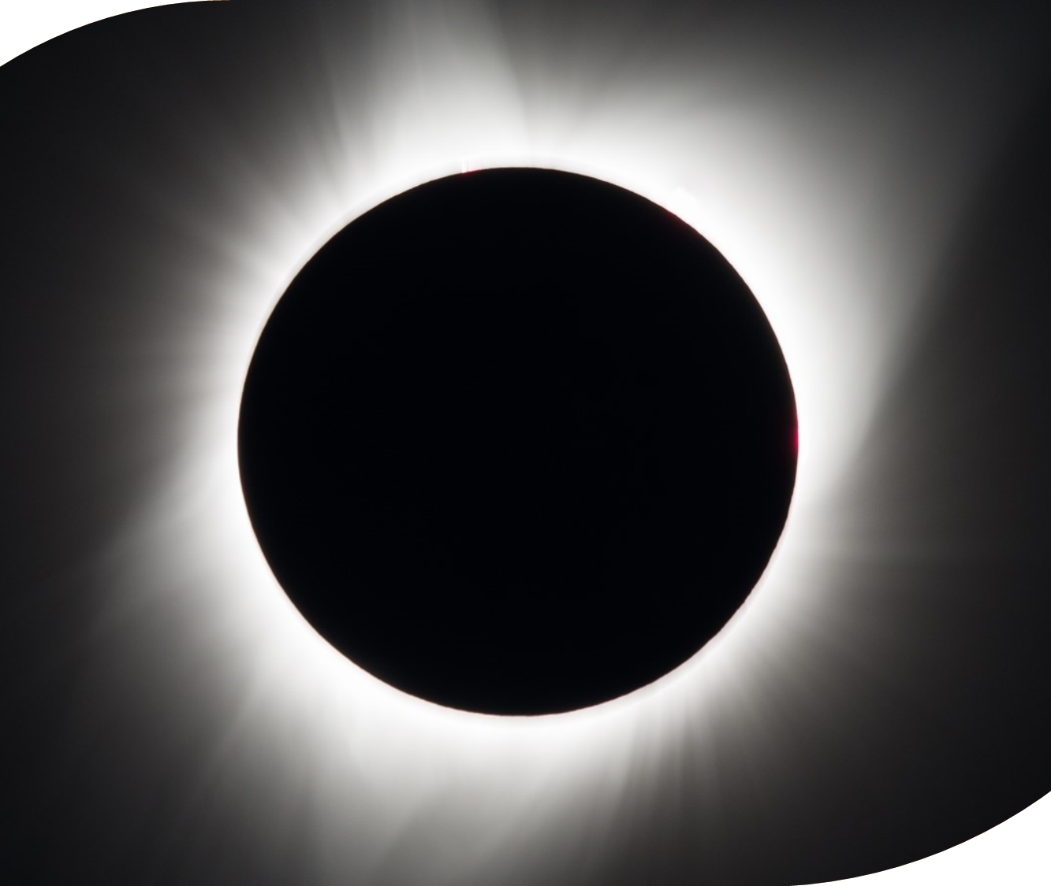
Projects during the eclipse
iNaturalist
GLOBE Observer: Eclipse
Eclipse Soundscapes
Notes:
iNaturalist: take photos of biodiversity during the eclipse and upload them to iNaturalist

Slide 26
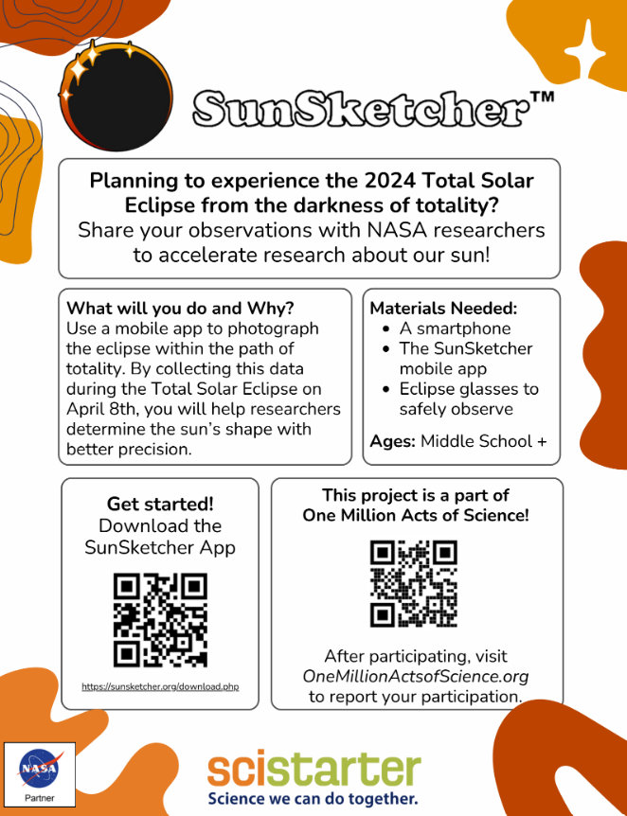
Projects before and after the eclipse (SciStarter.org/eclipse)
Aurorasaurus: Submit sightings and classify relevant tweets about auroras.
Citizen CATE: Make observations of the inner and middle solar corona.
Citizen Weather Observer Program: Contribute your weather data and check the data quality of others.
Do-It-Yourself Relativity Test: Measure the gravitational deflection of starlight.
Eclipse Ballooning Project: Students will conduct high-altitude balloon flights.
Eclipse Megamovie: Share photos you take of the sun during the eclipses so scientists can stitch them together to create an expanded view of the Sun’s atmosphere.
Globe at Night: Measure the night sky brightness.
HamSCI: Are you a Ham radio operator? Help us better understand Earth’s ionosphere.
iNaturalist: Take photos of biodiversity and upload to iNaturalist.
ISeeChange: Share reports of changes in your local environment.
Solar Active Region Spotter: Identify active regions of the sun, online.
Solar Jet Hunter: Join the hunt for solar jets — enigmatic bursts of energy from the Sun.
The Sungrazer Project: Find comets in our solar system, online.
Notes:
Globe at night: measure your observations of the sky at your location to help scientists understand how light pollution impacts energy consumption as well as human and animal life.
Solar Jet Hunter: examine high resolution images of the Sun to identify solar jets (small and narrow ejections of solar material) to help scientists better understand solar activity
Ham Radio:

Slide 27
Citizen Science Month Webinar
Join SciStarter and STAR Net
Tuesday April 17th 2024
Explore citizen science and your library all year long!
Registration link available soon at
https://www.starnetlibraries.org/development/webinars/

Slide 28
Participate
We aim to make a collective impact of One Million Acts of Science where our goal is to collectively generate over one million data points to featured projects.
Notes:
Tara

Slide 29
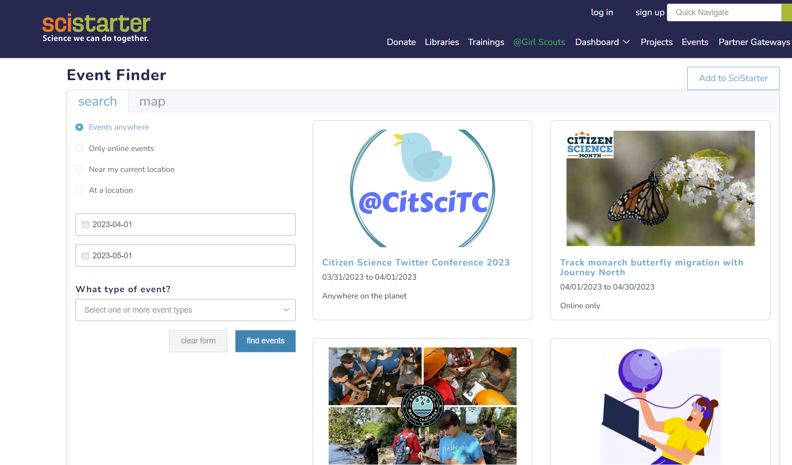
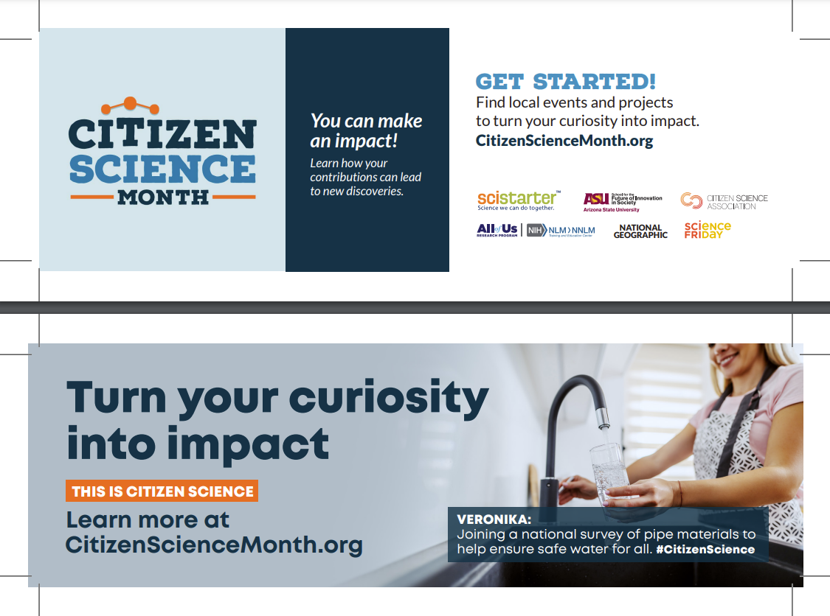
Add & Promote Your Event
SciStarter.org/events
Help people learn about your event
Help us measure collective impact
Access to ASU evaluation tools and data
Notes:
Emma
https://scistarter.org/library-network

Slide 30
Upcoming Webinars & Opportunities
CSM Event Facilitator Support Meetings
March 13
12PM Pacific | 3PM Eastern
Community Driven Science Adventures(s) at Your Library this Summer!
March 27
12PM Pacific | 3PM Eastern
SciStarter.org/library-events
Notes:
SciStarter LIVE on January 16th, Facilitator part II, register here: https://us02web.zoom.us/webinar/register/WN_X_Usvnt3SFKCihOXHBUOjA

Slide 31
Thank you!

Slide 32
Questions?
How might you participate in citizen science month this year?
Where do you need more support?
Type your questions in the chat!
Notes:
Mentimeter/chat debrief
Emma’s screen? https://www.mentimeter.com/app/presentation/alp9oruhug3khhjrp4qbvgnbt6ckndxn/5h1rmr88ac9d/edit

