Slide 1
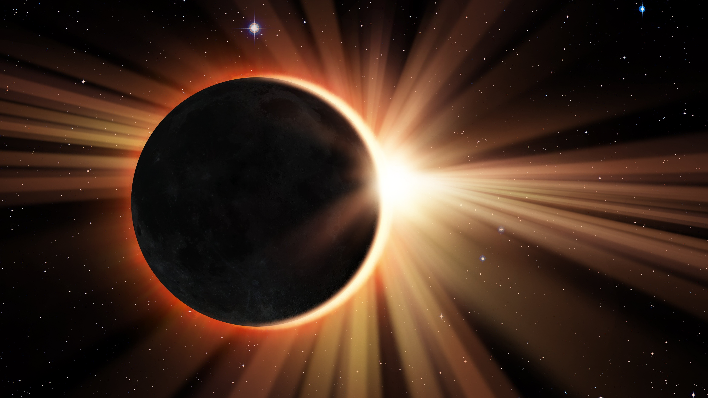
Get Ready For The 2024 Eclipses: How To Inspire And Connect With Patrons And Partners Through Engaging STEM Programs

Slide 2

Agenda
Introductions
Icebreaker
Who is STAR Net?
Website/Community
Clearinghouse
Facilitation Strategy: Guide on the Side
Other resources
Ending Q&A
Passion for Pixels Activity

Slide 3

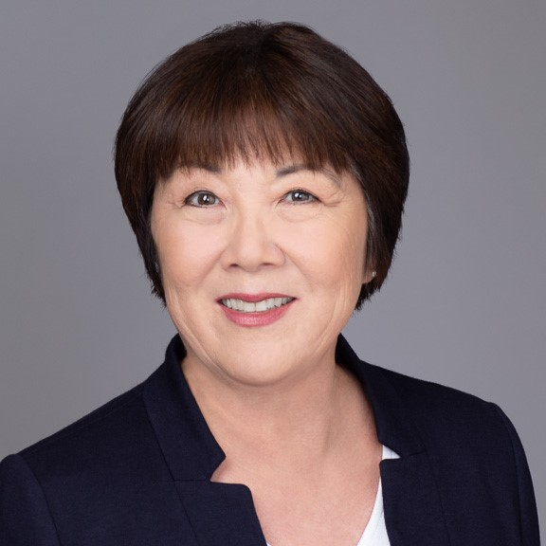

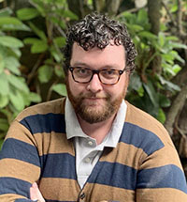
Introductions
Phyllis Kanekuni
Community Outreach and Engagement NASA@ My Library Coordinator, Thelma Parker Memorial Public Library
Stephanie Vierow-Fields Education Associate, Space Science Institute
Dillon Connelly
Education Specialist, Space Science Institute

Slide 4

Ice breaker
What are your favorite STEAM programs you've facilitated at your library?
Or
If you're new to STEAM programming, what types of programming interest you?

Slide 5
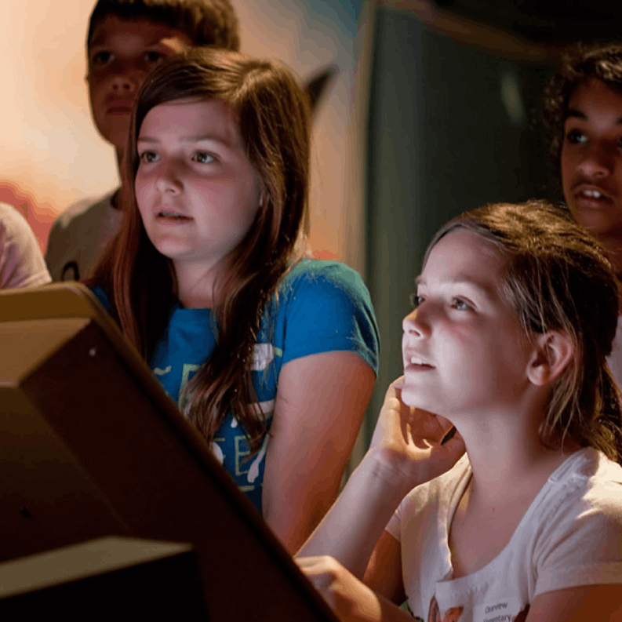



SSI's Mission
Discover, Educate, Inspire
Enable scientists to advance our understanding of Earth and the Universe
Increase science and tech literacy for all
Inspire youth to pursue STEM education and careers

Slide 6
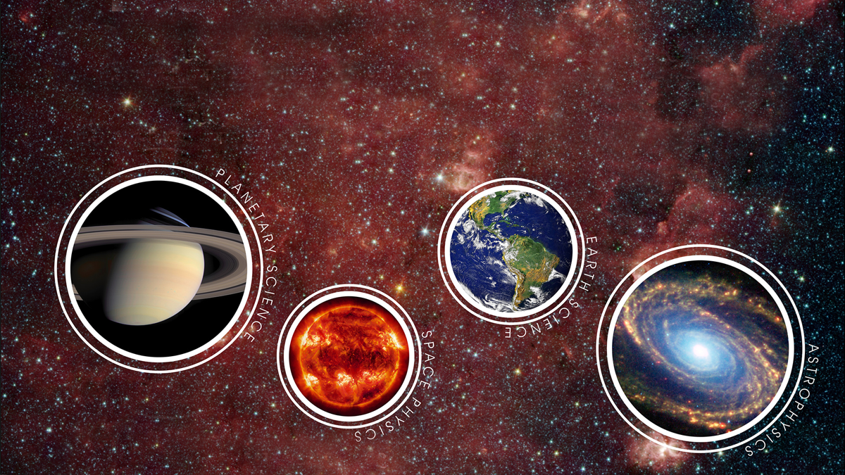
RESEARCH PROGRAMS
at Space Science Institute
Research, development and consulting services in science, education and management.

Slide 7


STAR Library Education Network
Who we are and what we do!
Notes:
Now I'm going to take a step back from the eclipses to share a bit about who we are at the STAR Library Education Network, or STAR Net, and what we do for libraries. Who here has heard of STAR Net?

Slide 8

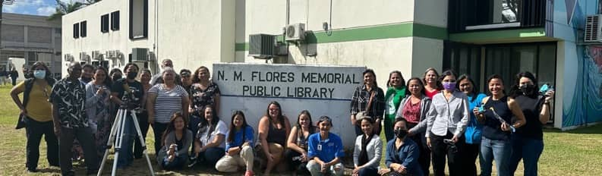

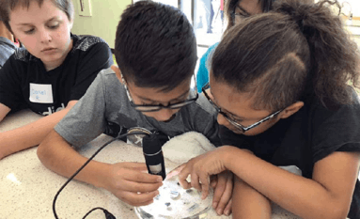
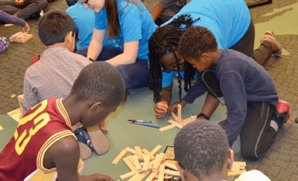
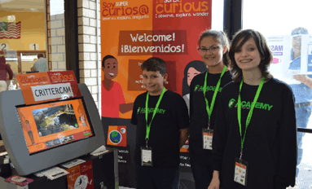
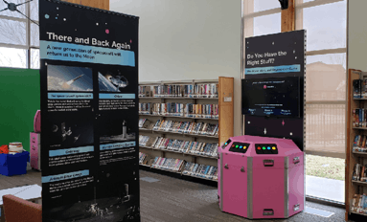
What does STAR Net do?
Events
Interactive Activities
Facilitation Strategies
Resource Dissemination
Eclipse Glasses and Training!
Exhibits
Kits
Professional Development
Community Dialogues
Partnership Guidance
SME Matchmaking
18

Slide 9
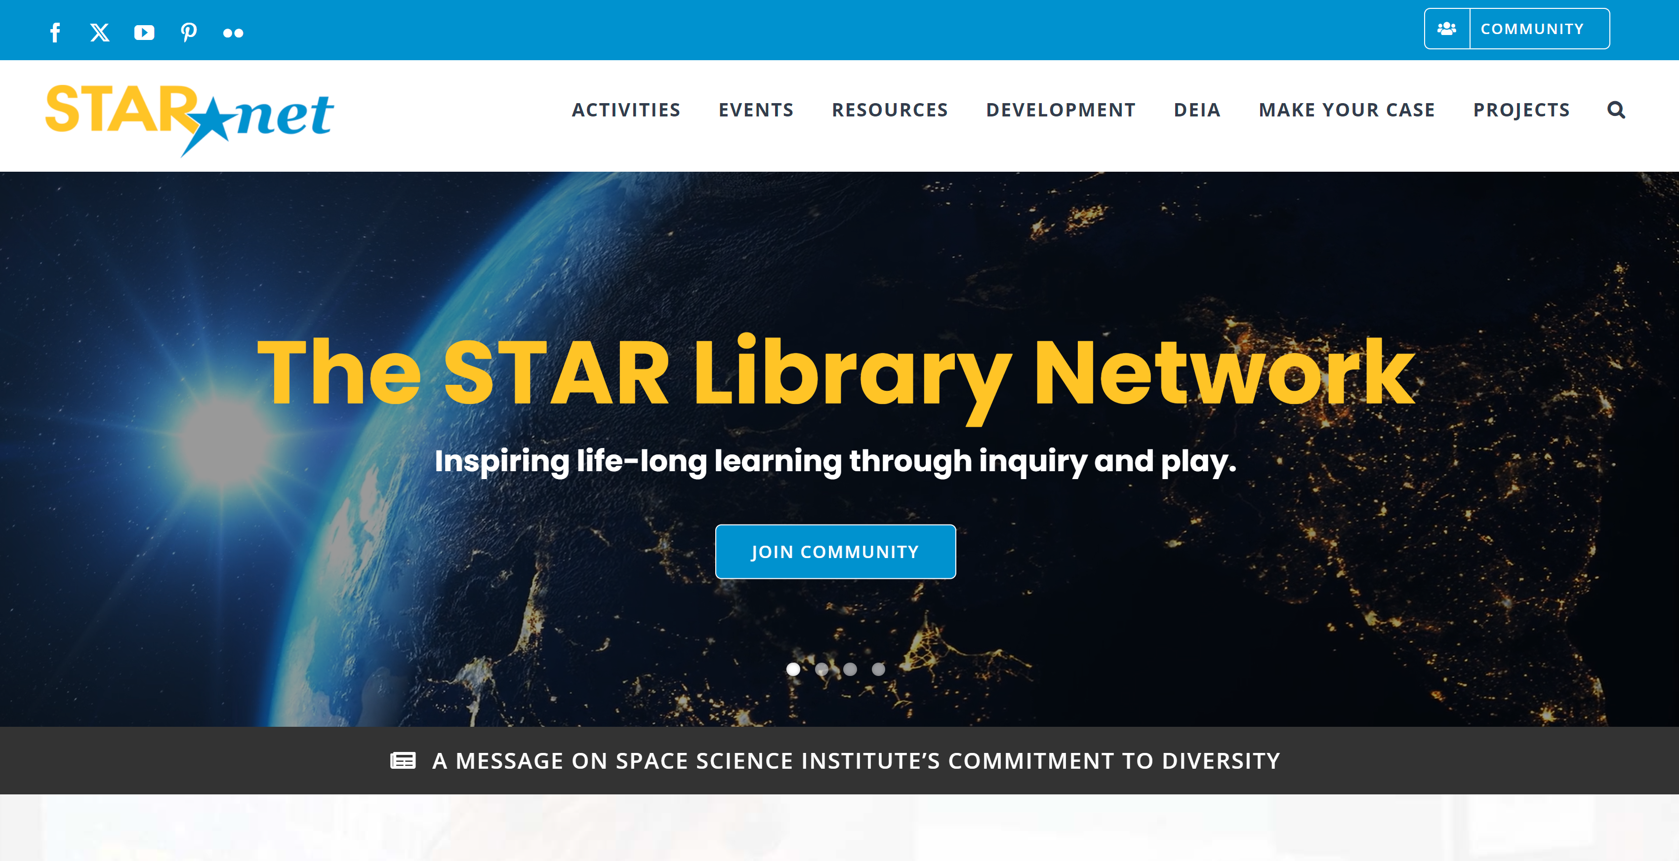

Slide 10
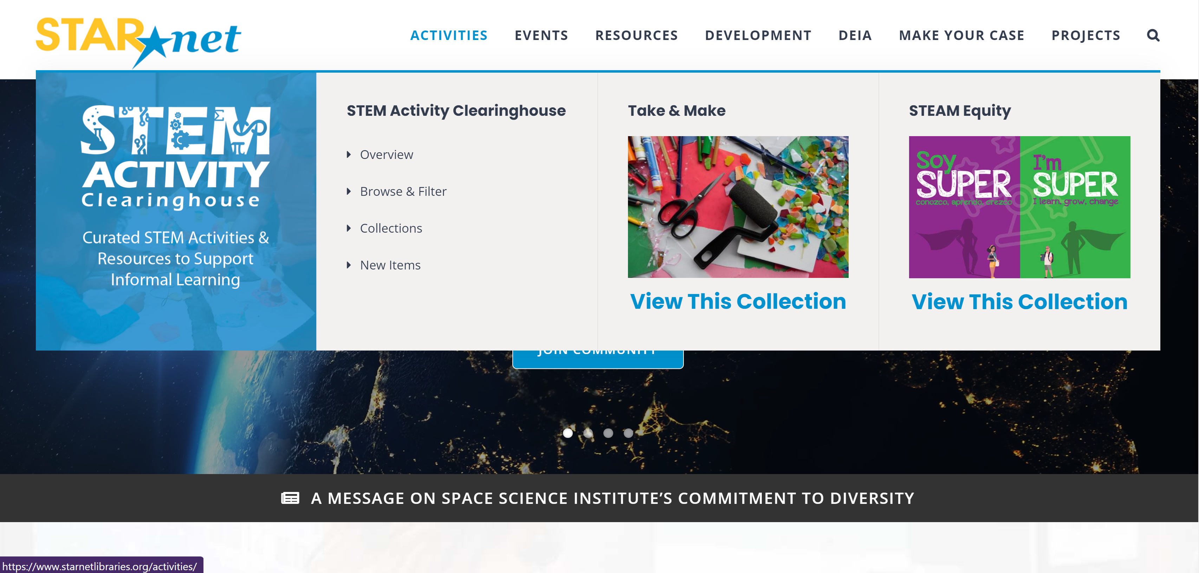

Slide 11
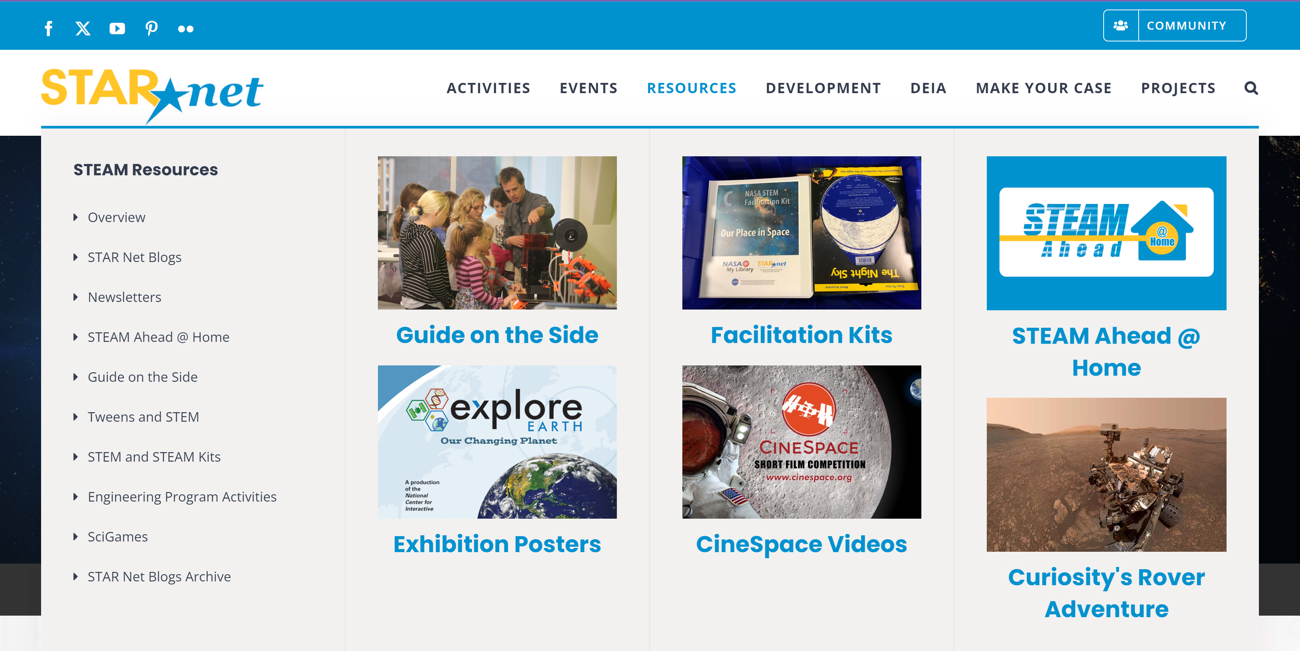

Slide 12
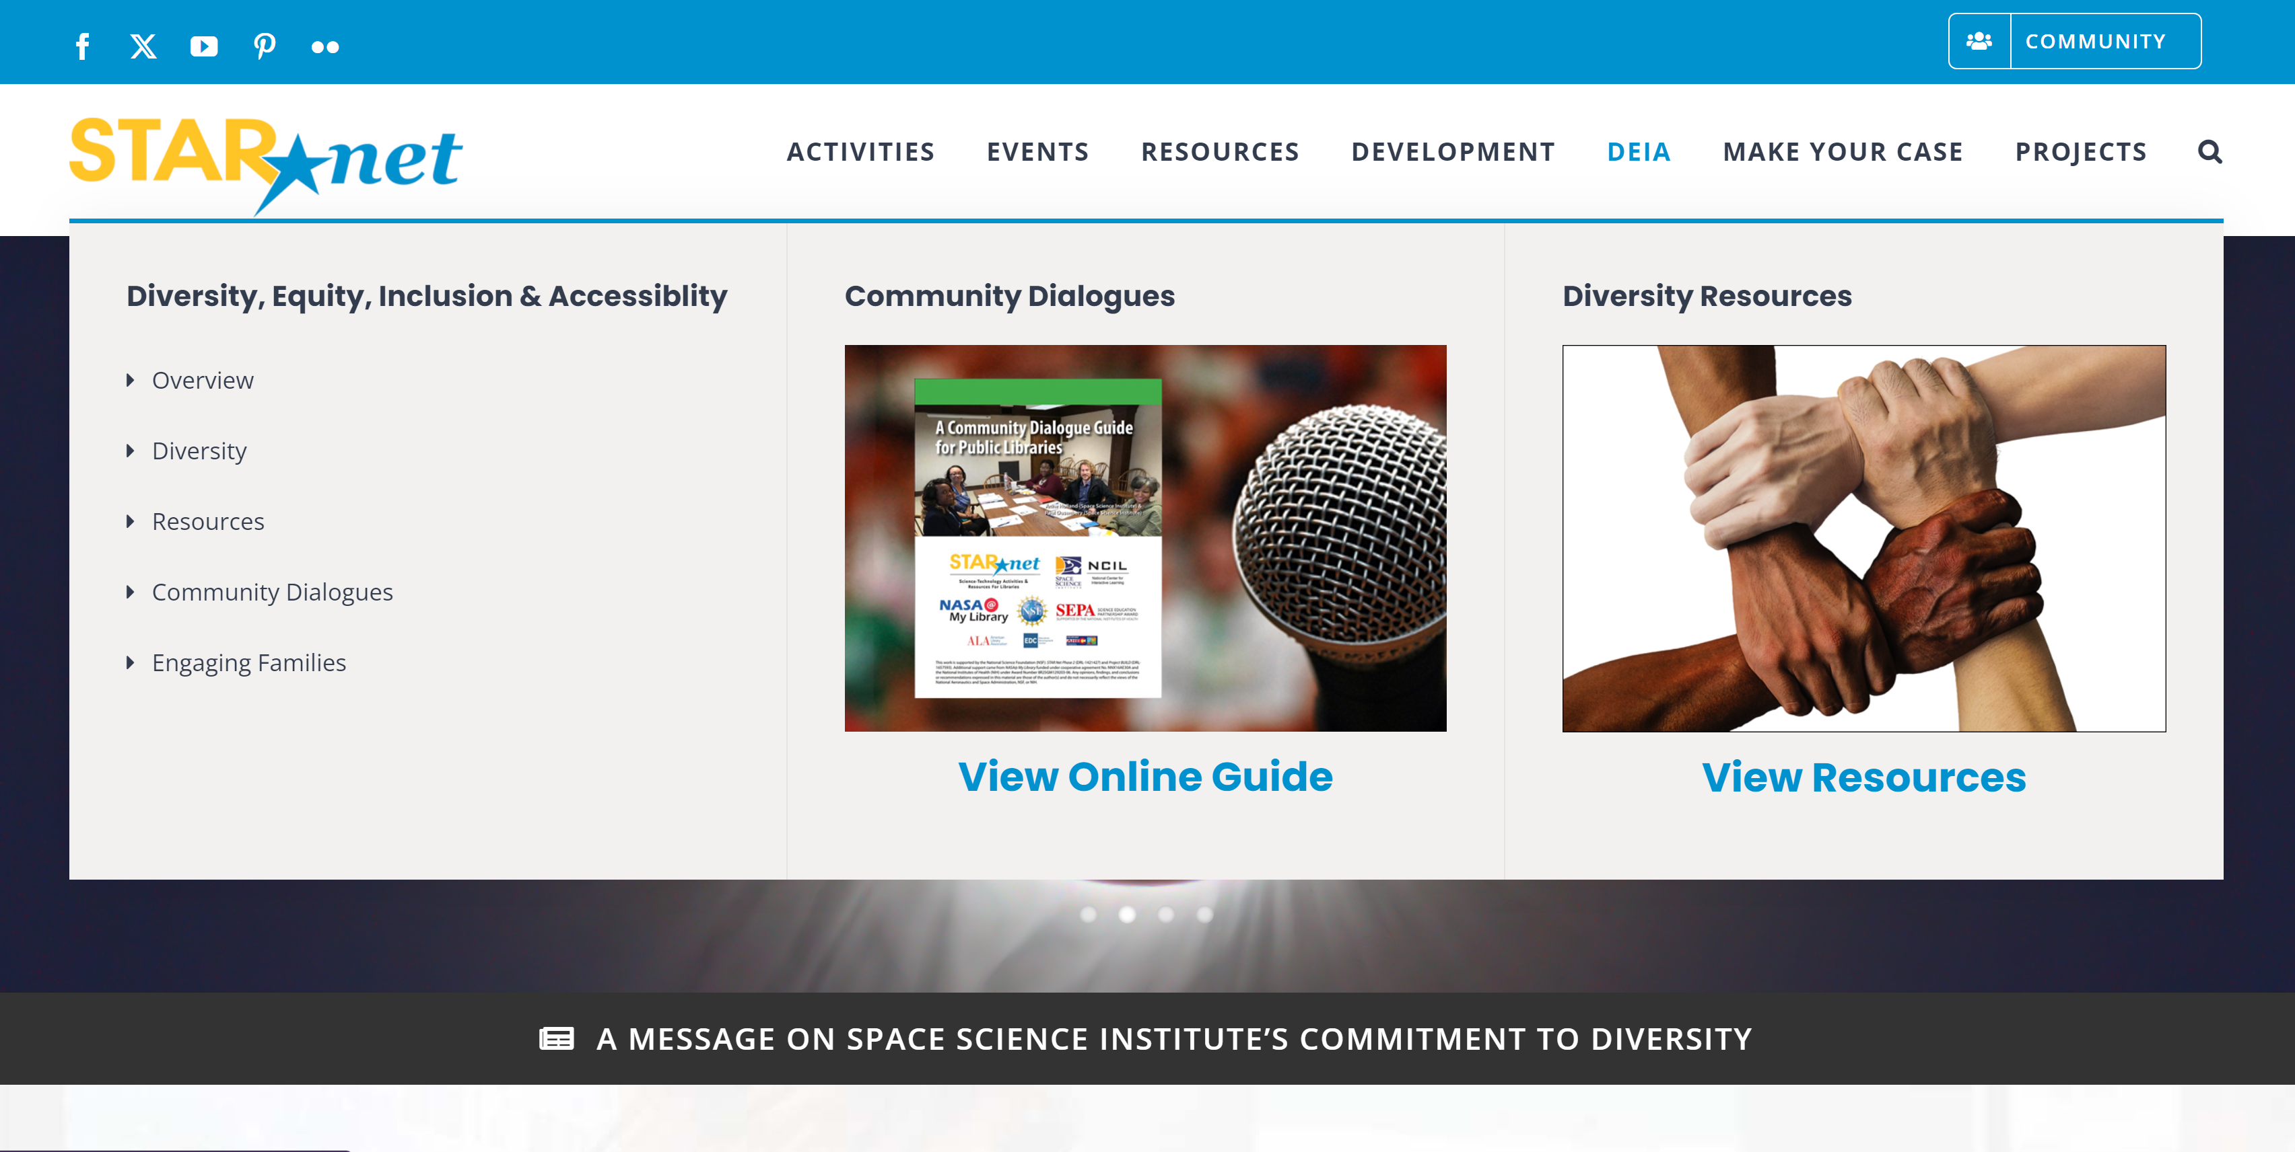

Slide 13

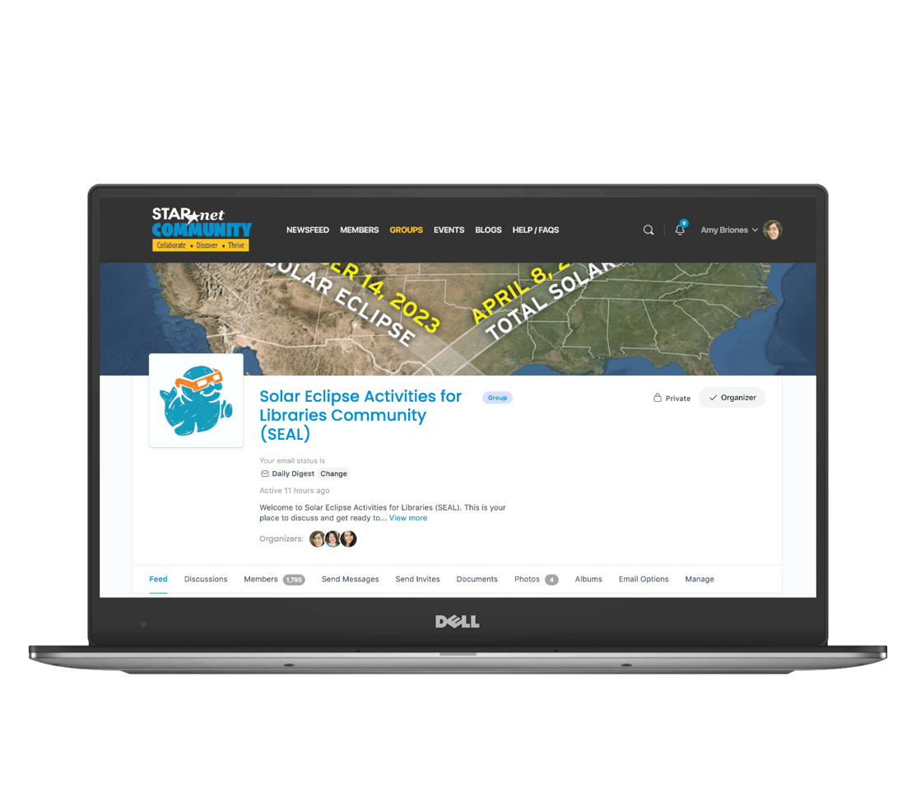
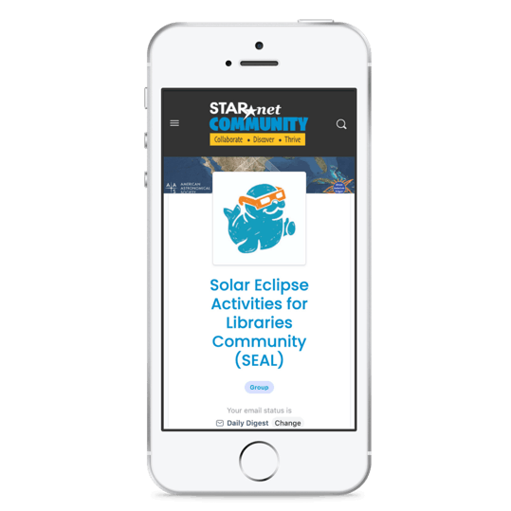
SEAL Group on the STAR Net Online Community

Slide 14
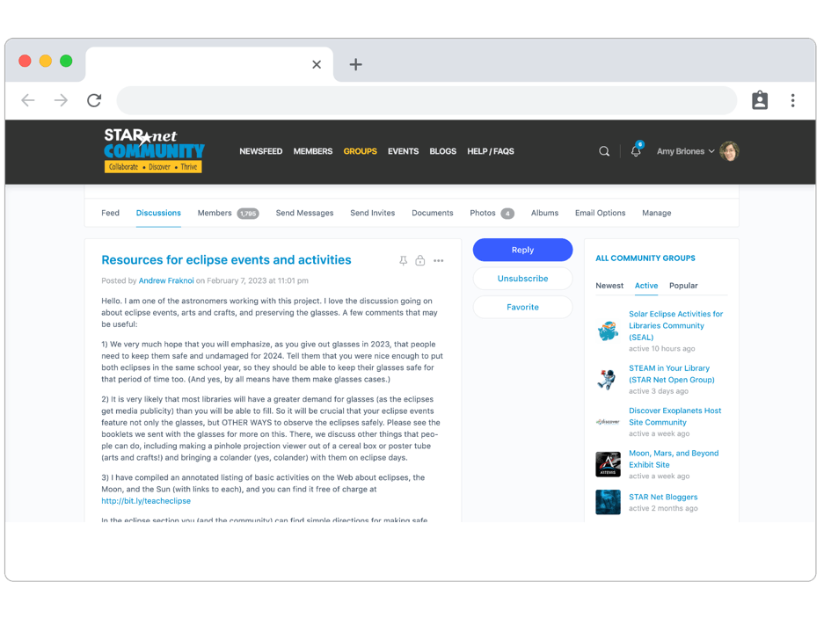
What is the Community?
Online network specially curated for you
Opportunity to interact with fellow libraries
Place to upload your program pictures, activity documents, and chat

Slide 15
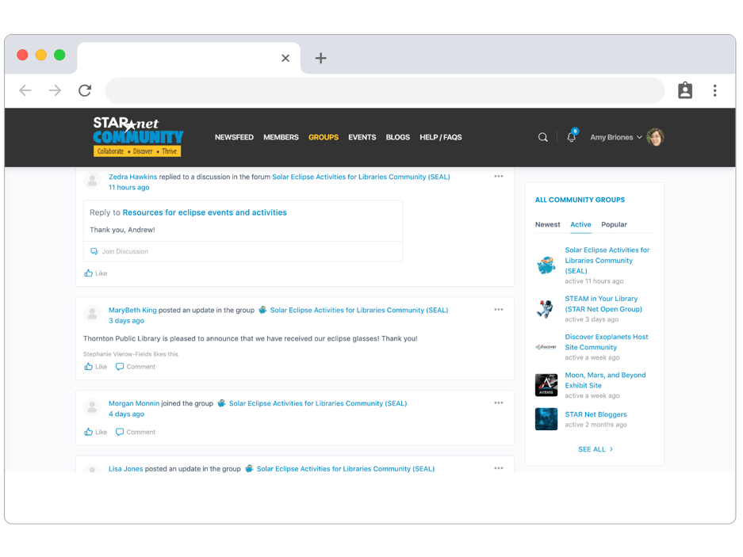
What is the Community?
Like other social media platforms, you can post discussions, “like” other’s comments, upload documents for activities and share pictures

Slide 16
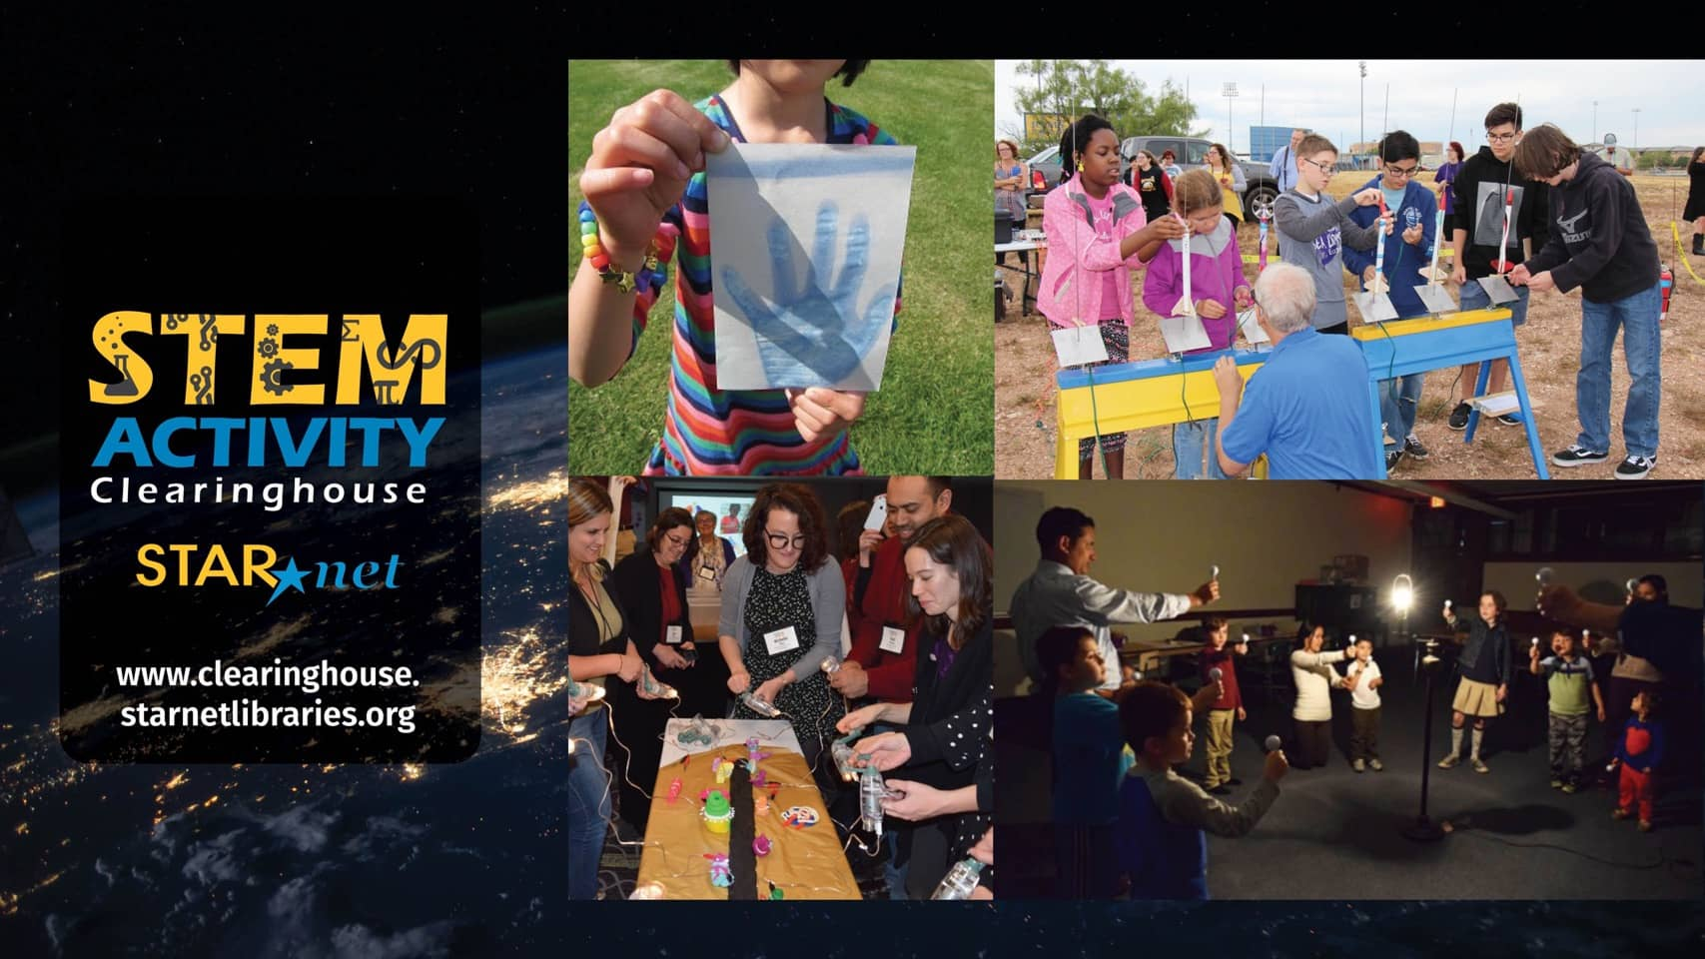
Notes:
A short walkthrough the STEM Activity Clearinghouse resource.

Slide 17
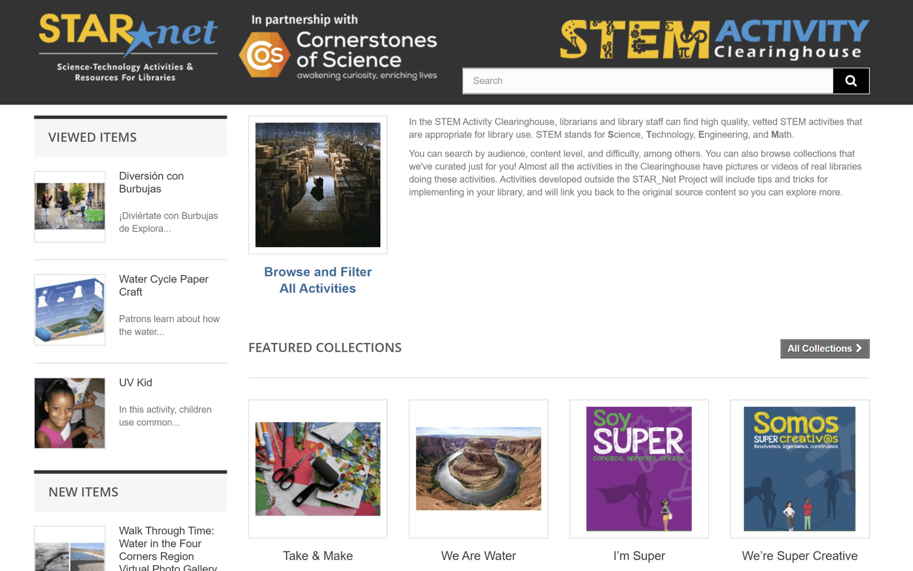
Notes:
There are 38 collections featuring over 500 interactive STEM activities for pre K through adult library programs. On the Clearinghouse’s homepage, you will find eight featured collections.

Slide 18
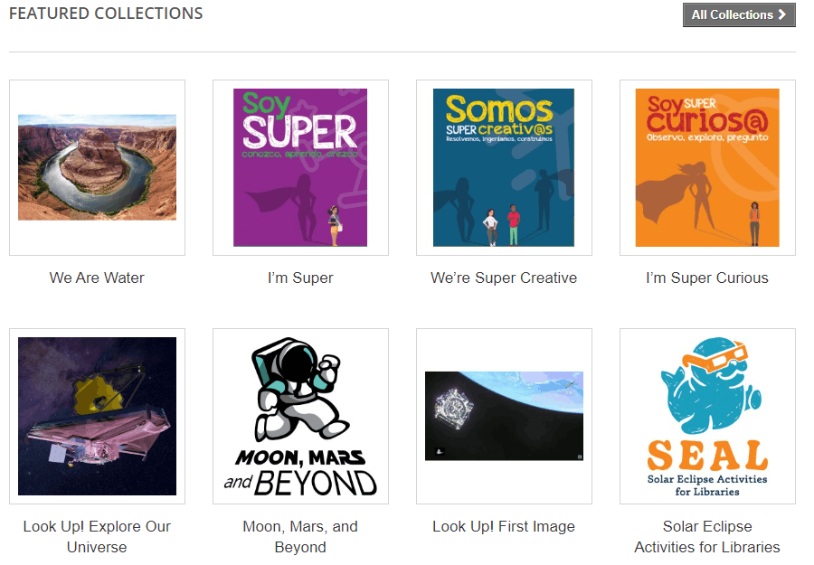
Notes:
The 8 featured collections may rotate throughout the year to reflect seasonal events or to showcase activities for specific STAR Net projects, such as the Solar Eclipse Activities for Libraries (SEAL) collection

Slide 19
Notes:
To help navigate the site. Click on the “Browse and Filter All Activities” button on the home page

Slide 20
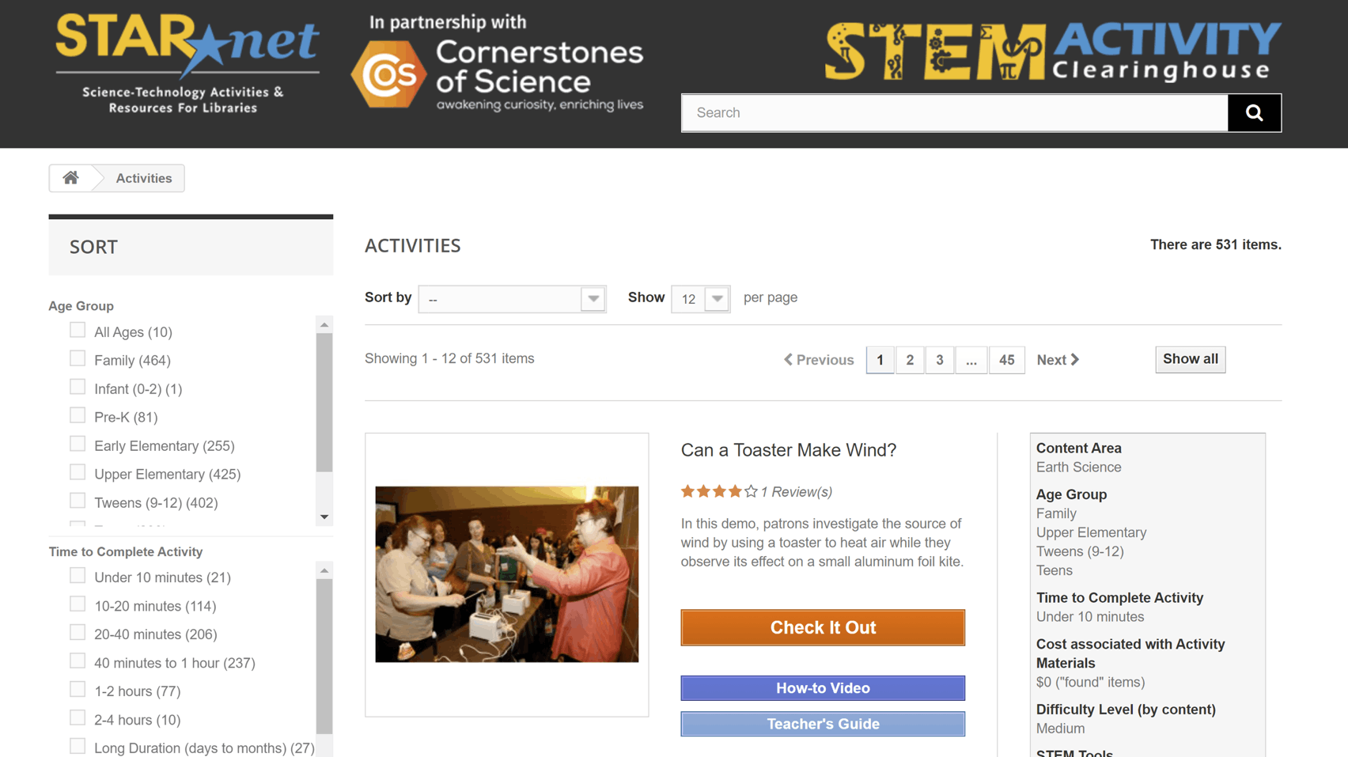
Notes:
and look for the Sort toolbar on the left-hand side

Slide 21
Notes:
to begin searching.

Slide 22
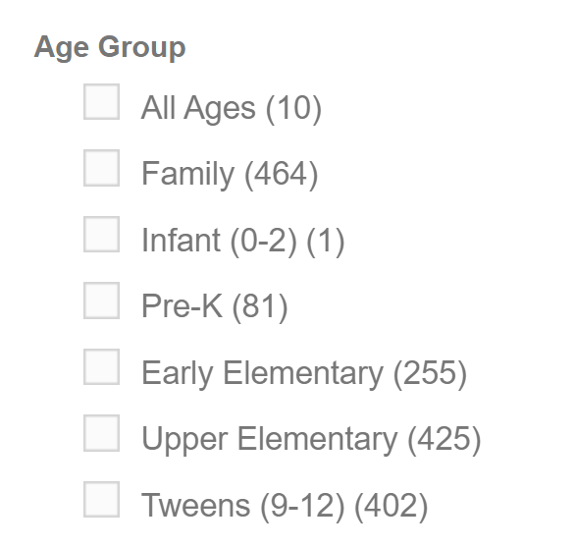

Tweens
Notes:
For example, I need an activity for Tweens

Slide 23
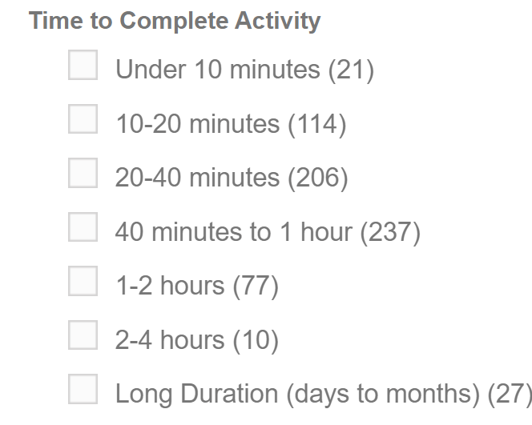
Tweens
One hour
Notes:
that takes one hour

Slide 24
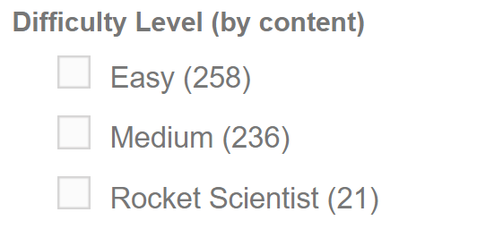
Tweens
One hour
Easy
Notes:
has an easy difficulty level

Slide 25
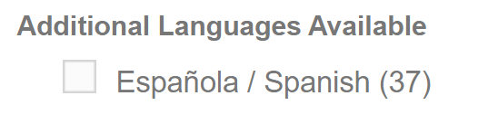
Tweens
One hour
Easy
Instructions in Spanish
Notes:
with instructions in Spanish.

Slide 26
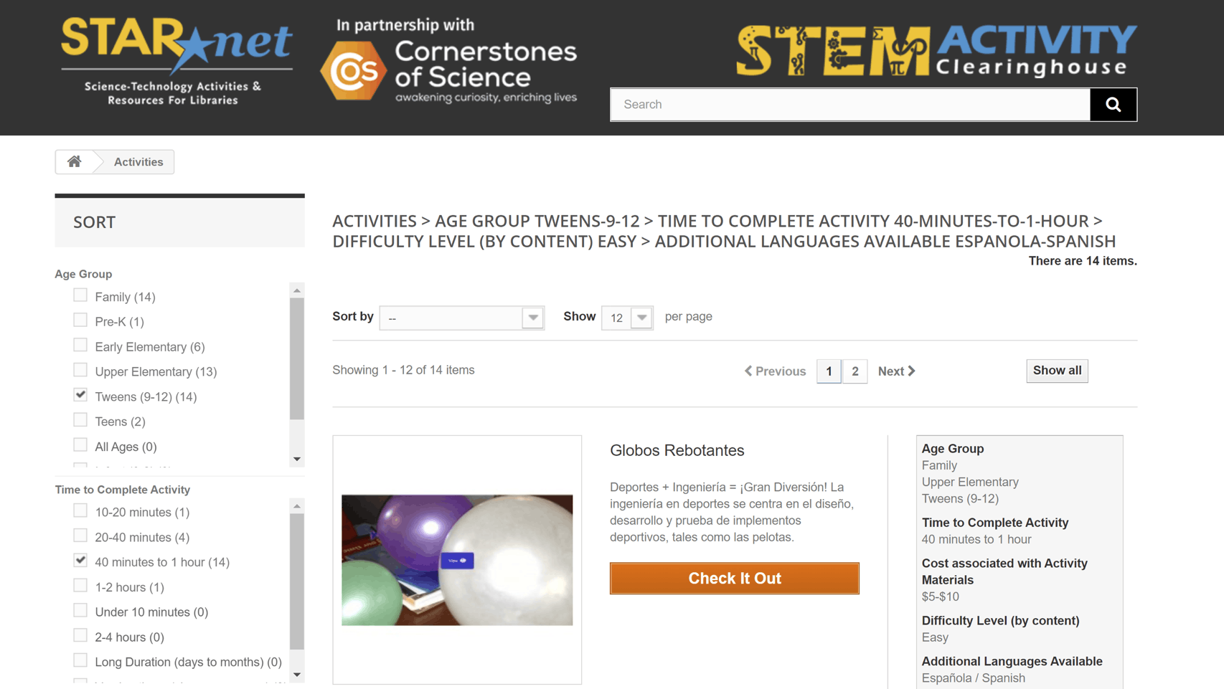
Notes:
14 activities match my requirements

Slide 27
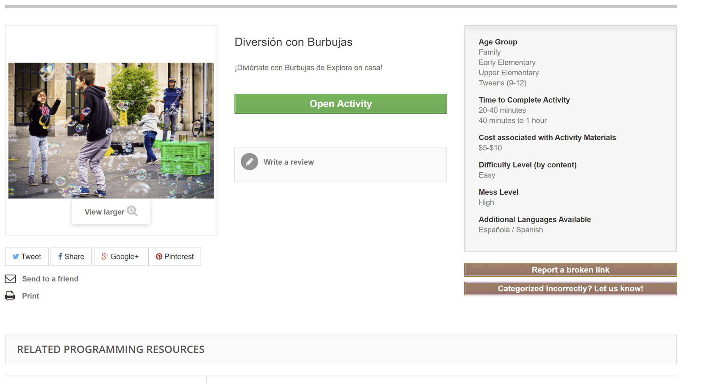
Notes:
After you select an activity, notice you can scroll down to “Related Programming Resources.”

Slide 28
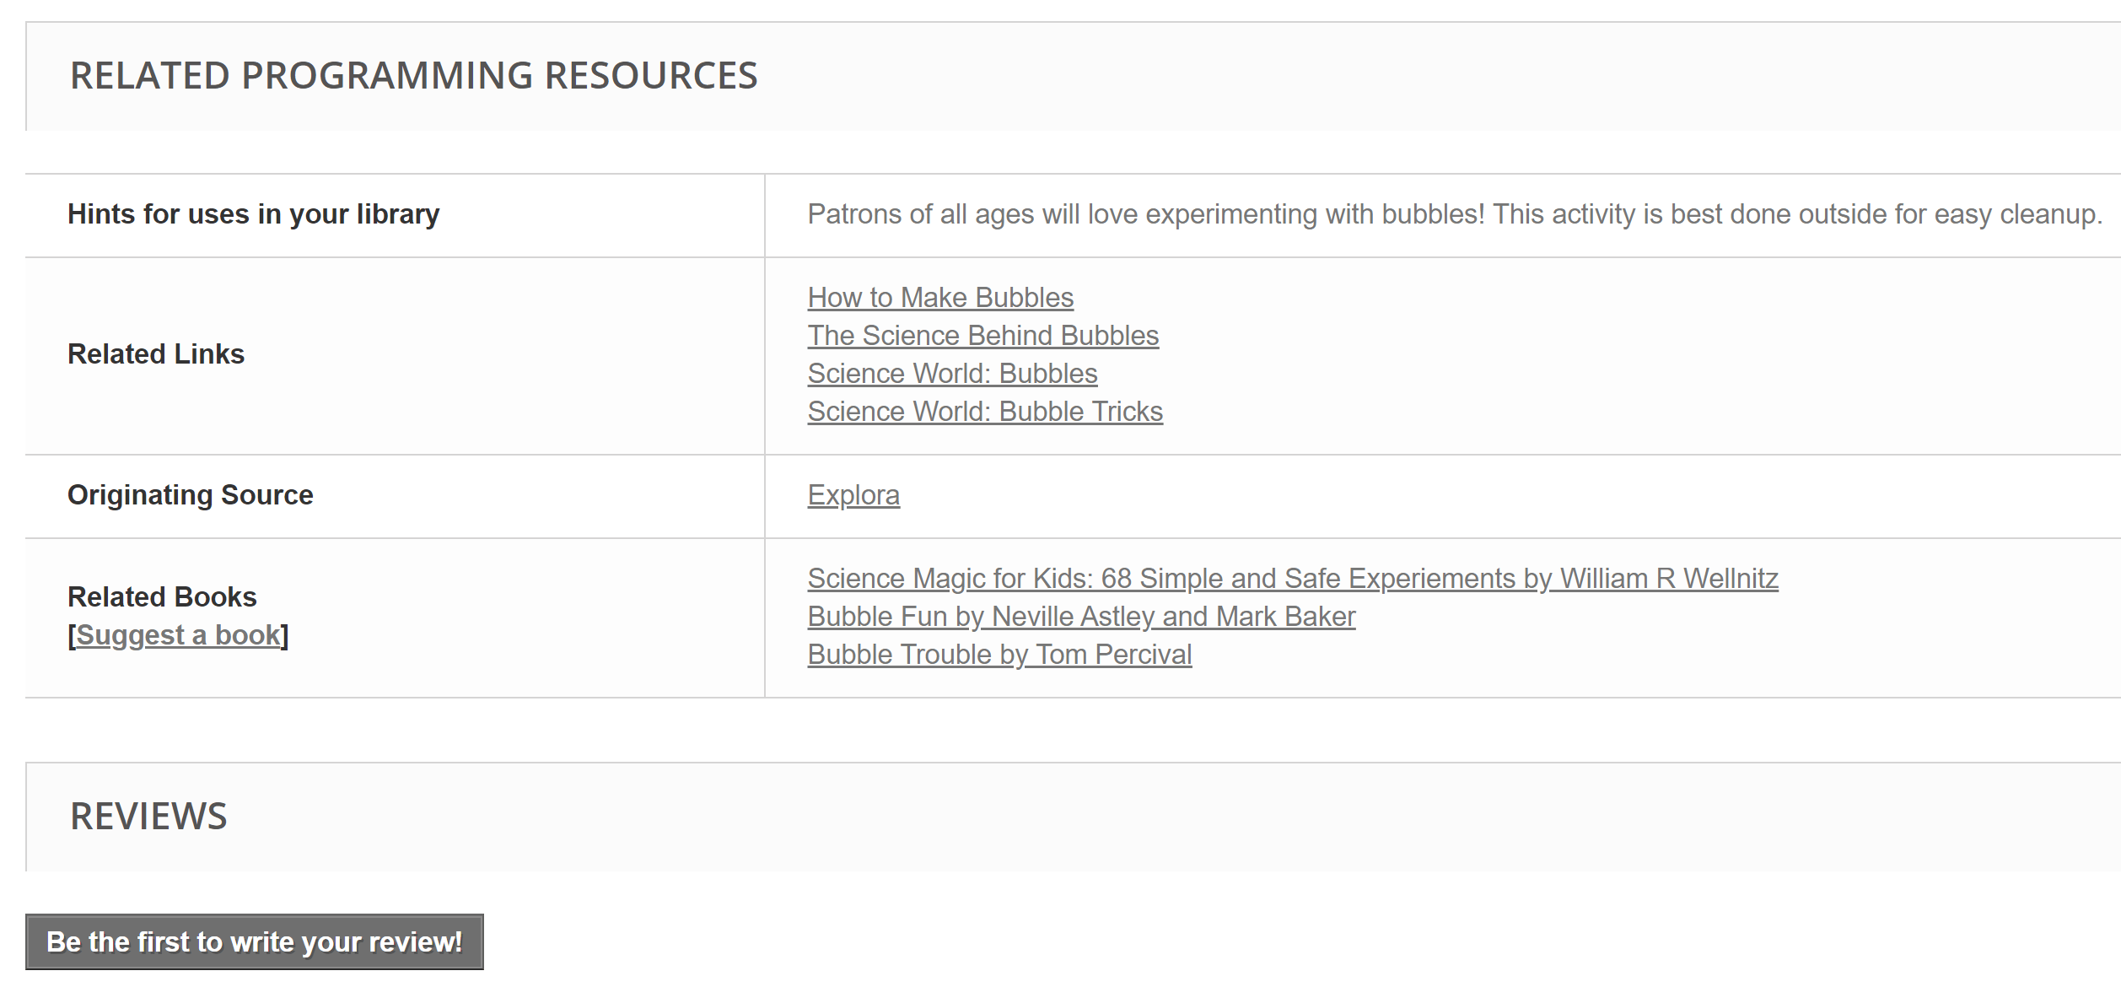
Notes:
It includes hints for uses in your library, related links, books, and other information to help you facilitate the activity.

Slide 29
Notes:
After you’ve done an activity, we invite you to write a review about how it went.

Slide 30
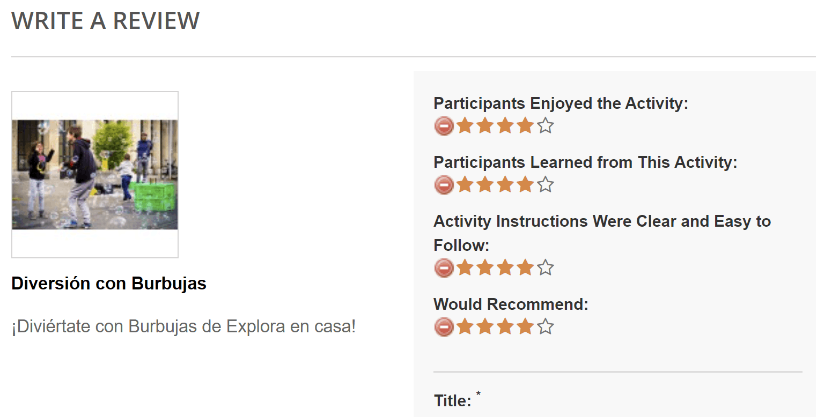
Notes:
This helps other library staff learn more about which activities work well in the library setting.

Slide 31

Activity: Passion for Pixels

Slide 32
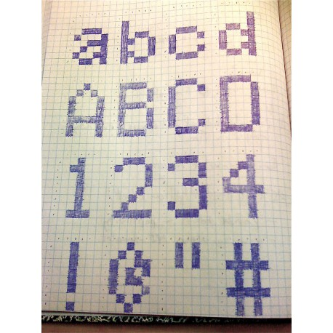
Passion for Pixels
Explore binary coding by “transmitting” a picture from yourself to a partner
Materials
  Two paper grids (paper grids or hand-drawn grids)
  Writing instrument

Slide 33



Passion for Pixels
Digital images are made of picture elements (pixels)
The ratio of pixels to area of the image determines the resolution (clarity) of the image
300 dpi – printed images
72 dpi – digital images

Slide 34

Pick a “transmitter” and “receiver”
The transmitter tells the receiver the image in binary code
“0” for empty square
“1” for filled square
This is binary coding!

Slide 35
Important tips
Determine order of transmission
Left to right? Right to left?
Does a new line start on the same side you began on or wrap around?

Slide 36


Slide 37
0
0
0
0
0
0
1
0
1
0
0
0
0
0
0
1
0
0
0
1
0
1
1
1
0

Slide 38
STEAM Facilitation Strategies

Slide 39
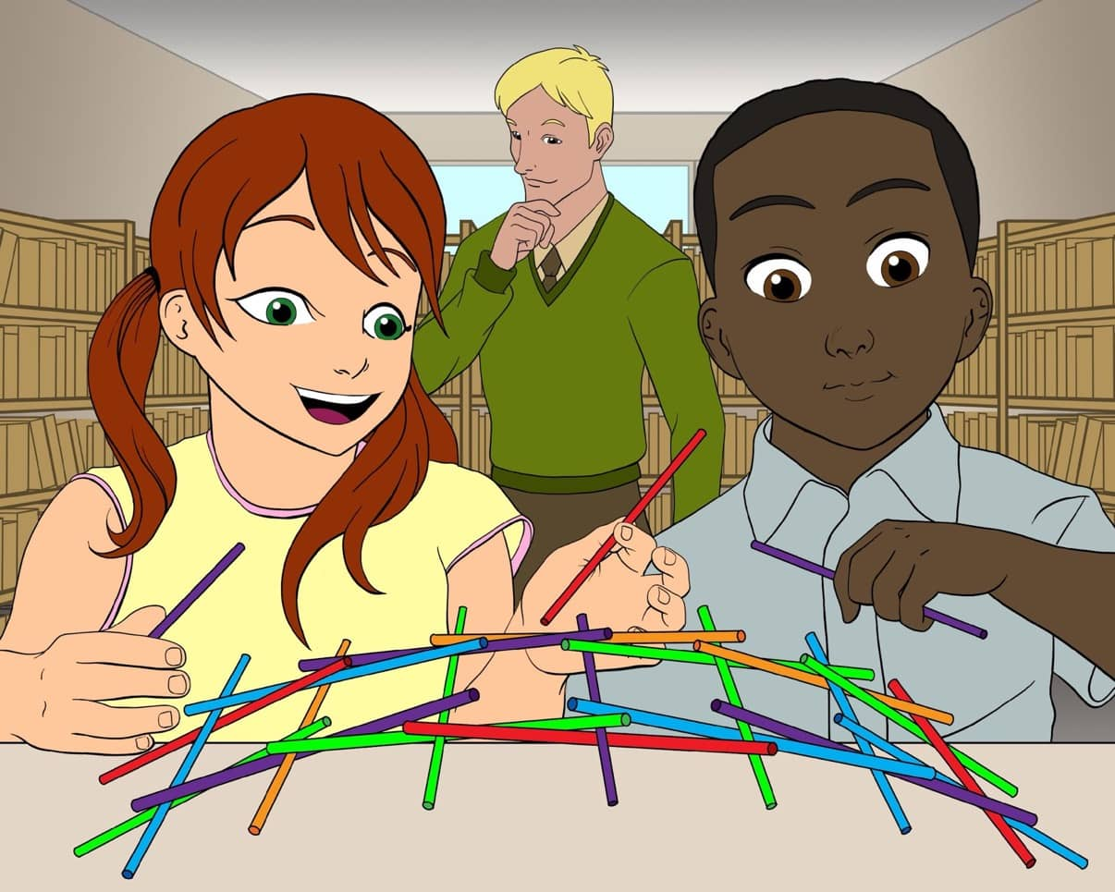
What do you notice about this image?
Guide on the Side
Illustration by Kevan Mills. Credit: Space Science Institute
Notes:
Now take a look at this image. What do you notice? / Who gets to participate? What is the facilitator’s role?
We call this style of facilitation "Guide on the Side." Being a “guide on the side” puts STEAM into the hands of the learners

Slide 40
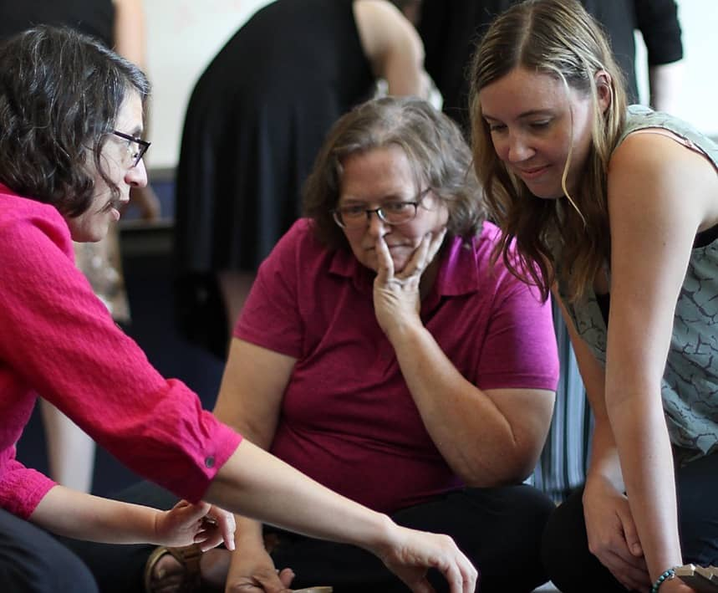
“Guide on the Side’’
Strategies for Your STEAM Programs
Credit: Space Science Institute
Notes:
Now we are going to dig into just how to be a “Guide on the Side” with strategies to help you guide library patrons in their own learning journeys.

Slide 41
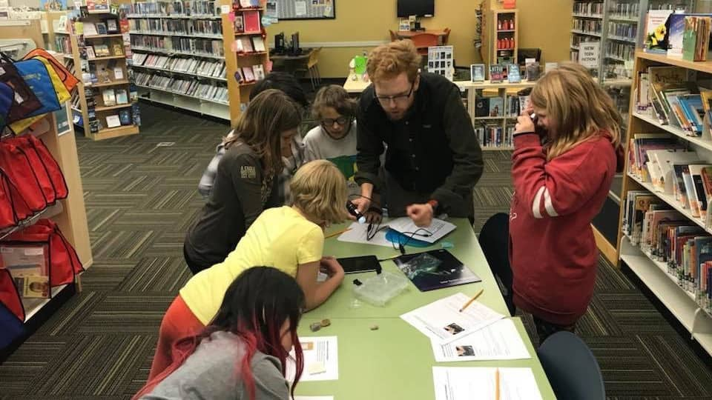
Strategy 1
Create a safe learning environment
Credit: Space Science Institute
Notes:
Strategy 1: Create an atmosphere that is safe for exploring – and where it’s okay to fail. Let patrons know that being wrong is the first step in learning!
Encourage patrons to use their own knowledge and experiences to help answer each other’s questions.
Show that you are not a “keeper of knowledge,” but rather that you are there to learn with your patrons.

Slide 42
I don’t know…let’s find out together!
Notes:
Try responding to challenging questions with phrases like: “I don’t know…let’s find out together!”

Slide 43
That is an interesting thought! How did you come up with it?
Notes:
When responding to patron’s answers, comment on the process of how they came to that answer, rather than on whether it is “right” or “wrong.”
Try phrases like: “That is an interesting thought! How did you come up with it?”

Slide 44
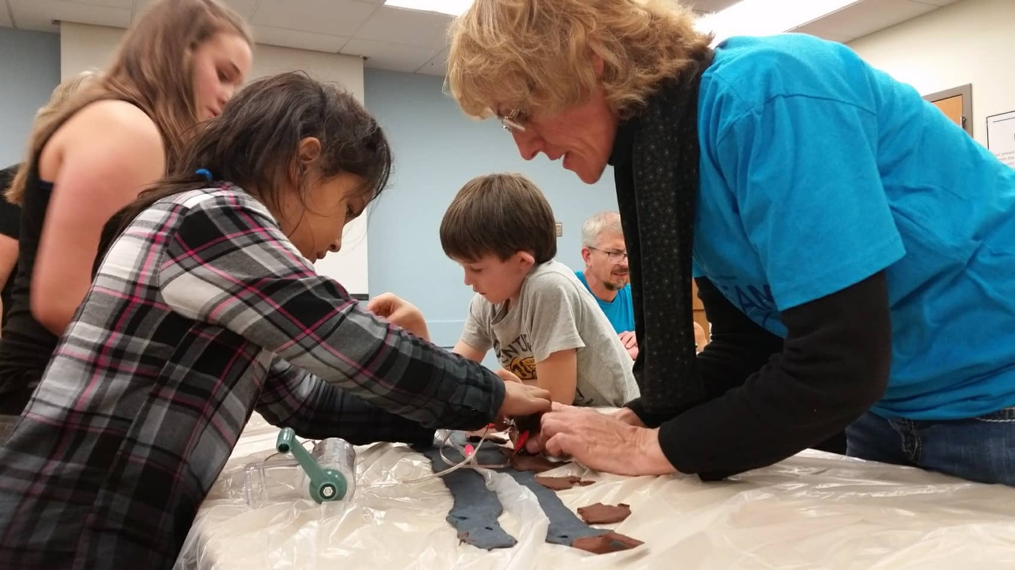
Strategy 2
Open-ended questions
Credit: Space Science Institute/High Plains Library District
Notes:
Strategy 2 Use open-ended questions to access patron’s prior knowledge and experiences. Open-ended questions are prompt learners to reflect and lead to more than one right answer.

Slide 45
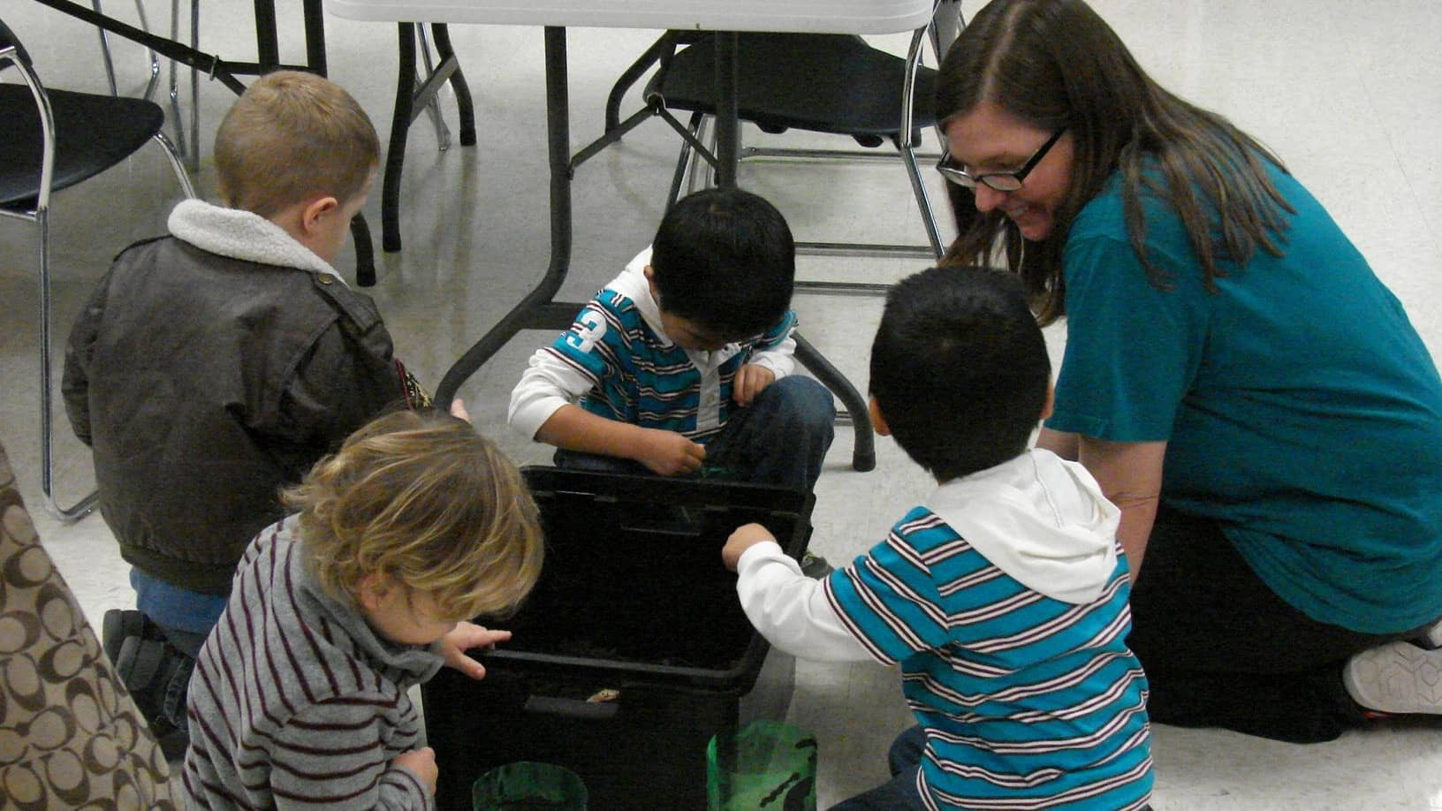
What do you notice?
Can you tell me more?
What does this remind you of?
Credit: Rolling Hills Consolidated Library
Notes:
For example, encourage patrons to try new things with questions like: What do you notice? Can you tell me more?

Slide 46

Strategy 3
Notes:
The third strategy will be demonstrated to you in a series of images over the course of 5 seconds. Please pay close attention and then share out what you observe.

Slide 47
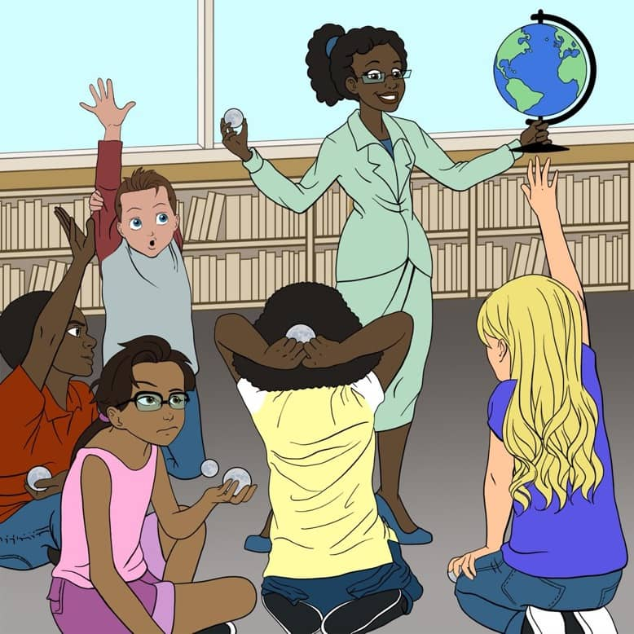
Illustration by Kevan Mills. Credit: Space Science Institute

Slide 48
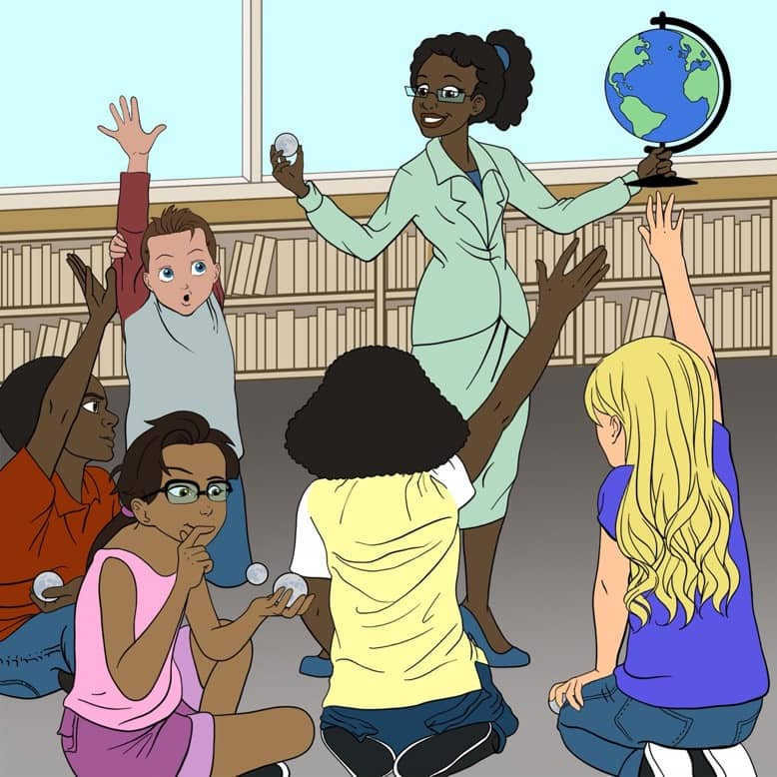
Illustration by Kevan Mills. Credit: Space Science Institute

Slide 49
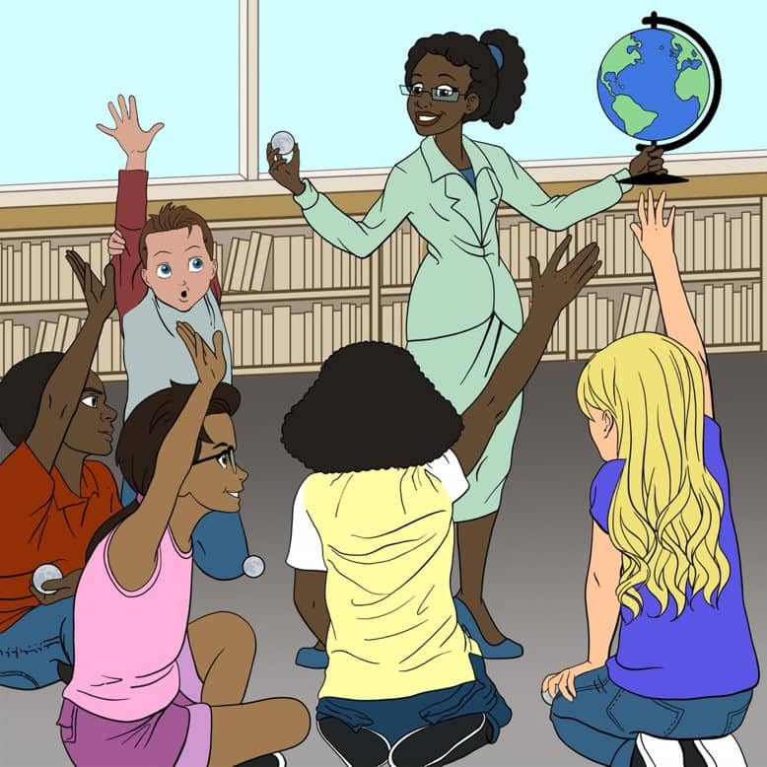
Illustration by Kevan Mills. Credit: Space Science Institute

Slide 50
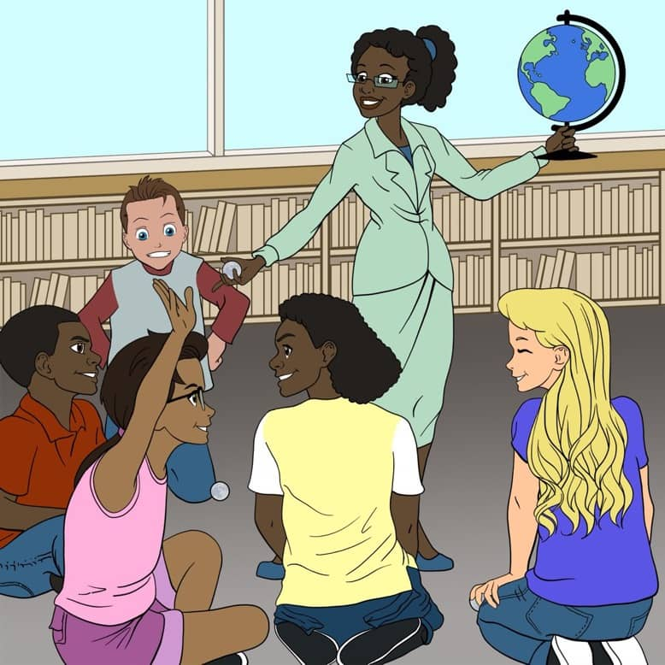
Illustration by Kevan Mills. Credit: Space Science Institute

Slide 51
Let's take another look

Slide 52
Illustration by Kevan Mills. Credit: Space Science Institute

Slide 53
Illustration by Kevan Mills. Credit: Space Science Institute

Slide 54
Illustration by Kevan Mills. Credit: Space Science Institute

Slide 55
Illustration by Kevan Mills. Credit: Space Science Institute

Slide 56
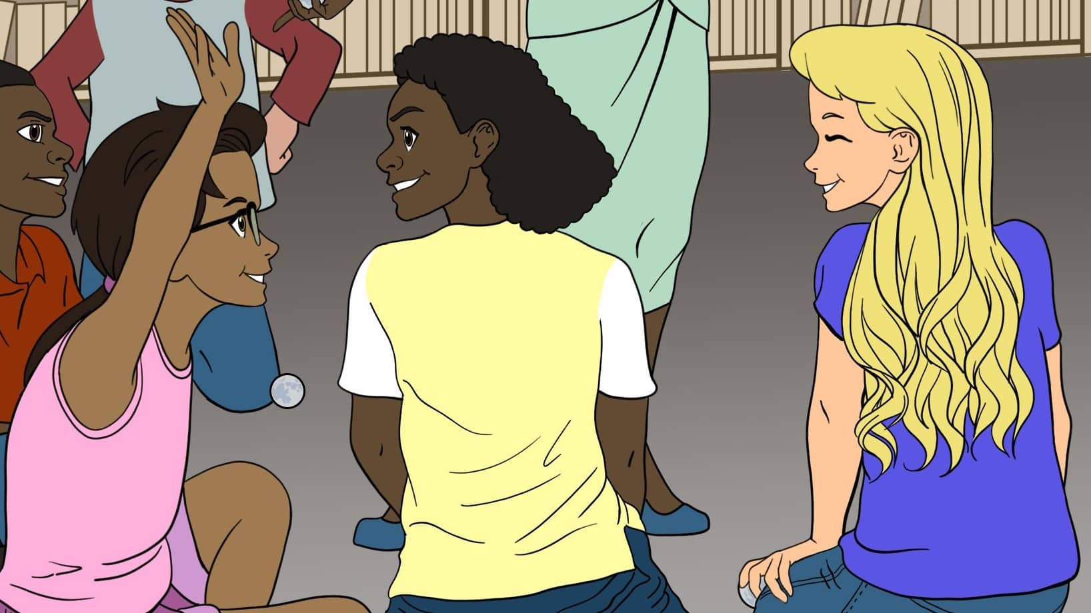
What did you observe?
Illustration by Kevan Mills. Credit: Space Science Institute
Notes:
What did you notice over the course of those images?

Slide 57

Strategy 3: Wait Time
Wait approximately 5 seconds after asking a question.
Respond to someone who took longer to form his or her thoughts.
Gives time for learners to think about and articulate their ideas.
Notes:
The third strategy is to provide a “wait time” of approximately 5 seconds after asking a question. Try responding first to someone who took a little longer to form his or her thoughts – after all, we need deep thinkers to help us tackle the challenges of the future! A wait time of 5 seconds gives time for learners to think about and articulate their ideas.

Slide 58

Strategy 4
Turn and talk
Notes:
Strategy 4: Turn and Talk
While using a wait time can give more learners a chance to participate, this next strategy ensures participation from everyone in your program. You can make sure everyone is being heard - and manage any individuals who might be dominating the whole conversation – by setting up smaller groups for discussion.

Slide 59
Please turn and tell your family member or friend your ideas.
Credit: Rolling Hills Consolidated Library
Notes:
Pose your question, then invite participants to “ please turn and tell your family member or friend your ideas.”

Slide 60
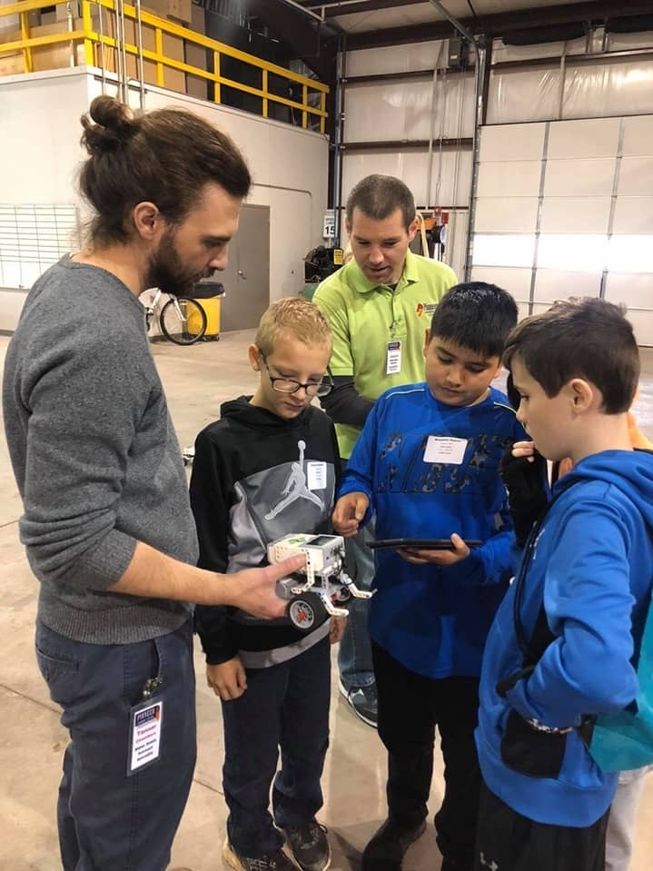
“Help each other figure this out. Take your time. I will come back in a few minutes to see how you’re doing.”
Credit: Pioneer Library System
Notes:
Give patrons space and time to try things for themselves with prompts like: "help each other figure this out. Take your time. I will come back in a few minutes to see how you're doing.

Slide 61
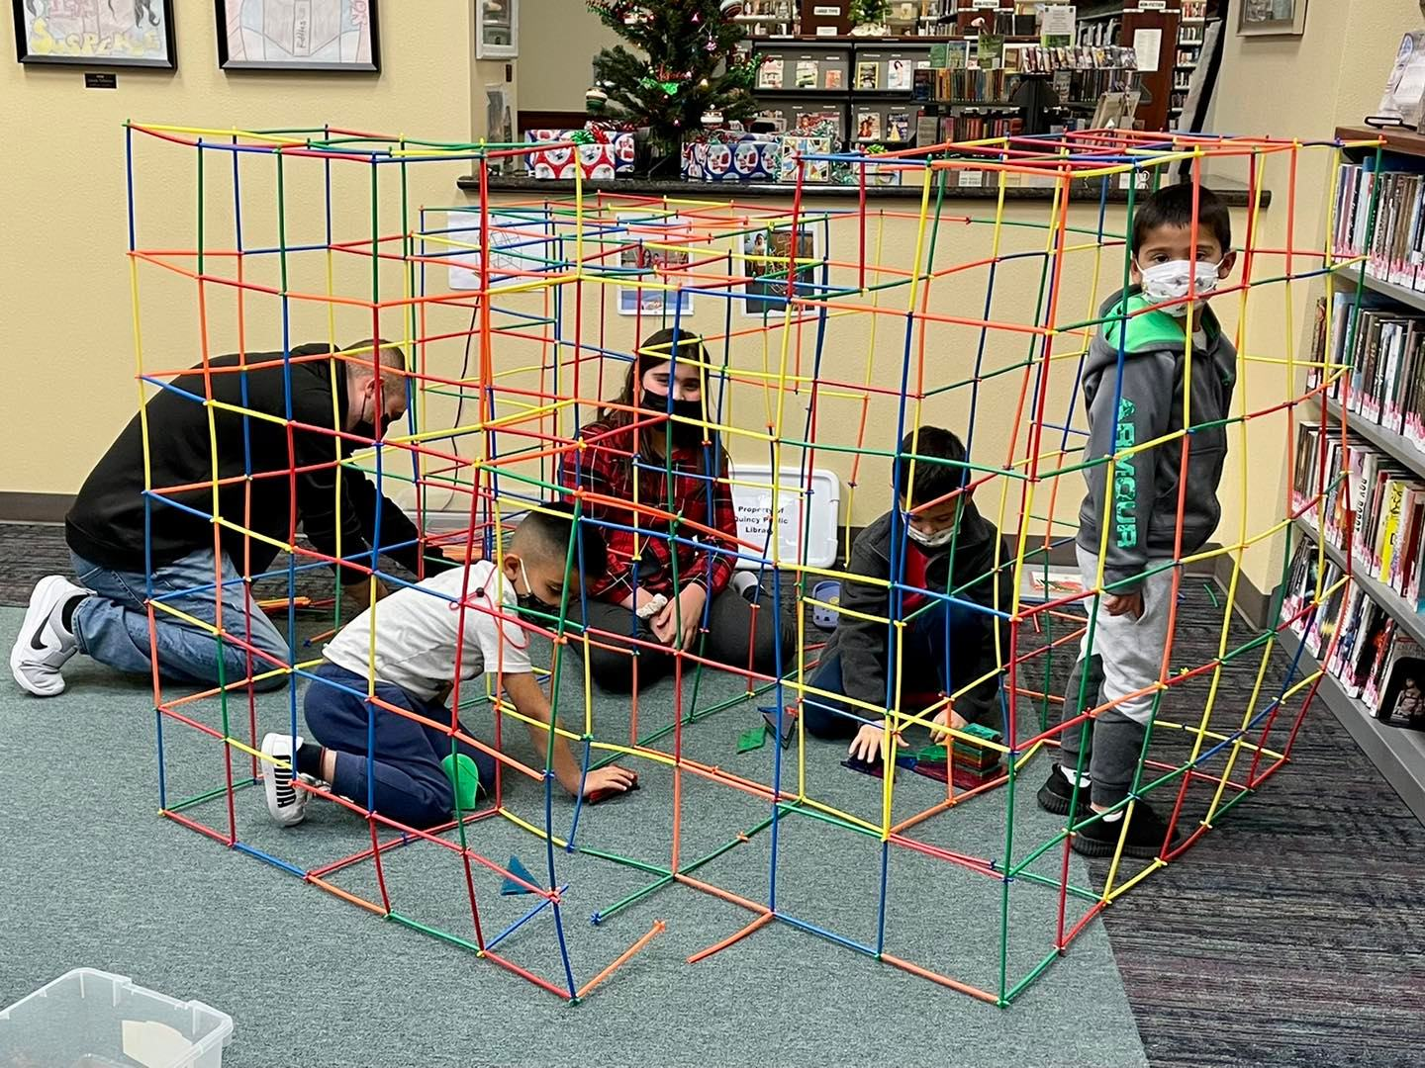
Strategy 5
Hands-on activities
Notes:
Strategy 5: Hands-on activities! Design programs that are centered around fun, interactive STEM learning experiences. Choose activities that allow patrons to interact and engage with unfamiliar concepts, ideas, and physical objects or tools.

Slide 62

Have you tried any of these facilitation strategies in your organization?
Create a Safe Learning Environment
Open-Ended Questions
5-Second Wait Time
Turn and Talk
Hands-on Activities

Slide 63
Free Additional Resources
500+ STEAM Activities for Public Libraries
  clearinghouse.starnetlibraries.org
STAR Net Online Community
  community.starnetlibraries.org/
Eclipses in Fiction (books, music, art, videos)
  www.fraknoi.com/wp-content/uploads/2022/11/Resources-Connecting-Eclipses-and-Other-Fields.pdf
#STEMInLib Videos
  youtube.com/starnetlibraries
Booklet for Librarians and Library Patrons: bit.ly/eclipsesforlibraries
NASA’s Night Sky Network
  nightsky.jpl.nasa.gov/
NASA’s Solar System Ambassadors
  solarsystem.nasa.gov/solar-system-ambassadors/events/
Getting Started with SEAL
  community.starnetlibraries.org/get-started-with-seal/
NASA Eclipses website solarsystem.nasa.gov/eclipses
American Astronomical Society Eclipse website
eclipse.aas.org
Notes:
Free eclipse glasses – application must be completed in one sitting; must upload (on library letterhead) a brief letter from your director or other similar responsible party attesting that you intend to utlize these glasses for educational programs, will not sell the glasses you receive, agree to complete a post event survey, and commitment to participate in relevant trainings; you have the option to receive 2,000, 1000, or 500 pairs of evlipse glasses.

Slide 64
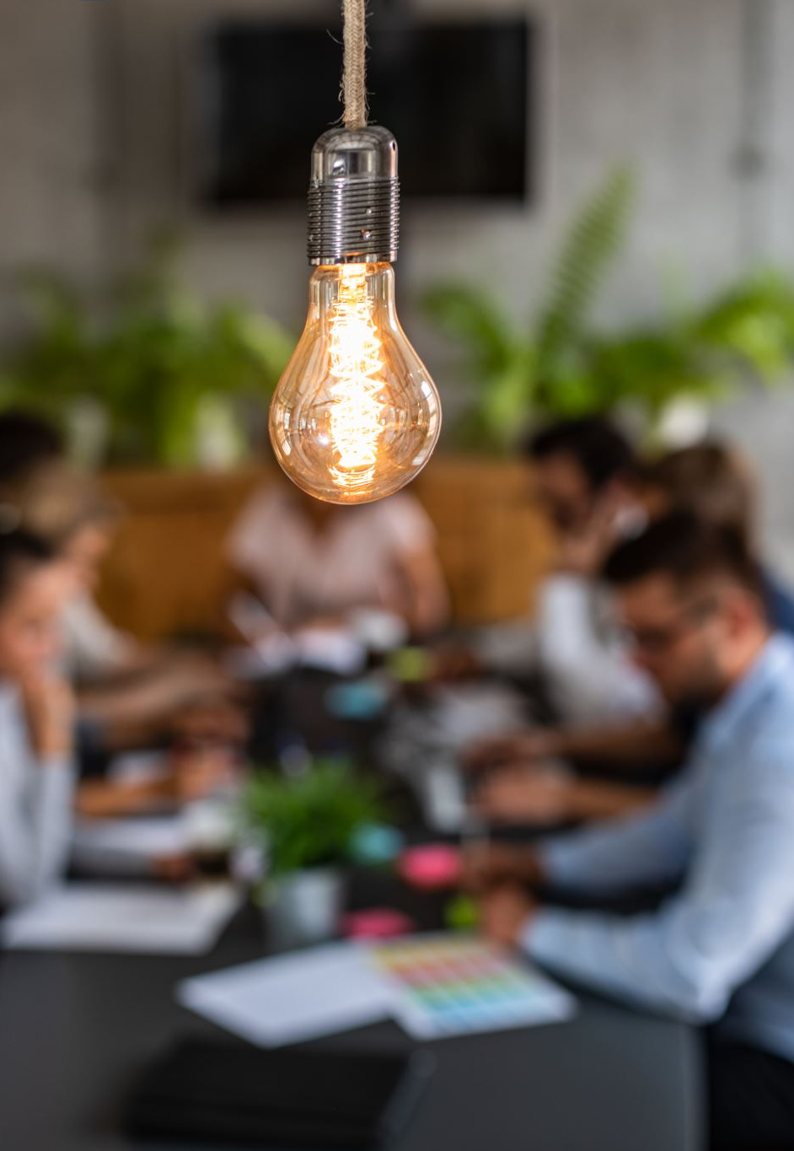
What ideas do you have to use all these resources?

Slide 65

Questions?

Slide 66
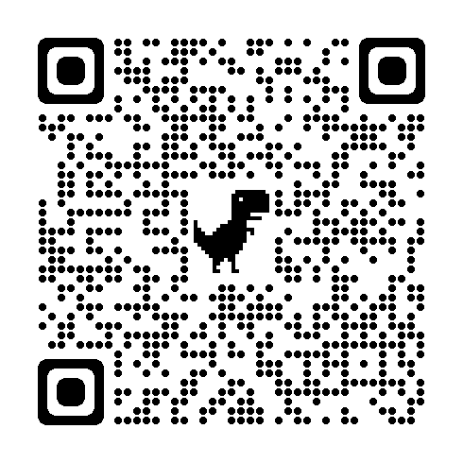
Session Feedback: "Get Ready For The 2024 Eclipses: How To Inspire And Connect With Patrons And Partners Through Engaging STEM Programs"
Also access the link from the Sched session page

